Slide 1
“Daring to Make a Difference” Ohio Justice Alliance for Community Corrections 36th Annual Conference October 13, 2023 Work Well, Be Well!
,
Dr. Reginald “Reggie” Wilkinson
Connecting the Dots, LLC

Slide 2
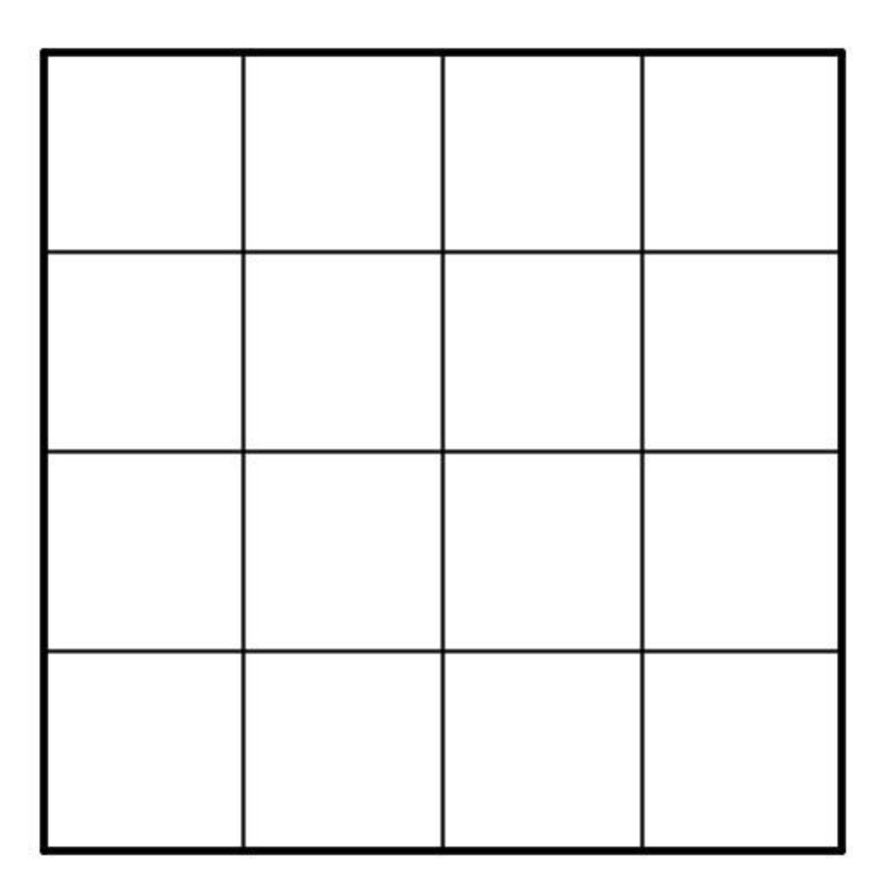

Slide 3
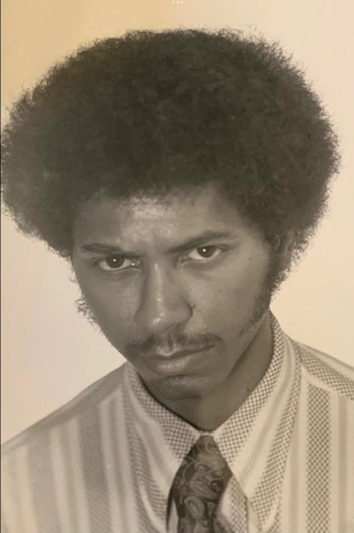
50 Years Ago
50

Slide 4
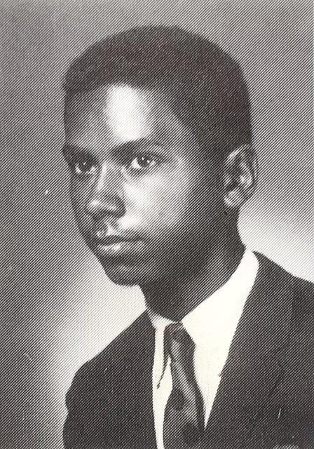
55 Years Ago
50

Slide 5
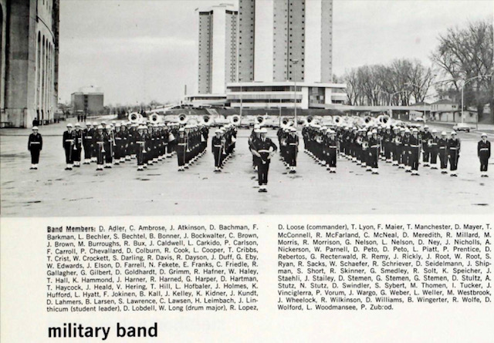

Slide 6
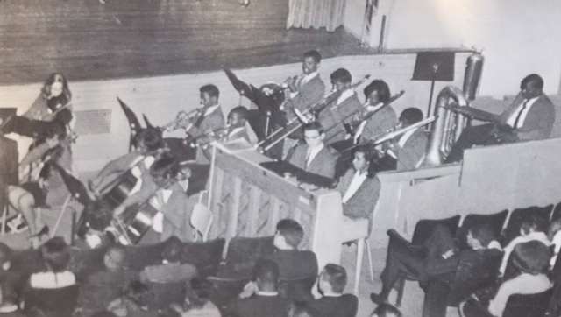
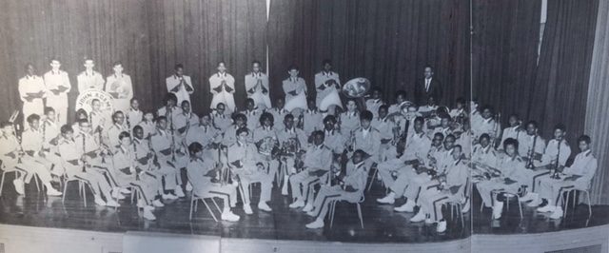

Slide 8
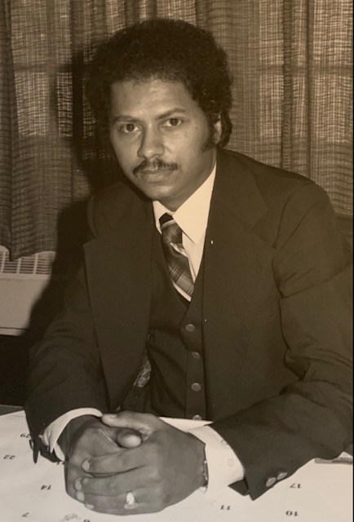

Slide 9
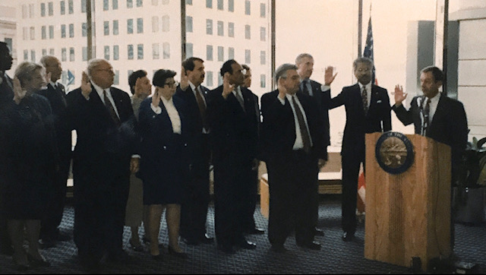

Slide 10
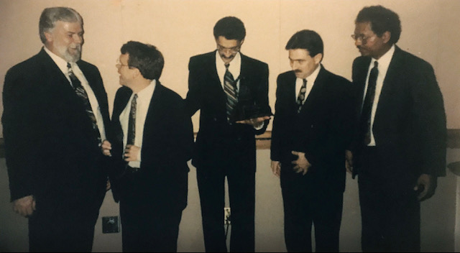

Slide 11
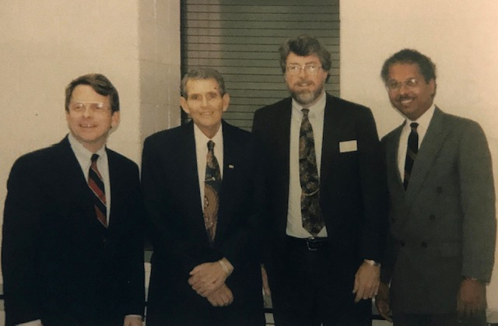

Slide 13
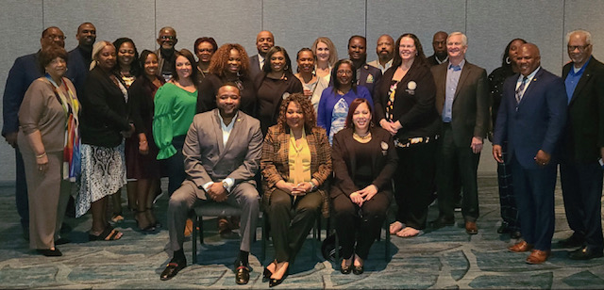

Slide 14
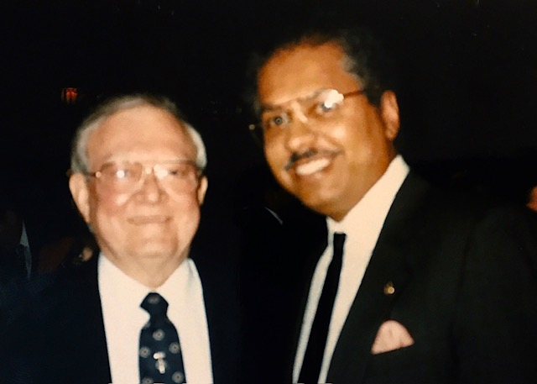
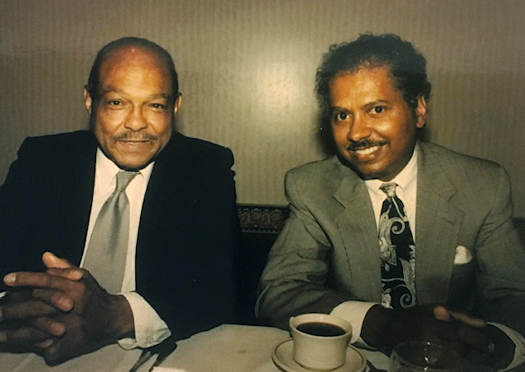

Slide 15
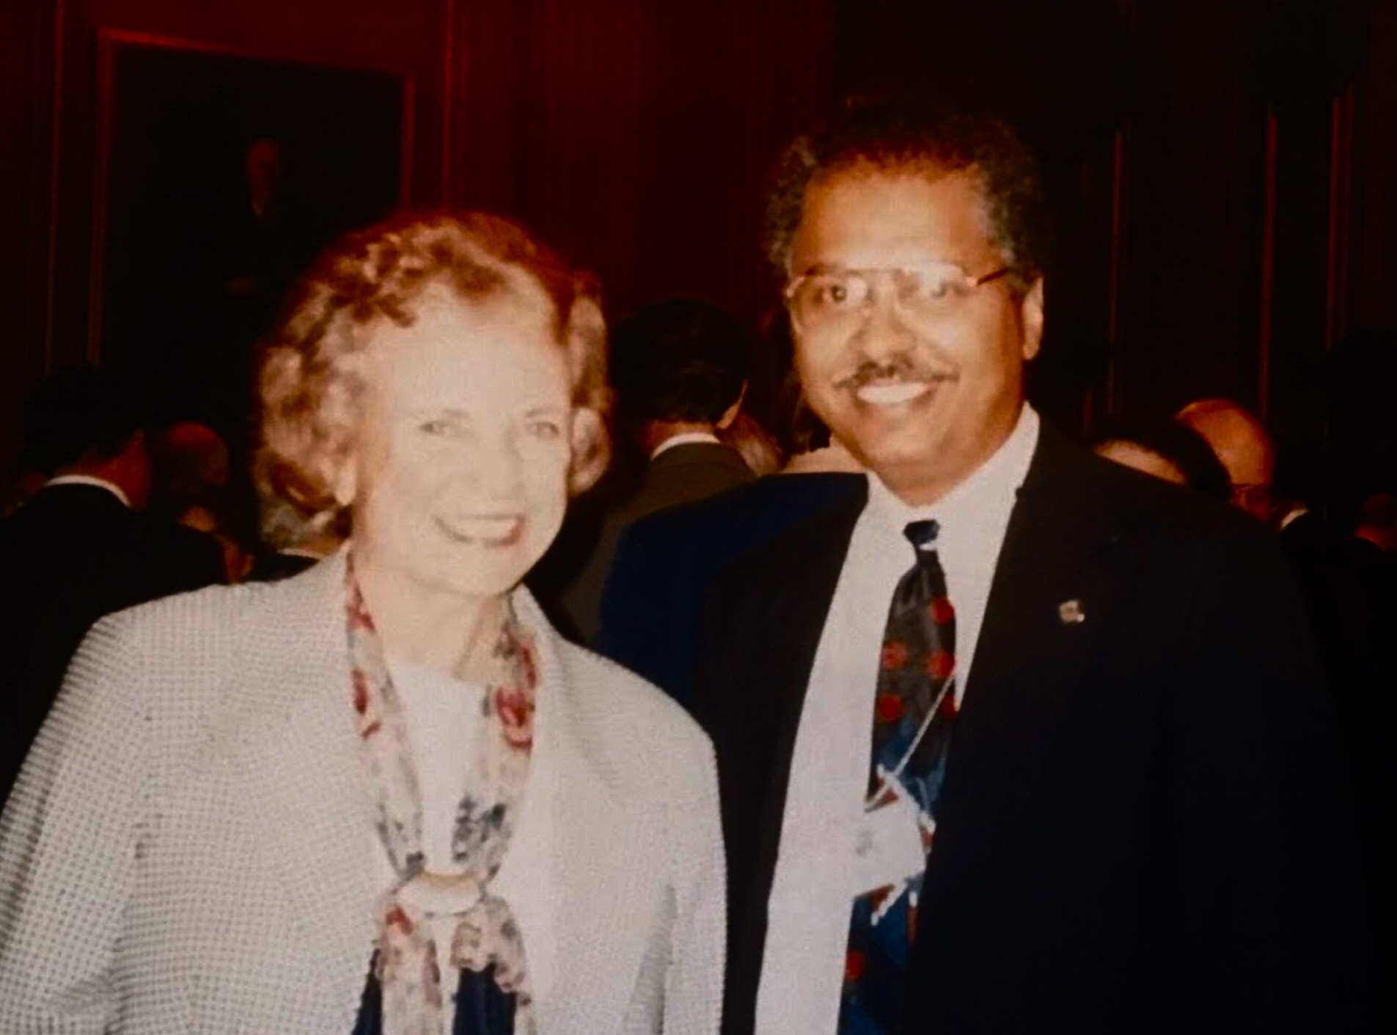
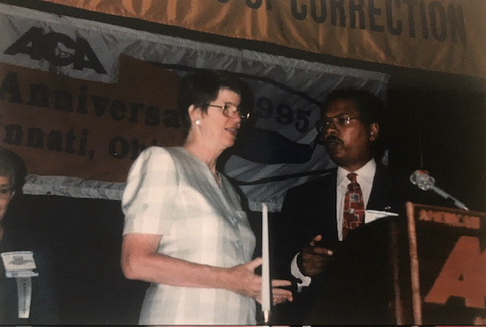

Slide 16
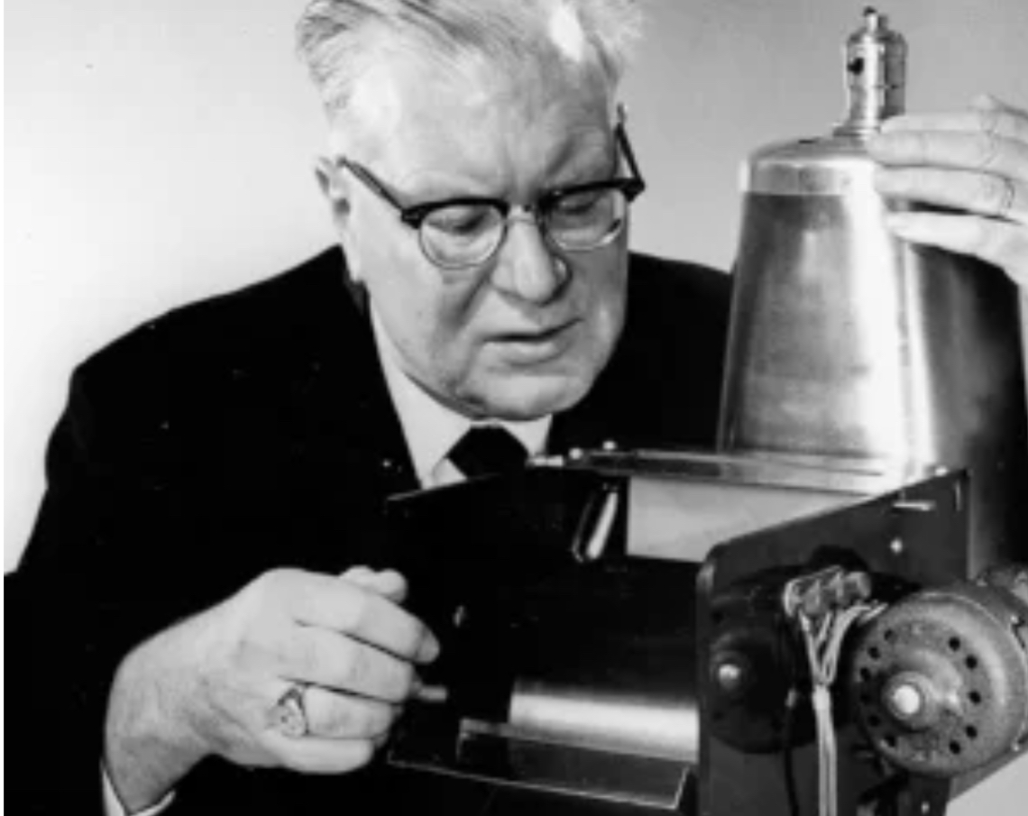
Xerox
Xerography
Xeroxing
Photocopying
Chester Carlson

Slide 17
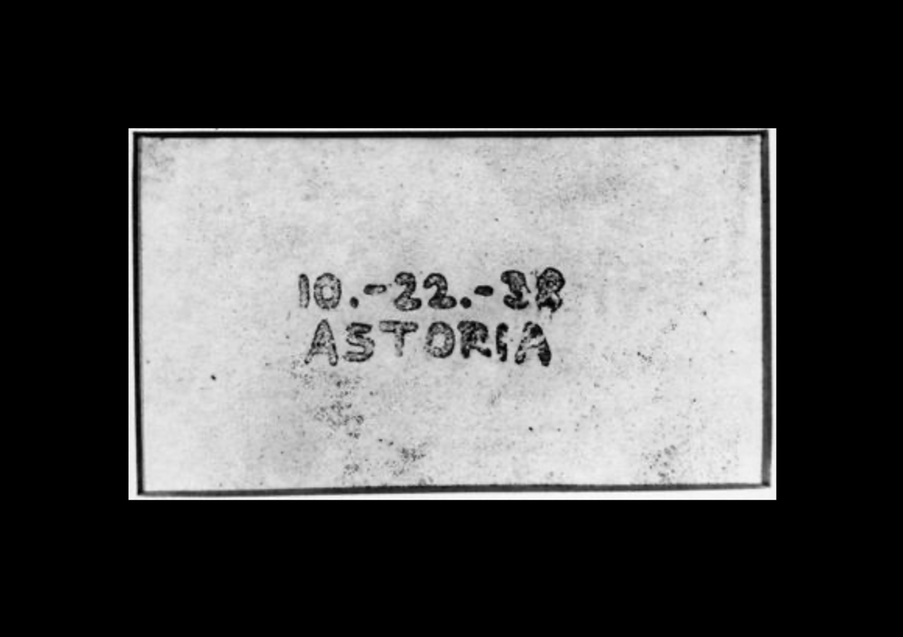

Slide 18
Success is the progressive realization of a worthy idea.

Slide 20
I had planned to mention the “Kitchen Cabinet.” it set the stage for a lot of innovation for Ohioans with mental health and other challenges.

Slide 21
I had planned to mention the “Kitchen Cabinet.” it set the stage for a lot of innovation for Ohioans with mental health and other challenges. Actually, you were the one that started it because you made that suggestion to me in the first place! Using that model, I set up the Steering Committee for Stepping Up that now has 55 members! I’ve attached the roster. See what YOU started! Evelyn Lundberg Stratton

Slide 22
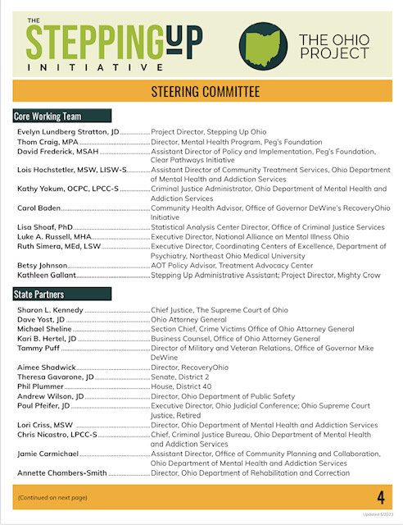

Slide 29
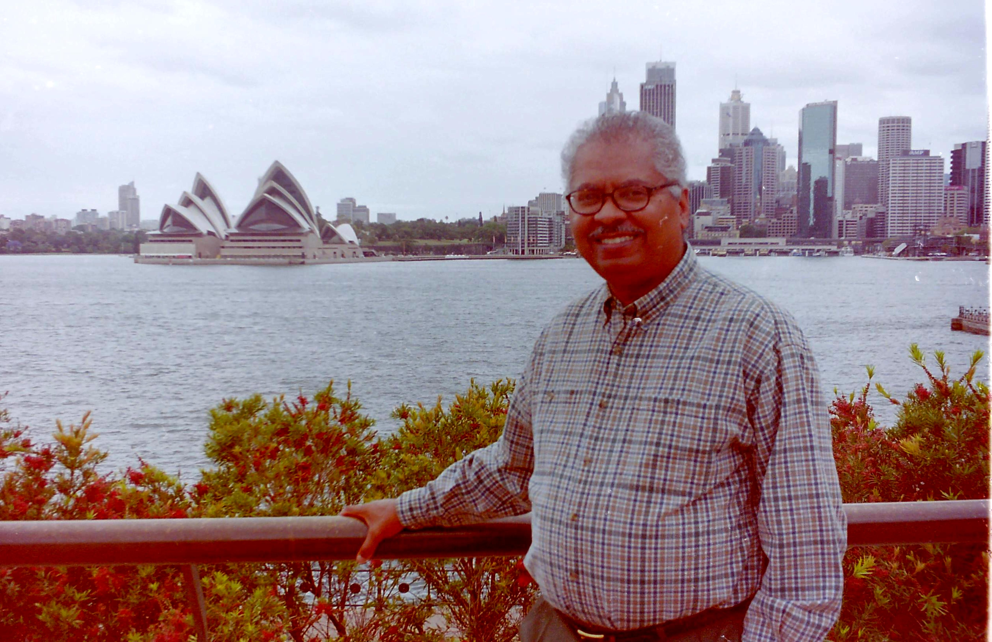
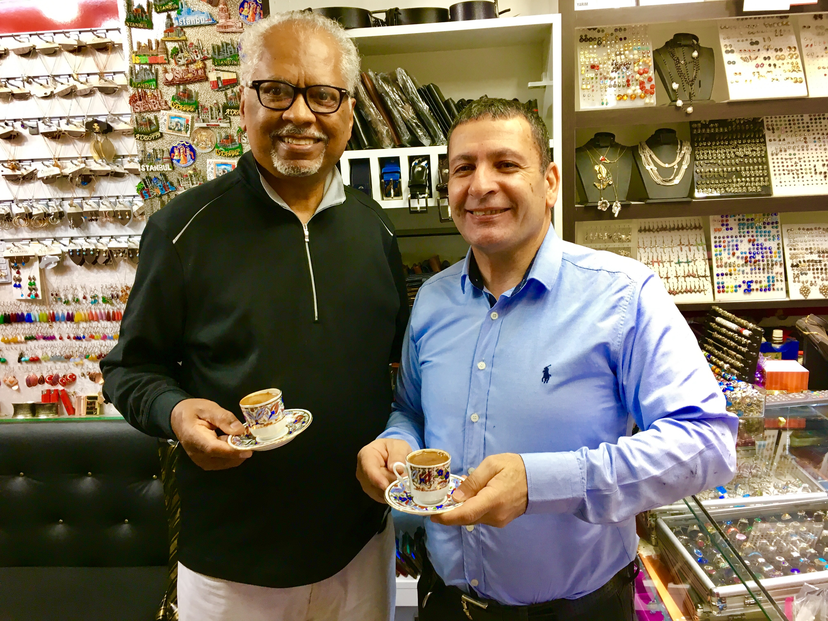
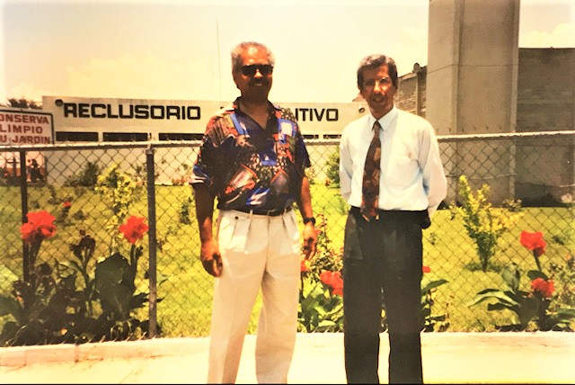
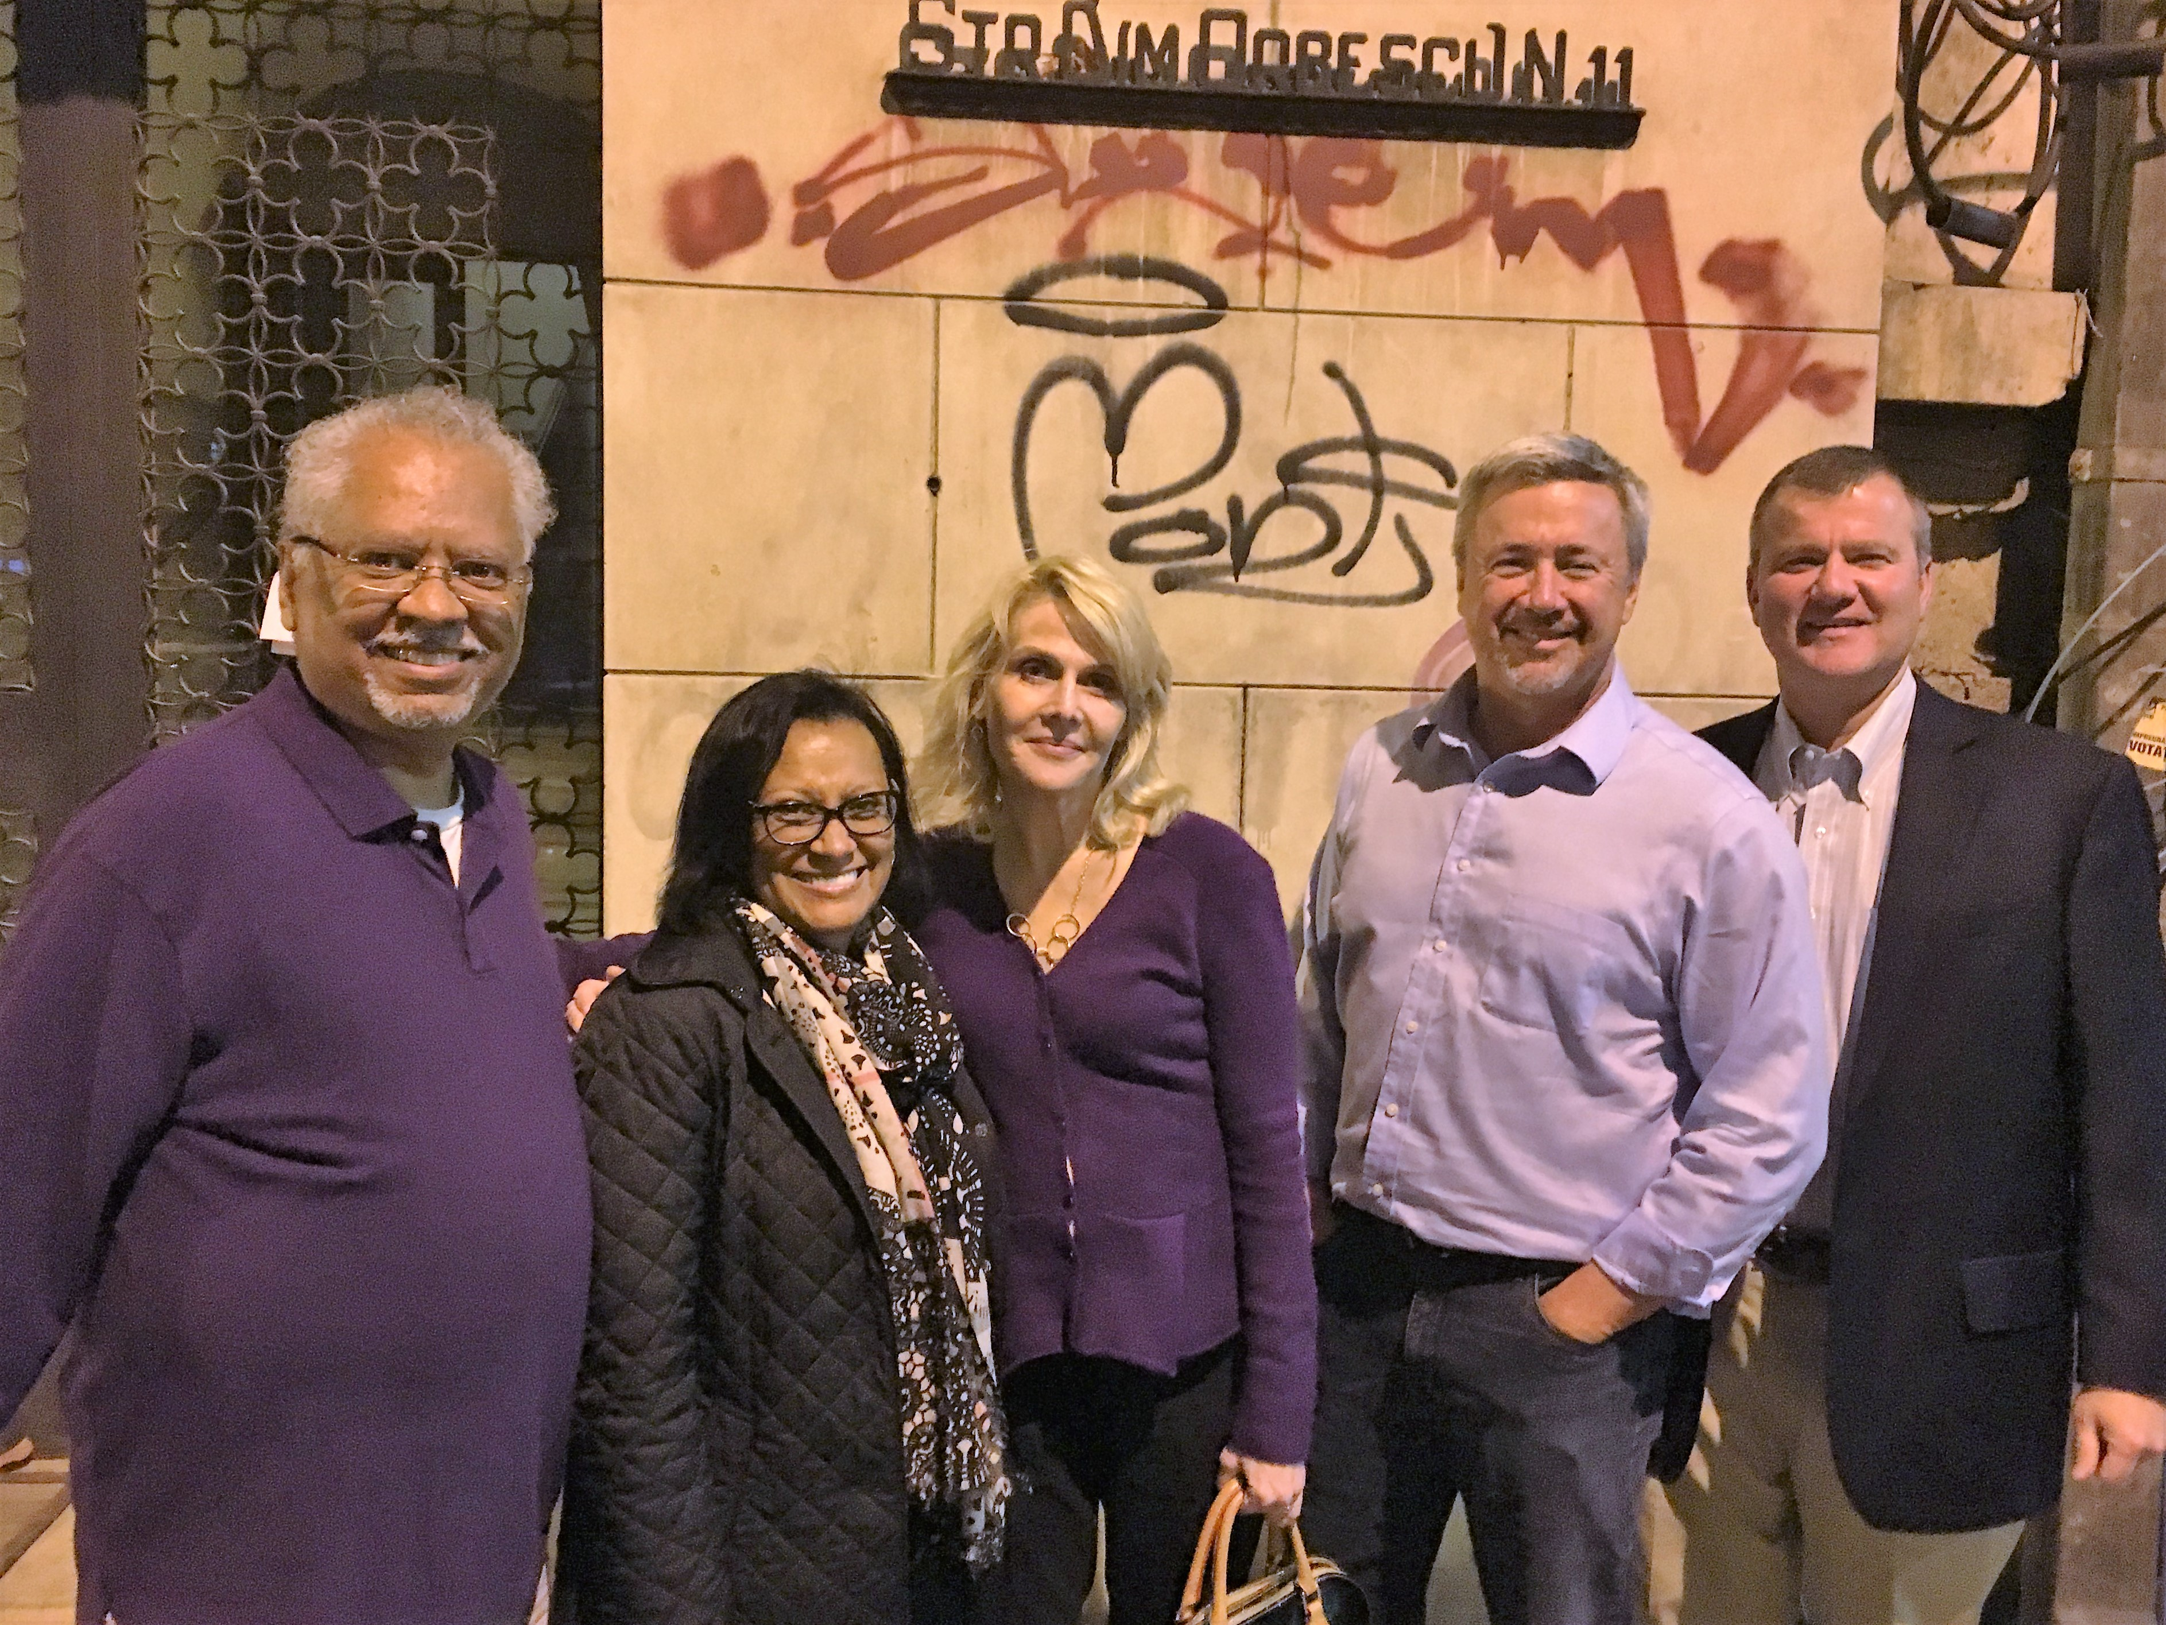
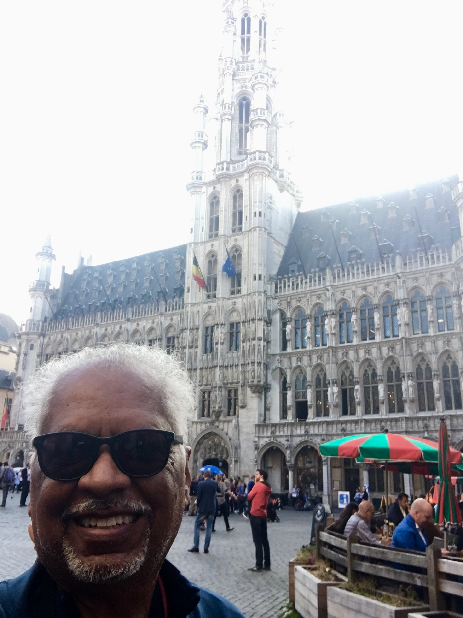
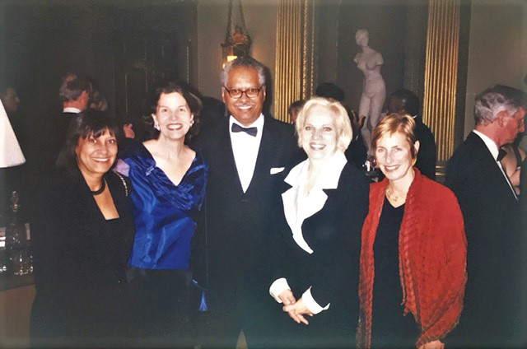
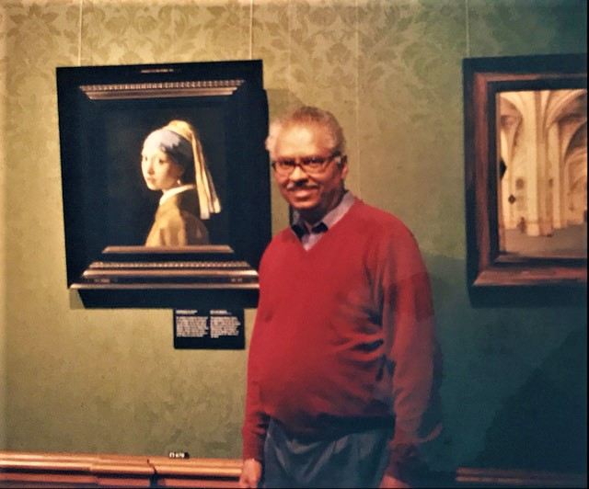

Slide 31
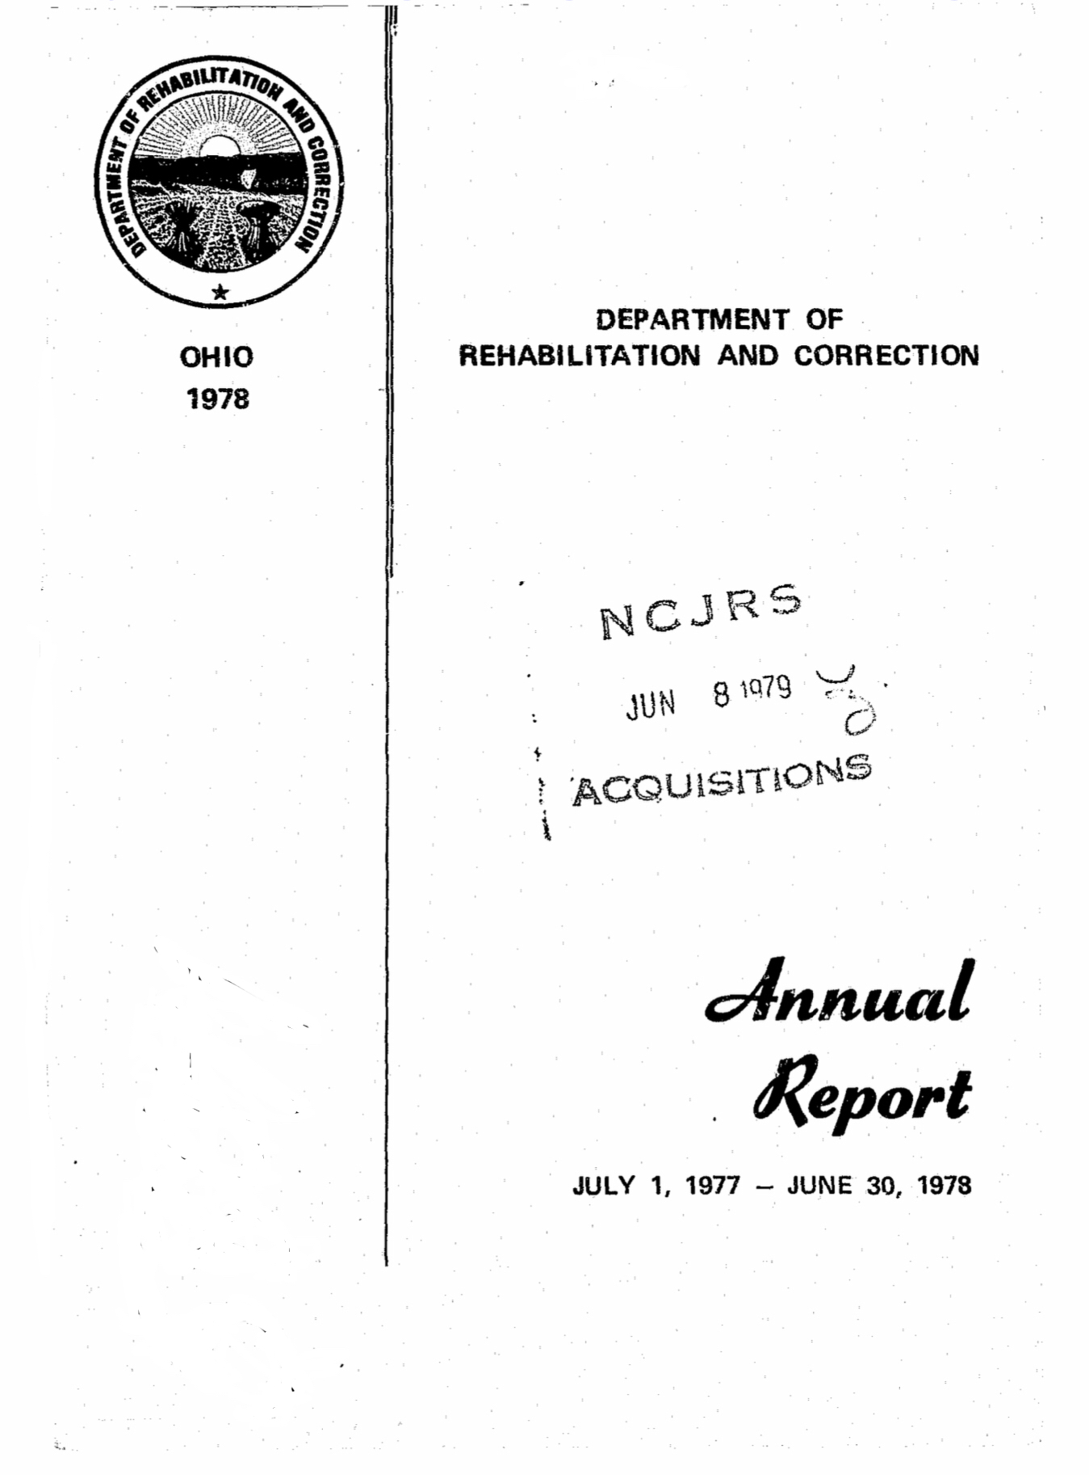
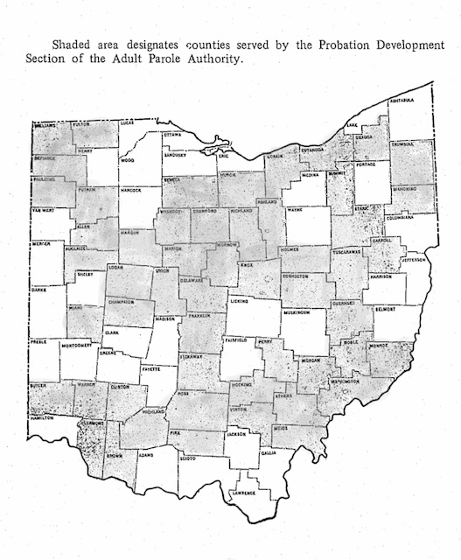

Slide 32
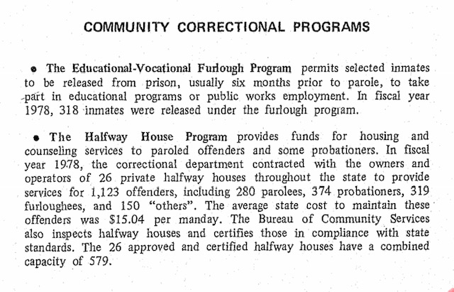
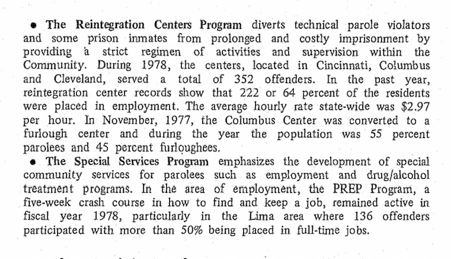

Slide 33
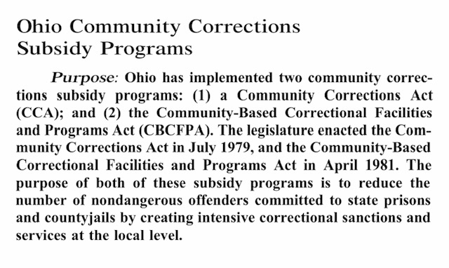

Slide 34
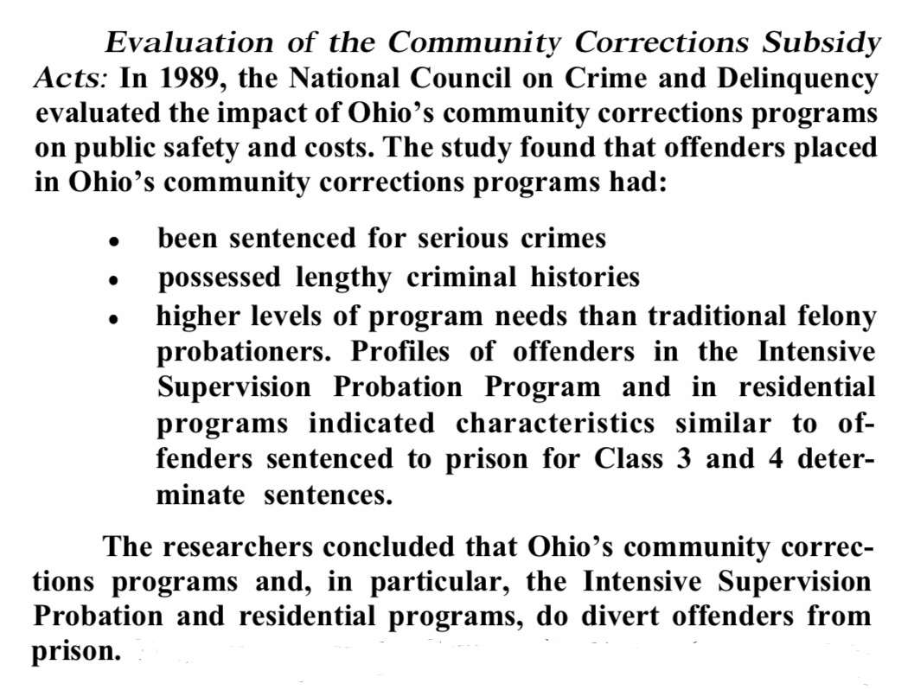
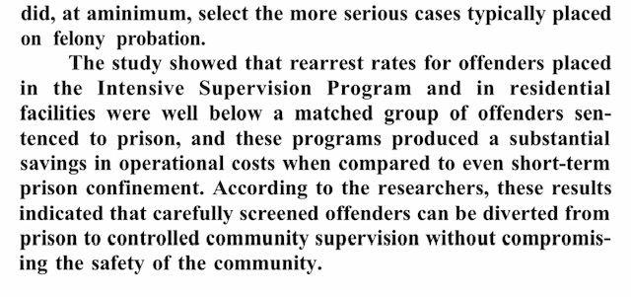

Slide 35
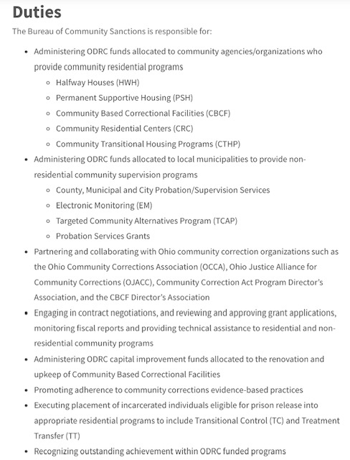

Slide 38
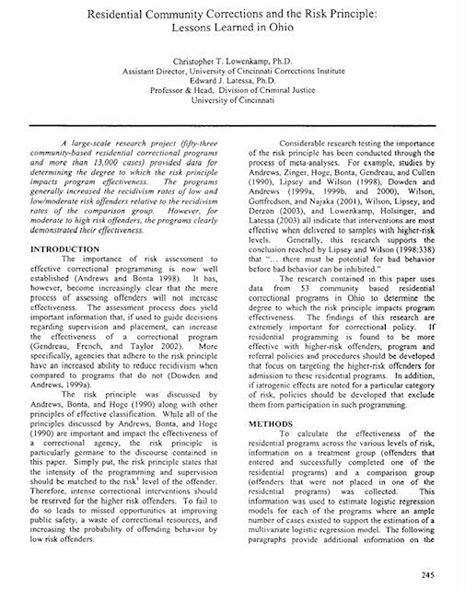

Slide 39
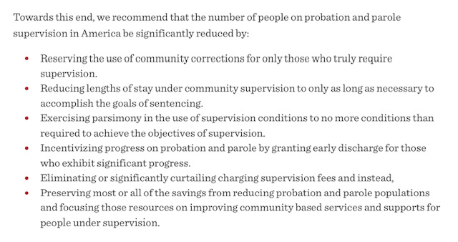

Slide 40
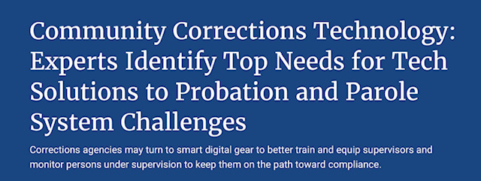

Slide 41
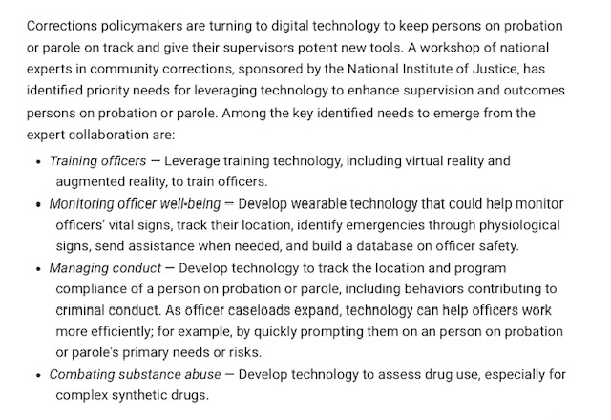

Slide 42
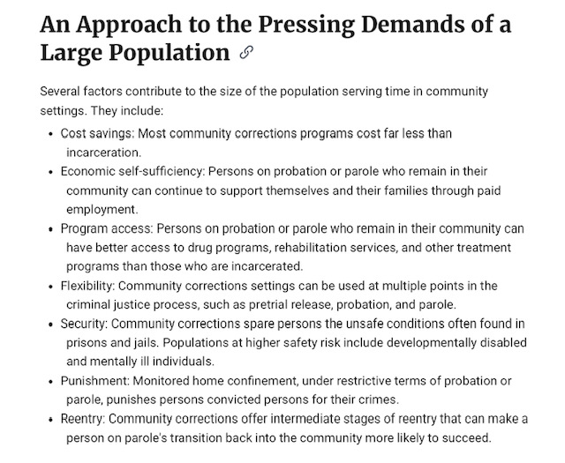

Slide 45
`

Slide 47
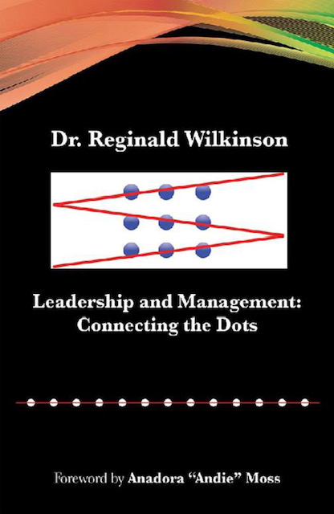

Slide 48
Under the Microscope
The Situational Leader
Total Quality Management
High Performing Teams
Biases in the Workplace
Four “I” of Transformational Leadership
Monitors and Measure

Slide 49
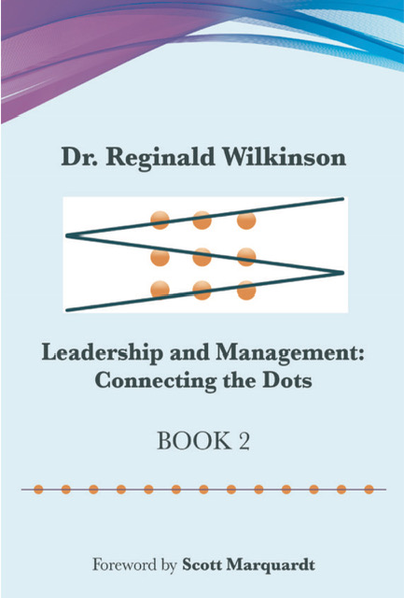

Slide 50
149. Critical Conversations

Slide 51
172. Thinking “Inside” the Box

Slide 52
179. The Adaptable Leader

Slide 53
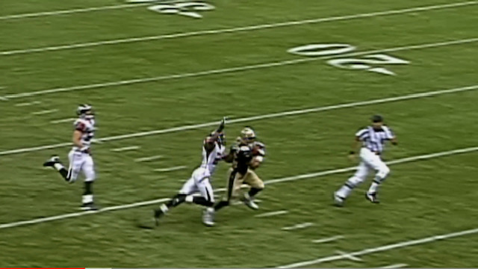

Slide 54
“Good things happen in all aspects of life when you just don’t give up on things.”

Slide 57
Thank you
Rwilkinson.ctd@gmail.com

