Slide 2
It’s a Whole new ball game: motivational interviewing for justice involved individuals
Ohio Justice Alliance for Community Corrections
October 12, 2023
3:00 pm to 4:30 pm
Moderator: Jessica Dennis, Superintendent
Notes:
(CLICK) (Jessica Dennis) Hello Welcome to It’s A Whole New Ball Game: Motivational Interviewing for Justice Involved Individuals. Thank you for starting your conference experience early and joining us today. I’m Jessica Dennis, Superintendent of Parole…
I’ll be your moderator today. The training that you are about to experience is a modified version of the Ohio Parole Motivational Interviewing Training Track, that we run regularly with our staff. Our MI training track was developed by seven of our MI subject matter experts for Parole/Probation Officers.

Slide 3
Training Objectives
Brief explanations of Motivational Interviewing Concepts. Develop Ability to Recognize and Strengthen Change Talk. Provide Opportunities to Practice Open Questions, Affirmations, Reflections and Summarizations. Expand Understanding of Empathy, Evocation, Acceptance and Compassion.
Notes:
(Jessica): Today’s Intensive session will involve a lot of practice. One instructor will provide brief explanations of MI concepts. Afterwards everyone will practice. We start out with some practice on change talk. How to recognize and strengthen change talk. We’ll provide real opportunities to sharpen your skills in OARS or Open Questions, Affirmations, Reflections and Summarizations. It is proficiency in these skills that makes someone a good interviewer. But this training is about more than being a good interviewer. We want you to be a good motivational interviewer. That comes with communicating in the spirit of MI. We’ll spend time understanding and demonstrating empathy, evocation, acceptance and compassion. We’ll talk about… and practice in the spirit of MI as it applies to Probation and Parole Officers.

Slide 4
Introductions
Lead: Troy Miglets, Parole Officer Assessor
Coach: Jacob Popp, Parole Officer Dayton
JII: Ashley Autry, Parole Officer Cincinnati
Notes:
(Jessica) This training flows different than most trainings that you’ve been through. The practices will simulate a batting practice. As we practice today, we’ll pass around the baseball bat. When It’s your turn, you will hear a statement that you commonly hear from the people that you supervise. That will be the pitch. Your goal is to respond using the MI technique we are focusing on. Afterwards, pass the bat to the next person.
. We have 3 trainers, and each will play a distinct role
Lead Instructor will give microbursts of Motivational Interviewing concepts and strategies. Then we will break out for practice
Coach will lead the practice. He will be your guide as you attempt to apply what you just learned.
The Justice Involved Individual will give you real statements that you might hear in your everyday jobs. Your objective is to respond using what we just learned.
And with that, I’m going to let our trainers introduce themselves:
Hello I’m Troy Miglets,…. During our training, I will be your lead trainer. I will introduce MI concepts in microbursts. Be sure to listen, it will be what you are about to practice with a coach and Justice Involved Individual.
Hello I’m Jacob Popp… I will be playing your coach today. Everyone gets to practice. But don’t worry, I will work with you if you get stuck and encourage you to keep trying. If you get stuck, I will help you.
Hello I’m Ashley Autry… I will be playing your Justice Involved Individual.. During the practice, I will make a pitch which are statements that a real justice involved individual might make. You will get plenty of opportunities to practice responding to me with MI skills.

Slide 5
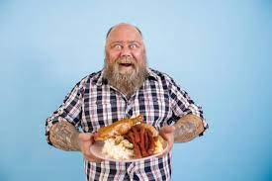
Motivational interviewing is not the main course
Bookish
Unstructured Practice
One and Done
Technicalities
Too removed from Community Correction
Notes:
(Jessica): To give you an idea of how this training came about. Ohio Adult Parole Authority received a grant that provided an opportunity to bring Motivational Interviewing training to all Parole Officers. We contracted with a non-criminal justice agency to provide the training and work with select staff members to become MI trainers for the agency. On paper the training was perfect. It covered everything in the MI textbook. The trainer was extremely knowledgeable, and the training was thorough. It was served up to officers as the main course. MI as the main dinner course meaning that it is now primary in what officers do and other communication is wrong or inadequate. However, staff were resistant and pushed back and complained about the training. We heard everything from “It doesn’t work” to “Its dereliction of duty” Which made us start questioning why our staff aren’t motivated to learn motivational interviewing.
Here are some of our takeaways from the original experience were that led us in a different direction:
(click) By covering everything in the MI textbook, the training became too bookish. MI theory was explained exceptionally, but people with limited MI skillsets saw little value in understanding the MI textbook. We saw it as teaching calculus to people who still needed to learn how to add and subtract.
(click) Limited training time was spent practicing. The time spent on practice was not structured. During the limited practice, often in breakout groups, staff ended up practicing wrong. No matter how clear explanations were, people were practicing wrong. We were concerned with how this undermined any goals for MI to permeate our culture.
(click) This was a one and done training that tried to get people to learn everything. We realized MI is a complicated subject matter. Like math, it takes starting with some very basic skill proficiency and then building on that. To truly be good requires lots of practice. We no longer believe in the idea that Motivational Interviewing is a one and done event.
(click) The original training was too focused on technicalities like the difference between an affirmation and reflection. Or whether a response is an amplified reflection or a double-sided reflection. Our staff cared about changing individual behavior but walked away confused because of too many advanced strategies thrown at them. Small explanations of MI theory to be applied to practice are good. But the more lost we get in technical coding of MI the less value staff saw in it as a tool for changing individual behavior.
(click) There were too many examples that dealt with using MI on my wife and kids or the waiter at the restaurant that disconnected staff from its value in changing individuals.

Slide 6
Motivational Interviewing is the gravy
Menu of trainings
Opportunities to practice
Coaching
Microbursts of MI instruction
Staff value opportunities to use MI to enhance ability to supervise individuals.
Notes:
(Jessica): We realized that Motivational Interviewing is not the main course. The main course is what officers do every day. Motivational Interviewing is the gravy on the side. It can spill everywhere or be used in moderation or not at all. It is something that makes the main course even better. We had a vision for a training which included:
(click) offering a menu of trainings meant to enhance staff success in supervisee management. We stopped thinking of Motivational Interviewing as a “one and done” training. It is a skill that constantly gets sharpened through time. You never stop learning new ways to sharpen MI skills,
(click) We wanted to provide numerous opportunities to practice. We wanted our training to look more like a practice session or sports event than a college lecture.
(click) Coaching should be prevalent anytime people are practicing. Practice mattered to us, because it’s the only way it will move from the training room into what we do every day. We stopped thinking about a coach as someone who only corrects mistakes and tells people what they should do. We wanted to intentionally build coaches who had MI technical ability, but ever more important, coaches who were authentic in their use of MI and could build relationships with people who are struggling.
(click) We didn’t want to throw out the MI textbook, but we knew we needed small, relevant pieces on MI theory with large amounts of practice.. We wanted to present microbursts of information with opportunities to practice sprinkled in between.
(Click) I’m proud to say our staff at Ohio Parole value any opportunity to better supervise individuals. For staff to value MI, our track would have to remain focused on how to be more effective as officers. Their main course is community safety and addressing criminogenic needs to reduce recidivism. MI is the gravy.

Slide 7
ODRC MOTIVATIONAL INTERVIEWING TRAINING TRACK
Prerequisite Training: Online Recording
The Spirit of MI
The Four Processes of MI
Reflective Listening
Notes:
(Jessica) The Ohio Parole’s MI training track includes four trainings:
Motivational Interviewing Prerequisite Training, which has about one hour of explanations from staff on MI concepts. It is a basic introduction to MI. As we come back from break, you will see clips that are excerpts from the Prerequisite training.
The other three are interactive trainings that include the practice that you will be doing today are:
The Spirit of Motivational Interviewing
Motivational Interviewing: Reflective Listening, and
The Four Processes of Motivational Interviewing
For today’s training, we have combined parts of all the trainings. But you are about to see for yourself how this works, and with that I will turn things over to our Lead Trainer, Troy…

Slide 8
Sustain Talk: One Side of Ambivalence
Language in favor of staying the same
Predictive of non-change
Normal
Not resistance
Notes:
LEAD TROY : We begin with what we do not want to hear, sustain talk.
(Click 1) Sustain talk is when the Individual talks about why they should NOT change.
(Click 2) If an Individual talks about why they should stay the same, then they probably will.
(Click 3) It is normal for someone to want to remain the same and this influences what strategy you use to help the Individual change.
(Click 4) Keep in mind that sustain talk or arguing to stay the same is not the same thing as resistance. Resistance is discord, it’s not working with you – resistance is about not following rules. What does resistance sound like?
Supervisee : “I’m not going to do it.” “I’m not going to listen to you.”

Slide 9
“I Do Not Want to Change”
“I really like marijuana.”
“I need to smoke to be creative.”
“I don’t see how I could give up pot.”
“I shouldn't have to quit.”
Notes:
LEAD TROY : Ambivalence is coexisting feelings when you want to change, and you don’t want to change. One way to think of sustain talk is as the “I don’t want to change,” side of ambivalence. What does sustain talk sound like? Think about some typical statements that you might here from someone on your caseload:
Supervisee Ashley reads the following:
(Click) “I really like marijuana.”
(Click) “I need to smoke to be creative.”
(Click) “I don’t see how I could give up pot.”
(Click) “I shouldn’t have to quit.”
When we hear sustain talk, then we know that what we are doing is not working. We will need to change our strategy.

Slide 10
Change Talk
Increase self-motivation
Listen and Encourage
Notes:
LEAD TROY : One of the main goals of MI is to get the supervisees to tell us that they are preparing to change and getting ready to change. Change Talk is language in the direction of change. The most important piece of MI is not what we say, but what they are saying. If the Individual is arguing for change, then we are using MI successfully. We use MI to increase someone’s self-motivation. If an Individual is not arguing for change, then we need to change our strategy.
This is a shift in responsibility: It is the Supervisee’s responsibility to tell us why they should change. Our role is to listen and encourage change talk. It is how we know that an Individual’s behavior is changing. Recognizing sustain talk is a signal indicating that a person’s behavior is NOT changing.

Slide 11
Notes:
LEAD TROY What do you see in this picture?
Answer: Tiger.
If you look at the surface of the picture, you only see the tiger. If you look deeper, a face appears near the tiger’s right eye (our left).
It is easy to focus on what is obvious and not look deeper. It is the same way with change talk. Sometimes it mixes in with sustain talk and resistance, so we must look for it and pull it out. Every time we miss change talk; we miss an opportunity to move closer to changing the Individual ’s behavior.

Slide 12
Change Talk
Desire – want, prefer, wish, etc.
Ability – able, can, could, possible
Reason – Why do it? What would be good?
Need – important, must, need to, got to
Notes:
LEAD TROY : Looking for change talk is a strategy we use in MI. Preparatory Change talk means someone is preparing to make life changes. When we hear someone express the ability, desire, reason or need to change, then the hidden picture is coming into view. This is when good interviewing becomes Motivational Interviewing. Consider some things a Justice Involved Individual might say. They may talk about wanting to change or wishing that things were different. These are statements that an Individual desires a change. If the Individual says that they could change, then they are saying that they can change. Another signal that someone is preparing to change is when they express their reasons why they should change. A fourth type of change talk is the need to change. The person says that they need to change, or it is important to change.

Slide 13
Change Talk
“I want to change.”
“I can change.”
“I need to change.”
“I should change.”
Notes:
LEAD TROY Notice in these statements that a person’s behavior has not changed yet. That’s because the change process starts long before someone changes their behaviors. In motivational interviewing, it is important to recognize these statements of change talk, because the individual is telling you what will ultimately lead to them changing behaviors.
Listen to what change talk sounds like:
Supervisee Ashley reads the following:
(Click) I want to Change.
(Click) I can change.
(Click) I should change.
(Click) I need to change.

Slide 14
Batting Practice: Listen for Desire, Ability, Reason, Need
I could go to group.
I don’t think I have a problem.
I want to control my anger better.
All my friends use drugs, why can’t I?
My kids are the reason that I need to change.
Notes:
COACH JACOB : Time for our first batting practice, finding change talk. You will hear real statements from our supervisee, Jason. If you are at bat, you will identify if the statement is change talk or sustain talk. If you are not at bat (listeners) you will determine if the change talk is preparatory change talk and if it includes desire, ability, reason, or need.
Who’s up to bat first? Remember, we will give you a statement and all you need to identify is, is it change talk or sustain talk?
Supervisee Ashley: Reads each statement to each batter. (each statement comes in on click)
(Click 1) I could go to group. (Ability)
(Click 2) I don’t think I have a problem. (Sustain Talk)
(Click 3) I want to control my anger better. (Desire)
(Click 4) All my friends use drugs, why can’t I? (Sustain Talk)
(Click 5) My kids are the reason that I need to change. (Reason)
COACH Kyle: After each batter ask, “Was the statement change talk or sustain talk?” “Listeners, if it was change talk, was it preparatory change talk, desire, ability, reason or need?”
Continues next slide

Slide 15
Batting Practice: Listen for Desire, Ability, Reason, Need
That neighborhood is bad for me; I need to avoid it.
I’ve got to find a job.
I shouldn’t have to avoid my victim.
I should stay out of trouble so I can see my kids.
Notes:
Continued from previous slide…
Supervisee Ashley : Reads each statement to each batter.
(Click 6) That neighborhood is bad for me; I need to avoid it. (Need)
(Click 7) I’ve got to find a job. (Need)
(Click 8) I shouldn’t have to avoid my victim. (Sustain Talk)
(Click 9) I should stay out of trouble so I can see my kids. (Reason)
COACH Jacob : After each batter ask, “Was the statement change talk or sustain talk? Listeners, if it was change talk, was it preparatory change talk, desire, ability, reason or need?”

Slide 16
Motivational Interviewing Spirit
Collaboration
MI
“Spirit”
Compassion
Acceptance
Evocation
Notes:
LEAD TROY MI Spirit has four elements Collaboration, Acceptance, Compassion and Evocation. When we practice our strategy is to focus on an individual’s inner thoughts and feelings to bring about a real change. MI Spirit is about how we are as we interact with supervisees. Think of it as just a way to be. The challenge is to resist the urge to tell the supervisee what to do, instead collaborate with them to work towards their own goals. Show acceptance by affirming their strengths. Be compassionate about their welfare. Use strategies to evoke change talk from the supervisee.

Slide 17
Motivational Interviewing Core Skills
Use O.A.R.S.
Open-ended questions
Affirm strengths, effort, intention
Reflect feelings and change talk
Summarize
Notes:
LEAD TROY OARS are referred to as “Core Skills” because they are foundational to MI responses. We use them in different ways to assist people in the change process and get information. The key is to adjust our OARS strategy, so we learn what will motivate them to change and act as their guide through that process. We know we are on the right track when the person is telling us why they need to change or hearing change talk. Keep that in mind as we practice OARS using the spirit of motivational interviewing. The bulk of this training will be time spent practicing Open, Affirmation, Reflection and Summarizing.

Slide 18
Batting Practice: Open Ended Questions?
What concerns do you have about your drug use?
Do you think your anger contributed to this?
How would that make things better for your kids?
What makes that so important to you?
What day were you arrested?
Notes:
COACH JACOB : Let’s start with the O in OARS. Open-ended Questions are questions that allow for a broad range of responses. The answer should be more than simply one word. It is not a yes/no question. You can think of questions as being on a continuum, on one end are closed-ended questions such as:
“What is your name?”
“How old are you?”
“Were you ever arrested?”
On the other end are open-ended questions, which is a good MI strategy. Examples of open-ended questions are:
“What can you tell me about yourself?”
“What experiences have you had?”
“Why is it important to stay out of trouble?”
COACH: For this batting practice, I’ll read the question and one by one, you will tell me if it is an open or closed-ended question. If it’s closed tell me how to change it to an open-ended question. OK, Batter up.
(Each question fades in and out on a click)
CLOSED SAMPLE ANSWERS TO OPEN
2 Do you think your anger contributed to this?- How did you anger influence your thinking?
5 What day were you arrested? – What events lead you to being arrested?
6. When is your court date?- What are your thoughts about your upcoming court date?
8. Don’t you think it’s time for a change? What would have to happen for you to consider change?
10 Is this an open-ended question?- what is an open-ended question?

Slide 19
Batting Practice: Open Ended Questions?
What is your court date?
What would it take to make that change?
Don’t you think it’s time for a change?
How can you ensure that you are successful?
Is this an open-ended question?
Notes:
Continued from slide
CLOSED SAMPLE ANSWERS TO OPEN
2 Do you think your anger contributed to this?- How did you anger influence your thinking?
5 When did you realize you were in trouble? – What events lead you to being arrested?
6. What is your court date?- What are your thoughts about your upcoming court date?
8. Don’t you think it’s time for a change? What would have to happen for you to consider change?
10 Is this an open-ended question?- what is an open-ended question?
Coach : (after last question)
What are the benefits of using closed-ended questions? (Open discussion)
Good in emergencies
In an investigation can be used to pin people down
What are the benefits of using open-ended questions?
People are more likely to be honest.
People are less defensive and are more likely to talk about the answers that really matter to them.
You get better information.
You get more change talk

Slide 20
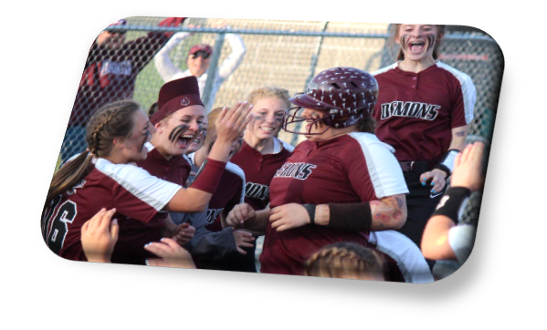
What is Collaboration?
Collaboration
Compassion
MI
“Spirit”
Acceptance
Evocation
Notes:
LEAD TROY: What is collaboration? Open Discussion: The belief that the person is an expert in themselves. So, let them be. We should take a non-coercive approach and resist the urge to solve their problems for them. Work cooperatively with them towards their goals. Stay curious about their ideas and willingness to change.
Why is collaboration important? Open Discussion:
Supervisees are more likely to be compliant if they feel they are involved in the plan.
It transfers responsibility to the supervisee.
It increases motivation

Slide 21
Collaboration Using Open-ended Questions To Evoke Change Talk
“In what way would it be good for you to change?”
“How would your life be different if you made this change?”
“If you did decide to change, what steps would you take?”
“How important is it for you to change?”
“How confident are you that you can change?”
Notes:
LEAD TROY: Consider some open questions we might ask to evoke change talk. Even how we ask a question, can show how that we intend to collaborate with someone on their success. Let’s just continue around the room and read each questions. How could each question show collaboration and get change talk? (Facilitator note - ask for volunteers or pick a participant)
(CLICK) “In what way would it be good for you to change?”
(CLICK) “How would your life be different if you made this change?” (CLICK) “If you did decide to change, what steps would you take?”
(CLICK) “How important is it for you to change?”
(CLICK) “How confident are you that you can change?”
Imagine a conversation with one of your supervisees where you ask these questions and demonstrate curiosity about a person's strengths and resources.
Asking open questions in this way could lead someone to answer with their desire, ability, reasons and needs to change.

Slide 22
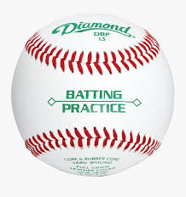
Batting Practice: Collaboration Using Open-ended Questions
“In what way would it be good for you to change?”
“How would your life be different if you made this change?”
“If you did decide to change, what steps would you take?”
“How important is it for you to change?”
“How confident are you that you can change?”
Notes:
(BATTING PRACTICE IS SPREAD OVER 2 SLIDES Do about 5 people then go to next slide)
COACH JACOB: Time for batting practice collaboration with open-ended questions. You will listen to the supervisee statement; consider which strategy you want to use to evoke more information or change talk and ask an open-ended question. Watch us model an example for you.
SUPERVISEE ASHLEY: “I don’t think I have a drinking problem. It’s just that my partner is overly sensitive because her dad was an alcoholic.”
COACH JACOB: “How would your life be different if you decided to stop drinking?”
SUPERVISEE ASHLEY: “We would probably get along a lot better, that’s for sure.”
COACH JACOB: Notice how my open question got him to talk about how his relationship would improve. Ok, batter 1 you are up. Remember, listen to the statement and take a moment to consider which of the open questions you want to ask and then ask it. We’ll see what kind of response you get from the supervisee.
SUPERVISEE STATEMENTS: ASHLEY does NOT RESPOND
Every time I deal with the police, I go to jail.
I don’t need to do treatment.
I keep having to do the same things over and over.
It’s hard for me to get employment.
There are more drugs in here than there are on the streets.
I haven’t checked in because I lost your number.
I want to get off paper, but I’m not sure I can stop drinking. All my friends drink, and I like hanging out with them.
I can see how shoplifting gets me in trouble, but I never seem to have enough money for the things I need.
I don’t want to go to work because they expect me to be there at 7am.
I quit drinking so many times, but I always relapse.
There are so many side effects to vivitrol that I really shouldn’t be expected to take it.
It’s hard for me to stop smoking marijuana because it helps me maintain my sense of self-control.
I finished my prison sentence, and I don’t see why I should have to be on Parole.
I feel like I am being forced to participate in treatment.
I’m sick and tired of jumping through hoops.
Nobody is going to hire me. I’m a felon, what am I going to do?
I don’t see why I should stop using marijuana. Most of my family smokes, it’s going to be legal, and it calms me down.
I can see why I should get a job.
I spent Saturday taking care of my son.
The sentence my judge gave me was fair.
Everyone should stop telling me what to do.
My wife wants me to quit smoking marijuana.
I try to avoid going to the valley because I know I’d get into trouble.
I know that I should stop using cocaine, but I love the way it makes me feel.
I don’t know how I’m supposed to get a job, while I’m in treatment.
I’ve been working for two weeks at my job.
I’m trying to get custody of my son on weekends.
I can picture how quitting heroin would make my life better, but I can’t imagine never shooting up again.
Staying sober the last few weeks makes me feel good, but part of me wants to celebrate by getting loaded.
Hanging out with Heartless Felons on weekends always gets me in trouble.
I’ve decided that the best way for me to quit drinking is to stop shopping in places that sell alcohol.
Staying away from my victim the last two months has kept me out of trouble, but I miss seeing her. I know I could do some things differently, but if she would just back off, then the situation would be a whole lot less tense; then these things wouldn’t happen.
I’ve been depressed lately. I keep trying things other than drinking to help me feel better, but nothing seems to work, except having a couple of drinks.
I know I’m not perfect, but why do they have to always tell me what to do. I’m not 3!
I might have a problem, but who are you to be giving me advice. What do you know about drugs? I bet you’ve never even smoked a joint!
I don’t think I have a drinking problem. It’s just that my partner is overly sensitive because her dad was an alcoholic.
I’ve been using cocaine for 7 years. If I don’t change, I know I’m going to get in trouble all over again and be taken away from my sons.
I like to use marijuana because I feel more at ease during the day.
Why can’t I report to you by phone, instead of coming into the office?
I’ve completed 4 Thinking for a Change groups. I’ll get my certificate in 2 months.
I’ve been having a rough time with all of this.
This is more than I’ve ever been expected to do in whole life.

Slide 23
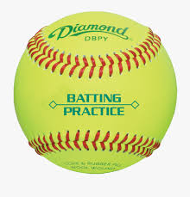
Batting Practice
Ask Open-ended Questions. The Goal is Collaboration
Ask so the person is the expert on themselves
Ask about their goals
Ask about their ideas
Ask about their willingness to change
Notes:
(Batting practice continues on open questions, without the samples on slides)
COACH JACOB : We are going to keep going with open-ended questions, or questions that have a large range of responses. The person answering could go a lot of different directions. In this batting practice, our strategy is to ask an open-ended question that demonstrates collaboration. In this practice, you will imagine you are working with one of your supervisees and are trying to be strategic and trying to collaborate. Looking at the slide, you will want to ask a question as if the supervisee is the expert in their own change process. Ask about their goals, ask about their ideas or ask what they are willing to change. Just pick from the slide the one that you want to use then ask an open-ended question. Nest batter…
Supervisee Ashley STATEMENTS: Ashley Responds
Every time I deal with the police, I go to jail.
I don’t need to do treatment.
I keep having to do the same things over and over.
I want to get off paper, but I’m not sure I can stop drinking. All my friends drink, and I like hanging out with them.
I can see how shoplifting gets me in trouble, but I never seem to have enough money for the things I need.
I don’t want to go to work because they expect me to be there at 7am
I quit drinking so many times, but I always relapse.
There are so many side effects to vivitrol that I really shouldn’t be expected to take it.
It’s hard for me to stop smoking marijuana because it helps me maintain my sense of self-control.
I finished my prison sentence, and I don’t see why I should have to be on Parole.
I feel like I am being forced to participate in treatment.
I’m sick and tired of jumping through hoops.
Nobody is going to hire me. I’m a felon, what am I going to do?
I don’t see why I should stop using marijuana. Most of my family smokes, it’s going to be legal, and it calms me down.
I can see why I should get a job.
I spent Saturday taking care of my son.
The sentence my judge gave me was fair.
Everyone should stop telling me what to do.
My wife wants me to quit smoking marijuana.
I try to avoid going to the valley because I know I’d get into trouble.
I know that I should stop using cocaine, but I love the way it makes me feel.
I don’t know how I’m supposed to get a job, while I’m in treatment.
I’ve been working for two weeks at my job.
I’m trying to get custody of my son on weekends.
I can picture how quitting heroin would make my life better, but I can’t imagine never shooting up again.
Staying sober the last few weeks makes me feel good, but part of me wants to celebrate by getting loaded.
Hanging out with Heartless Felons on weekends always gets me in trouble.
I’ve decided that the best way for me to quit drinking is to stop shopping in places that sell alcohol.
Staying away from my victim the last two months has kept me out of trouble, but I miss seeing her. I know I could do some things differently, but if she would just back off, then the situation would be a whole lot less tense; then these things wouldn’t happen.
I’ve been depressed lately. I keep trying things other than drinking to help myself feel better, but nothing seems to work, except having a couple of drinks.
So, I’m not too worried, but it’s been over a year since I’ve had an HIV test.
I know I’m not perfect, but why do they have to always tell me what to do. I’m not 3!
I might have a problem, but who are you to be giving me advice. What do you know about drugs? I bet you’ve never even smoked a joint!
I don’t think I have a drinking problem. It’s just that my partner is overly sensitive because her dad was an alcoholic.
I’ve been using cocaine for 7 years. If I don’t change, I know I’m going to get in trouble all over again and be taken away from my sons.
I like to use marijuana because I feel more at ease during the day.
Why can’t I report to you by phone, instead of coming into the office?
I’ve completed 4 Thinking for a Change groups. I’ll get my certificate in 2 months.
I’ve been having a rough time with all of this.
This is more than I’ve ever been expected to do in whole life.
COACH: Sample Questions if participants get stuck. The goal is collaboration:
What would you do to solve this problem?
How would you fix the situation?
What role do you see us playing to help you succeed?
What goals have you set?
What ideas do you have about fixing the problem?
How willing are you to solve the problem?
“In what ways would it be good for you to …?”
“If you did decide to …, how would you do it?”
“What would be the good things about …?”
“Why would you want to …?
“What can you tell me about…”
“What else…”
“What's an example…”
“What can you tell me about the last time that occurred…”
What were things like before your [target behavior] began?
What are the differences between you now and years ago?
How has your [target behavior] interfered with your life?
How would you like things to be in [5 years]?
If you woke up tomorrow and everything was better, what would you do?
What would happen if you don’t change?
How does [target behavior] fit into that?
What’s the worst thing that could happen if you continued to [target behavior]?
What’s the best thing that could happen if you were free of [target behavior]?
What might you say to a friend or family member who was in this situation?
What might happen that would let you know it was time for a change?
If you were to make this change, how might you go about it?
Not now, but when the time is right for you, what might your next step be?

Slide 24
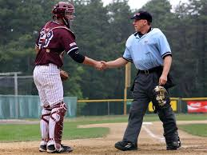
Collaboration and Open-ended Questions
How do you feel about me giving you some advice?
What do you plan to do with this information?
Notes:
LEAD TROY : Another strategy to build collaboration has to do with how we give information. If you think about it, when we start giving the supervisee advice and information, we are shifting responsibility off them for their change process on to ourselves. When we say, you need to do this, we are saying they don’t have the answers inside of them. We want to turn that dynamic around and get the supervisee stepping up and trying to solve their own problems. We want to get them to start asking us for information and advice and then let them use that information to make their own decisions. That is one way collaboration builds motivation. The aim is to get them to practice looking inward to what solutions will work for them.
(CLICK) In the spirit of collaboration, ask the supervisee for permission to give advice and let them know it is okay for them to disagree or go in another direction. The information we give is much more likely to be considered if we first ask for permission.
(CLICK) Another great open question in the spirit of collaboration is asking the supervisee , “What do you plan to do with this information?”

Slide 25
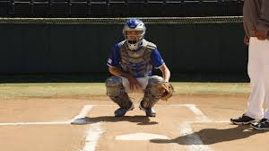
Acknowledging Choice
You have different options. It is your choice…
Would it be okay if I shared some ideas?
What is your best choice to move forward
Notes:
LEAD TROY : An important piece of collaboration is acknowledging that the supervisee is the one who will make the choice. What keeps us from allowing a supervisee to make their own choices? Open Discussion:
They are mandated to be on supervision and follow certain roles.
We are afraid they will not make the best choice.
We feel responsible.
(CLICK) Even though supervisees are mandated, they still have choices. Every time they follow a condition, they are making a choice. Why should we acknowledge the supervisee’s choice(s)? Open Discussion:
It demonstrates that we are genuinely involved.
It shows respect. So, they will collaborate with us.
So, they will take responsibility.
(CLICK) We can acknowledge choice by using open questions.
Would it be okay if I share some ideas?
Would it be okay if I share some options and emphasize that it is their choice?
What is your best choice to move forward.
It’s not that supervisees don’t have choices; it’s they may need to answer some questions about the consequences of their choices.

Slide 26
Acknowledging Choice
“Only you can decide what is best for you.”
“This is a lot to think about. It is important for you to have the opportunity to think things through, so that you can make your own decision.”
Notes:
LEAD TROY : Here are some examples of things we can say to respectfully emphasize a supervisee’s choice. Our supervisee is going to pitch you a statement and you will respond with the reflection on the screen. Can someone please volunteer and read the statements when they appear?
Supervisee ASHLEY : I don’t need to do treatment.
Coach Jacob: CLICK: Only you can decide what is best for you
Supervisee ASHLEY : There are so many side effects to vivitrol that I really shouldn’t be expected to take it.
Coach Jacob: CLICK: This is a lot to think about….
Continued on next slide

Slide 27
Acknowledging Choice
“The decision is yours to make, no one can make it for you.”
“You may or may not be interested in some of these options. Here are examples of what others have tried…”
Notes:
Continued from last slide
Supervisee ASHLEY : Everyone should stop telling me what to do.
Coach Jacob: CLICK: The decision is yours to make…
Supervisee ASHLEY : I feel like I am being forced to participate in treatment.
Coach Jacob: CLICK: You may or may not be…..

Slide 28
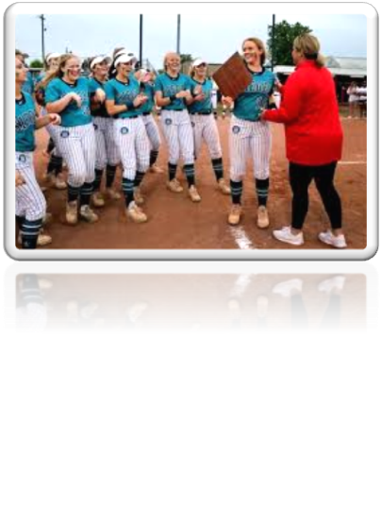
What is Acceptance?
Collaboration
Compassion
MI
“Spirit”
Acceptance
Evocation
Notes:
LEAD Troy : We’ve talked about Collaboration, now let's move into Acceptance. As a Criminal Justice Professional, what does acceptance mean? Open Discussion:
Demonstrating empathy and understanding for a supervisee's experiences and perspective.
It provides the supervisee autonomy.
Supervisees chose their own path, so they take responsibility.

Slide 29
Affirmations
Promote positive interactions
Focus on strengths and efforts
Lead to retention
Avoid using the word “I”
Genuine and nonjudgmental
Notes:
LEAD Troy : The A in OARS stands for affirmations. A good strategy to show acceptance is to use an affirmation.
(CLICK) Affirmations promote a positive relationship that helps engage a supervisee.
(CLICK) An affirmation is a statement that acknowledges a person’s strengths and efforts.
(CLICK) The more affirmations we use with a supervisee the more likely they are to engage in supervision.
(CLICK) In the interest of focusing on the supervisee avoid using “I” statements.” Remember this is about what they are doing right.
(CLICK) The goal is to be as genuine and nonjudgmental as possible.

Slide 30
Affirmations
Acknowledge the person’s ability
Acknowledge how hard they are trying
Acknowledge a past success they’ve had
Acknowledge their chances for future success
Notes:
LEAD Troy : Affirmations tend to be positive, but not all positive statements are affirmations. To be an affirmation a response should acknowledge a person’s ability, how hard they are trying, past or future successes.
(CLICK) LEAD Troy: Our coach is going to give an example of an affirmation with ability…
COACH JACOB:
You must be a resourceful person to have dealt with this problem for as long as you have
You have the ability to (solve problems with your family, stay sober…)
(CLICK) LEAD Troy: Affirmations acknowledge how hard they are trying. Coach can we get an example to acknowledge someone trying hard…
COACH Jacob:
You took a big step
You are trying so hard that must be difficult for you
(CLICK) LEAD Troy: Here is an example of acknowledging a past success they’ve had..
COACH Jacob:
You are certainly a resourceful person to have dealt with this problem as long as you have
You took care of you son(held a job, stayed sober…) for three years
(CLICK) Lead Troy: Let’s here acknowledging their chances for future success
COACH Jacob:
You are taking the necessary steps to be a good father
You are on the right path for success now
.

Slide 31
Batting Practice: Affirmations to show Acceptance
You are taking the necessary steps to…
You must be a resourceful person to have…
You have the ability to…
You are trying hard to…
You have been successful at…
You will be successful at…
LISTENERS: Did you hear acceptance?
Notes:
Coach JACOB : Time to do some batting practice with affirmations. In this practice you will listen to a statement and practice responding by stating back a strength, effort, good intention or ability. Remember, affirmations show acceptance. We have some starter phrases for you to use. We will model an example for you.
Supervisee ASHLEY : “I am trying to get custody of my child on weekends.”
COACH JACOB : “You are taking the necessary steps to show that you are a responsible parent.”
Coach JACOB: Notice how my affirmation showed acceptance, while acknowledging that they are trying to become a responsible parent. Who is up to bat?
Coach JACOB : (after each batter) Do you think the Individual would feel accepted with that affirmation?
Supervisee ASHLEY STATEMENTS
I want to get off paper, I have finally stopped drinking.
I can see how shoplifting gets me in trouble, I need to find a job making enough money for what I need.
I quit drinking so many times, this time feels different.
I can see why I should get a job.
I spent Saturday taking care of my son.
The sentence my judge gave me was fair.
My wife wants me to quit smoking marijuana.
I try to avoid going to certain neighborhoods because I know I’d get into trouble.
I know that I should stop using cocaine, my family is so disappointed.
I’ve been working for two weeks at my job.
I’m trying to get custody of my son on weekends.
I can picture how quitting heroin would make my life better, I haven’t shot up in 3 days.
Staying sober the last few weeks makes me feel good,.
I’ve decided that the best way for me to quit drinking is to stop shopping in places that sell alcohol.
Staying away from my victim the last two months has kept me out of trouble, but I miss seeing her.
I’ve been using cocaine for 7 years. If I don’t change, I know I’m going to get in trouble all over again and be taken away from my sons.
I’ve completed 4 Thinking for a Change groups. I’ll get my certificate in 2 months.
I’ve never worked this hard in my whole entire life.
COACH: OPTIONAL SAMPLE AFFIRMATIONS IF PARTICIPANTS GET STUCK:
It must have been very hard to you to admit that.
You took a big step.
It’s great that you want to do something about this problem.
You are certainly a resourceful person to have dealt with this problem for as long as you have.
You are trying so hard, that must be very difficult for you.
You’re the kind of person that puts a lot of thought into something.
You are contributing some really important things here.
You’ve spent a good deal of time thinking about this.
It’s important to you that your family is taken care of.

Slide 32
What is Compassion?
Collaboration
MI
“Spirit”
Compassion
Acceptance
Evocation
Notes:
LEAD So, we’ve talked about collaboration and acceptance. Let’s spend some time on compassion. What does it mean to show compassion to a supervisee? Open discussion
Actively promote the supervisee’s welfare
Conversation is in service of the supervisee’s needs NOT the staff's needs
It is not sympathy or identifying with the supervisee
One strategy that can be used to promote a supervisees welfare is to use reflections or repeating back language that demonstrates an understanding of their needs.

Slide 33
Reflections
Repeating their words
Restatement with different words
Making a guess at their meaning
Notes:
LEAD : The R in OARS stands for reflection. When we talk about reflections or reflective listening, we mean relying on reflections as a primary way to prompt a person to talk. A reflection is a statement, not a question that relates accurately to what the person has said. Like the way questions are on a continuum from closed questions to open questions, reflections are on a continuum from simple to complex.
(CLICK) A simple reflection can be as easy as repeating back what a person has just said. As we restate what an someone says using different words, reflections become more complex. We might use expressions instead of repeating back exact words. Sometimes reflections are about guessing what a person means and that’s okay. Guessing wrong when repeating back, may prompt someone to talk more on the subject that we need to know about..

Slide 34
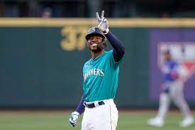
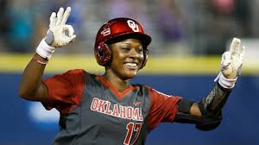
Strategic Responses
Use 2 to 3 Reflections for every question
Notes:
LEAD : Responding with reflections is a good strategy to keep people engaged. The general rule is use 2 to 3 reflections for every question that you ask. Keep in mind, you keep adjusting your strategy until you are getting better information from the person.

Slide 35
Forming Reflections
Make a guess about what the person means.
It’s okay to guess wrong.
Form a statement, not a question.
Inflect your voice down at the end.
A reflection is typically not longer than the statement.
Notes:
LEAD : Reflections are often more effective at getting information than questions because when a person feels understood, they want to say more, they trust us more, and they are more likely to be honest. Reflections can help us stay objective and non-judgmental.
(CLICK) When forming a reflection, we start by making a guess at what the person means. Consider what it is that they really want you to understand. As previously stated, guessing wrong is fine. In fact, it’s a strategy that we can use to get more information. It can also be a way to signal the person to be clearer. When we think we know the meaning, form a statement. This is not a question. When we ask a question, we typically raise our voice on the last word to signal a question. Inflect down when at the end when reflecting.
“You are trying your best?” Now keeping my tone flat like a statement, “You are trying your best.”
Can you hear the difference? How do you think you would feel after the first question? (open discussion) Answers: defensive or being judged
How would you feel after the reflection? (open discussion) Answer - understood

Slide 36
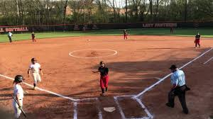
Reflection Examples
“You see a connection between your drug use and the possibility of ending up back in prison.” (CONTENT)
“You are worried that if you continue using you might end up back in prison.” (FEELING)
“Your children are important to you, and you want to be there for them.” (MEANING)
Notes:
LEAD TROY : Let’s go through some examples of good reflections. For the first one, notice the content of what Ashley is saying.
Supervisee ASHLEY : I’ve been using heroin for 7 years. If I don’t change, I know I’m going to get in trouble and not see my sons.
(CLICK) Coach Jacob: “You see a connection between your drug use and the possibility of ending up back in prison.”
LEAD TROY : Do you think the reflection had Ashley’s content? Did it sound like a statement with the voice inflection down?
Let’s do it again. Guess what feeling Ashley is trying to express.
Supervisee ASHLEY : (as if worried) “I’ve been using heroin for 7 years. If I don’t change, I know I’m going to get in trouble all over again and be taken away from my sons.”
(CLICK) Coach Jacob: “You are worried that if you continue using you might end up back in prison.”
LEAD Troy : What feeling do you think Ashley was trying to express? ANSWER: Worry. Did you hear the voice inflect down when the Joe made the reflection?
All right, last one. This time let’s try a more complicated reflection where we guess what Kyle really means.
Supervisee : “I’ve been using heroin for 7 years. If I don’t change, I know I’m going to get in trouble all over again and be away from my sons.”
(CLICK) Coach Jacob : “Your children are important to you, and you want to be there for them.”
LEAD Troy : How do you think this reflection will impact Ashley over the first two? ANSWER: It gets at what is important to Ashley. Why focus on Ashley’s sons? ANSWER: Her sons are meaningful.

Slide 37
Batting Practice: Reflections
Restate using different words
Restate feelings
Restate beliefs
Restate attitudes
Take a guess at what the person means
Take a guess at what the person feels
Notes:
COACH Jacob : Thinking about the examples we just gave, let’s do some batting practice using reflections. In this example, Kyle will pitch you a statement and you will do your best to form a reflection. You can reflect using different words, feelings, beliefs, attitudes, or take a guess at what the person means or feels. Try to use your reflection to demonstrate compassion. When not up to bat, consider does the reflection demonstrate compassion. Who is up first? (Facilitator note try to get through everyone)
Supervisee STATEMENTS:
Every time I deal with the police, I go to jail.
I don’t need to do treatment.
I keep having to do the same things over and over.
I want to get off paper, but I’m not sure I can stop drinking.
I can see how shoplifting gets me in trouble, but I never seem to have enough money for the things I need.
I don’t want to go to work because they expect me to be there at 7am.
I quit drinking so many times, but I always relapse.
There are so many side effects to vivitrol that I really shouldn’t be expected to take it.
It’s hard for me to stop smoking marijuana because it helps me maintain my sense of self-control.
I finished my prison sentence, and I don’t see why I should have to be on parole.
I feel like I am being forced to participate in treatment.
I’m sick and tired of jumping through hoops.
Nobody is going to hire me. I’m a felon, what am I going to do?
I don’t see why I should stop using marijuana. Most of my family smokes, it’s going to be legal, and it calms me down.
I can see why I should get a job.
I spent Saturday taking care of my son.
The sentence my judge gave me was fair.
Everyone should stop telling me what to do.
My wife wants me to quit smoking marijuana.
I try to avoid going to the valley because I know I’d get into trouble.
I know that I should stop using cocaine, but I love the way it makes me feel.
I don’t know how I’m supposed to get a job while I’m in treatment.
I’ve been working for two weeks at my job.
I’m trying to get custody of my son on weekends.
I can picture how quitting heroine would make my life better, but I can’t imagine never shooting up again.
Staying sober the last few weeks makes me feel good, but part of me wants to celebrate by getting loaded.
Hanging out with Heartless Felons on weekends always gets me in trouble.
I’ve decided that the best way for me to quit drinking is to stop shopping in places that sell alcohol.
Staying away from my victim the last two months has kept me out of trouble, but I miss seeing her. I know I could do some things differently, but if she would just back off, then the situation would be a whole lot less tense; then these things wouldn’t happen.
I’ve been depressed lately. I keep trying things other than drinking to help me feel better, but nothing seems to work, except having a couple of drinks.
So, I’m not too worried, but it’s been over a year since I’ve had an HIV test.
I know I’m not perfect, but why do they have to always tell me what to do. I’m not 3!
I might have a problem, but who are you to be giving me advice. What do you know about drugs? I bet you’ve never even smoked a joint!
I don’t think I have a drinking problem. It’s just that my partner is overly sensitive because her dad was an alcoholic.
I’ve been using cocaine for 7 years. If I don’t change, I know I’m going to get in trouble all over again and be taken away from my sons.
I like to use marijuana because I feel more at ease during the day.
Why can’t I report to you by phone, instead of coming into the office?
I’ve completed 4 Thinking for a Change groups. I’ll get my certificate in 2 months.
I’ve been having a rough time with all of this.
This is more than I’ve ever been expected to do in whole life.
COACH: OPTIONAL SAMPLE REFLECTION STARTERS
Sounds like…
You are saying that…
You are feeling like…
Almost as if…
It’s like…
It feels like…
For you, it’s a matter of…
From your point of view…
As you see it…
You…
You are wondering
You really …
You believe…
Your concern is that…
Your fear is that…
It seems that…
You’re not terribly excited about…
You’re not much concerned about…
This really…
You feel so…
It’s really important to you that...
You’re not really…
You feel as though…
What I heard you say was…

Slide 38
What is Evocation?
Collaboration
Compassion
MI
“Spirit”
Acceptance
Evocation
Notes:
LEAD TROY : Now that we’ve talked about Collaboration, Compassion and Acceptance, What is evocation? Open Discussion - bringing or recalling an answer to the conscious mind.
We’re trying to elicit a response. It’s like when we are playing a trivia game with someone, and they can’t remember the answer. We don’t want to give them the answer, because it would spoil the game. Consider a time when someone spoiled a movie for you that you haven’t seen. Doesn’t that make seeing the movie less of a priority?
Evocation is about assuming the person can find their own answers. We stay curious and ask questions as if the questions are clues that get them closer to the answer they are looking for.

Slide 39
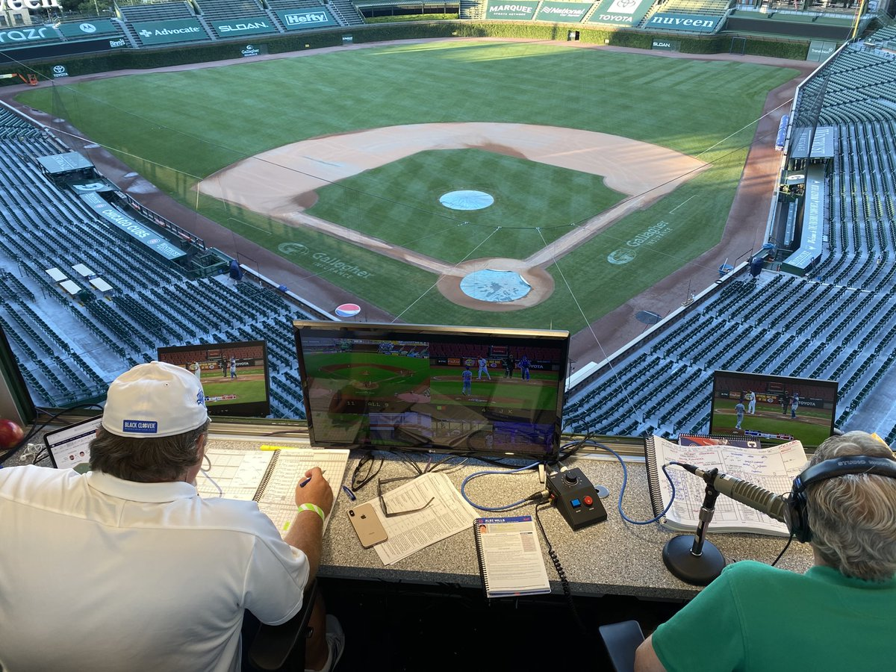
Summaries
Let the Individual know that you are going to summarize
Pull out 3 points about what the Individual said
Let me see if I have this right
Notes:
LEAD TROY : The S in OARS stands for summaries. Think of Summaries as a way to repeat back different parts of a larger conversation.
(CLICK) First let the person know that you are going to summarize.
(CLICK) Then, pick out 3 points that the person was making and repeat them back to them.
(CLICK) “Let me see if I understand you” and then allow the person to make corrections. It’s okay to summarize wrong. Summaries are a way to bring together different ideas and a great way to pull in ideas from a previous conversation. They are also a polite way to change the subject.

Slide 40
Summary Example
Okay Let me see if I have this right, You started shoplifting for extra money, shoplifting has cost you more than it was worth, and made less than your current job.
Notes:
LEAD TROY : What does a summary sound like:
Supervisee ASHLEY : “I started shoplifting because I needed money. I didn’t have a regular job. I got arrested multiple times. I ended up missing out on so much because of the trouble that I got into. Today, I am making so much money that I don’t even want to shoplift.”
Coach JACOB : (Click): “Let me see if I have this right, You started shoplifting for extra money, shoplifting has cost you more than it was worth, and made less than your current job.
LEAD TROY : Any questions on summaries?

Slide 41
Batting Practice: Evocation Using Summaries
Let me see if I have this right
Collect 3 things about what was said
Listener: Do you think this would lead an Individual to talk about change?
Notes:
COACH JACOB : Time for batting practice with summaries. Not everyone will need to bat in this practice. Remember, listen to the statement, let Joe know that you are going to summarize by saying something like, let me see if I have this right and then repeat back 3 thoughts about what they said. Watch us model an example for you.
Supervisee ASHLEY: “I started using marijuana when I was 14. I got addicted to heroin my senior year of high school and used daily for 3 years. After being terminated from treatment the first time, I overdosed. I went to treatment 3 more times and was successfully released the last time. My Aftercare Counselor and I talk about how I never stop thinking about heroin.” (Use for example, and with all 4 practices)
COACH JACOB: “Let me see if I have this right. You got addicted to heroin in high school. You’ve worked hard to stay safe and sober. You are setting future goals with your treatment counselor.”
COACH JACOB: Notice that I flagged that I was getting ready to summarize with “Let me see if I have this right” I picked out 3 things that Joe said to focus on his issues and well-being.
Okay we’ll have the next three people in the batting order do some practice with summary: Who is next up to bat?
(After every couple batters ) Coach Jason: Do you think this would lead someone to talk about change?

Slide 42
Motivational Interviewing Spirit
Collaboration
Compassion
MI
“Spirit”
Acceptance
Evocation
Notes:
LEAD TROY : To review, relying on MI spirit should make our job easier. It reduces time spent arguing and increases the chances for a supervisee’s success. The challenge is to resist the urge to tell them what to do, instead collaborate with the supervisee to work towards their own goals. Show acceptance by affirming their strengths and be compassionate about their welfare. Use strategies to evoke change talk from the supervisee. With that, I will turn things back over to Jessica.

Slide 43
Questions?
Notes:
Jessica and all…

Slide 44
Conclusion
Motivational Interviewing Concepts. Ability to Recognize and Strengthen Change Talk. MI Spirit: Empathy, Evocation, Acceptance and Compassion. Practiced OARS with a Coach.
Notes:
(Jessica) Thank you so much for your participation today. Back at Ohio Parole, we do 3 separate three-hour trainings, each one involves OARS practice like you just went through.
We opened with some objectives today, we wanted to provide microbursts of information about MI concepts, with opportunities for practice. As you leave, we hope you are more comfortable recognizing and strengthening change talk, applying MI Spirit and using OARS.

Slide 45
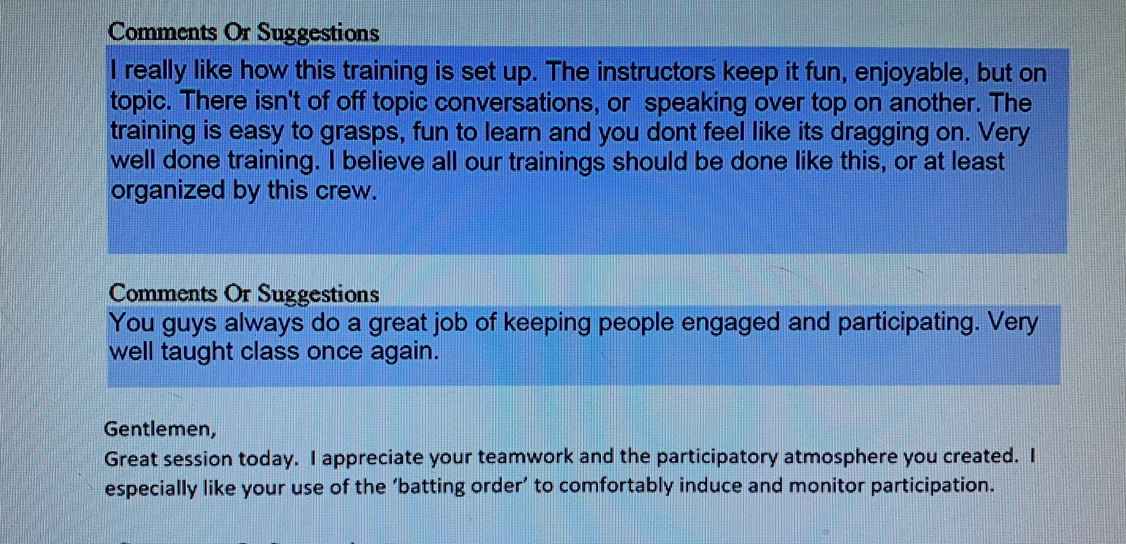
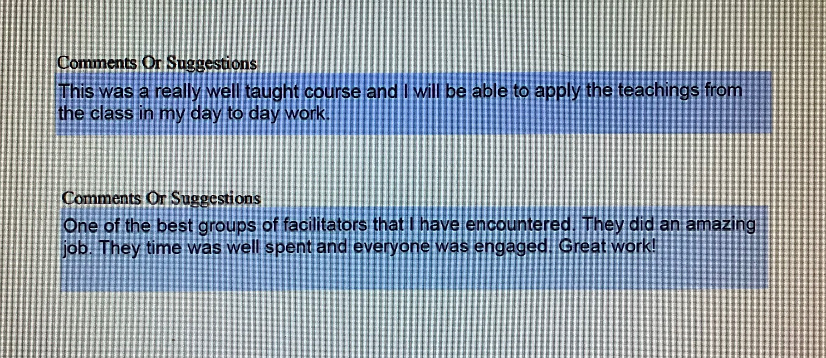
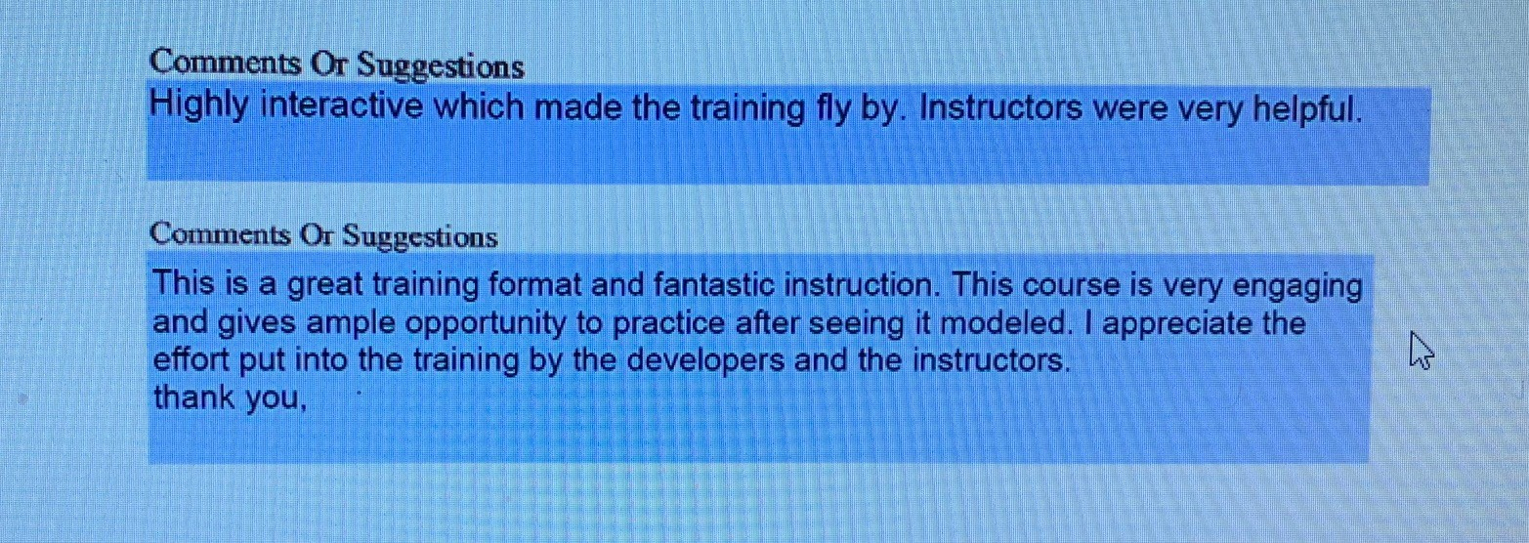
Feedback
Notes:
Mulitple clicks 4: with more feedback from officers who completed the tracks
(Jessica): We rolled out this format for MI training in November 2021. Overwhelmingly we received positive feedback from the officers who have attended the trainings. From my perspective this has been a great training vehicle for people who are trying to grow as change agents. The practice that they do in these training events spills over into our culture. I’m so proud of the work our officers do at Ohio Parole. Some of the officers who have been most committed to this training track are also serving on task forces and out arresting the supervisees who pose threats to the community. These balanced officers are the first to speak up about how important it is to sharpen MI skills to make a difference when the opportunity presents. I so appreciate you spending time with us over the last four hours.

Slide 46
Contact Information
Jessica.Dennis
Ashley.Autry
Jacob.Popp
Troy.Miglets
@odrc.state.oh.us
Notes:
ALL
This is our email information. Thanks for joining us today.

