Slide 1


Improving Supervision to Reduce Crime and Recidivism
An update and advancement of the ORAS

Slide 2
Introductions
Dionne Addison – Ohio Department of Rehabilitation and Correction
Myrinda Smith - University of Cincinnati Correctional Institute
Chris D’Amato – University of Cincinnati Correctional Institute

Slide 3

ORAS Journey
Notes:
In 2002, ODRC contracted with UCCI to examine the effectiveness of Ohio’s halfway houses and Community Based Correctional Facilities (CBCF) at reducing recidivism. One of the key findings from the study was that reductions in recidivism varied substantially based on offenders’ risk levels. A subsequent study of community corrections programs supported these results. These studies also revealed that correctional agencies across the state of Ohio were using a variety of RAs, ranging, for example, from “home-grown” assessments, to actuarial RA, to no assessment instrument at all. After consultation with UCCI, the Ohio Office of Criminal Justice Services (OCJS), and several local jurisdictions, ODRC thus made the decision to standardize the offender assessment process across the state by developing a non-proprietary assessment system.

Slide 4

ORAS Journey
Notes:
In 2006 ORDR contracted with the University of Cincinnati, Center for Criminal Justice Research to create a risk assessment system that would provide assessments at multiple points in the criminal justice system and that was validated on an Ohio population. A major goal of the project was to develop assessments that abided by the principles of effective classification by constructing assessments that
separated Ohio offenders into risk groups based on their likelihood to recidivate,
identified dynamic risk factors that can be used to prioritize programmatic needs, and
identify potential barriers to treatment.
The Ohio Risk Assessment System was created using a prospective design that involved conducting in-depth structured interviews of over 1,800 offenders at the following stages in Ohio’s justice system: pretrial, community supervision, prison intake, and community reentry. After interviews were conducted, offenders were tracked for approximately one year to gather follow-up information on recidivism.
The latest generation of RAs, fourth-generation instruments, encourage adherence to the RNR model by including static and dynamic predictors of recidivism as well as take into consideration offenders’ responsivity factors. When RNR factors are properly identified, offenders can be better matched to treatment and intervention strategies, so their likelihood of success is maximized.
UCCI revalidation study conducted in 2017, report published in 2018. Continued to find that the ORAS tools were valid predictors of recidivism.
Over 150 agencies worldwide (24 statewide agencies and 1 Pacific US territory) have adopted the ORAS and thousands of correctional staff have been trained in the use of the tool

Slide 5
ORAS Reliability
ODRC has been conducting Reliability studies with staff conducting ORAS assessments since 2013.
Several versions of reliability studies.
Address outcomes.
Most recent version completed and outcome report being finalized.
Have reached strong inter-rater reliability and now moving into validity study.

Slide 6

Innovations in Supervision Initiative
Building Capacity to Create Safer Communities
Improving Supervision to Reduce Crime and Recidivism
Notes:
Offender classification is one of the first steps in making evidence-based decisions related to the placement, treatment, and supervision of offenders. While Ohio uses a fourth-generation risk assessment, this classification tool provides risk information related to general recidivism. Predicting risk for violent recidivism is an important goal to protect public safety and enhance the identification of offenders’ risks and criminogenic needs. In response to this need, (ODRC), in collaboration with UCCI sought and received funding through the Bureau of Justice Assistance’s Innovations in Supervision Initiative in order to determine whether the assessment of offenders in the state of Ohio can be improved. The project, more specifically, will seek to develop an ORAS 2.0.

Slide 7

ORAS 2.0
Updating the ORAS
Revalidation
Advancement
Notes:
ORAS 2.0 includes:
The revalidation of the current ORAS tools to evaluate their accuracy in predicting nonviolent and violent recidivism
an examination of additional factors that are theoretically and clinically relevant to predicting an offender’s likelihood to commit violent recidivism. In doing so, ODRC and UCCI are pursuing several objectives aimed at:
(1) reducing recidivism and violent crime.
(2) aligning agency practices with best and evidence-based practices.
(3) assessing and documenting the process and outcomes of implementing recidivism and violent crime reduction strategies to serve as models for other agencies throughout the nation.
(4) promoting and increasing collaboration among agencies and officials who work in probation, parole, pretrial, law enforcement, treatment, reentry, and related community corrections fields; and
(5) supporting capacity-building activities related to the development of the ORAS 2.0 to enable our agency and other agencies across the state to invest in the effectiveness and future sustainability of the Ohio CJ system.

Slide 8
Why now?
Notes:
The evolution of RAs continues today with researchers continually working to improve their understanding of criminal behavior and the corresponding adaptations needed to enhance the tools. Given the dynamic nature of both the offender population and the CJ system itself, it is important that RA systems be continually revisited and updated. The use of RAs to predict violence recidivism, for example, is one area that has been advocated for more recently. The ability to predict violent recidivism is especially salient for ODRC at this time, as several recent cases across the state have gained attention due to the violent nature of the crimes that were committed (e.g., Brian Lee Goldsby, Anthony Pardon, and James Worley).

Slide 9

Data Collection
Gateway portal
Data from ODRC and OAG
Notes:
Very brief description of the data

Slide 10
ORAS Tools Re-validated
Pre-Trial Assessment (PAT)
Community Supervision Tool (CST)
  Screener Tool (CSST)
Prison Intake Tool (PIT)
  Screener Tool (PST)
Reentry Tool (RT)
Supplemental Reentry Tool (SRT)
Notes:
Quick overview of which tools are included

Slide 11
ORAS Tools Violence Predictors
Community Supervision Tool Violence Predictor (CST-VP)
Prison Intake Tool Violence Predictor (PIT-VP)
Reentry Tool Violence Predictor (RT-VP)
  Used for both the RT and SRT
Notes:
Explain that we formed three tools, with the RT-VP accounting for both the SRT and RT

Slide 12
Study Outcomes
New Arrest – 2 Years
  New arrest for any criminal offense
  New arrest for a violent criminal offense
  New arrest for a non-violent
New Conviction – 2 Years
  New conviction for any criminal offense
  New conviction for a violent criminal offense
  New conviction for a non-violent
Notes:
Very quick description of recidivism measures

Slide 13
Analysis plan

Slide 14
Main Analysis
Bivariate Analyses
  Item impact on predictive validity
  Internal reliability
  Correlations
  Area under the Curve
  Recidivism distribution across risk level
Notes:
Overview of the analyses, very quick but try to draw attention to the amount of work that went into the analyses/decisions around the tool.
Bold indicates that the types of results showing today

Slide 15
Revalidation
Identify and test potential changes to the tool
  Assess Predictive Strength/Improvements
  Removal of items
  Adjustment to items
  Adjustment of cutoff scores
  Scoring/interview changes
Notes:
Explain what went into the revalidation of the tool

Slide 16
Violence Tool Process
Examine current items relationship with violent recidivism
Use AGO Criminal History Data to identify new items
Notes:
Explain what went into the VP

Slide 17
Correlations
Measure of association between two variables
Range from -1.00 to 1.00
  0 = No Correlation
  1.00 or -1.00 = perfect correlation
Interpretation:
  The probability that an individual with a higher risk score will recidivate in comparison to an individual with a lower score

Slide 18
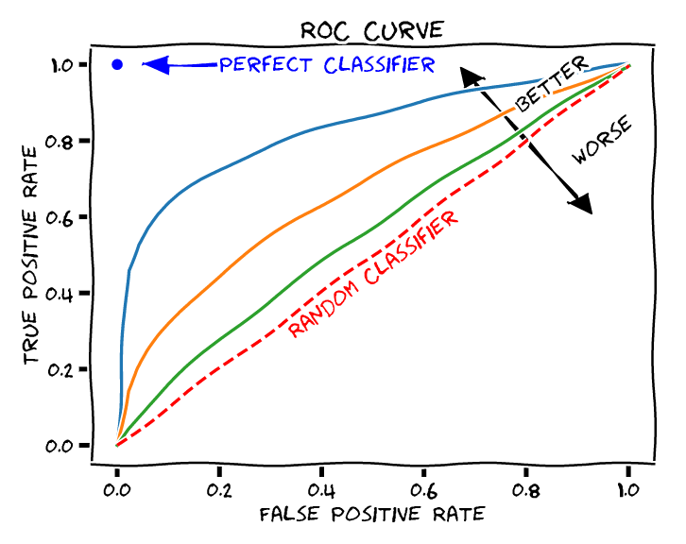
Area Under the Curve (AUC)
Assesses the predictive strength of a risk assessment instrument
  Ranges from 0.00 to 1.00
  0.50 = Chance
Interpretation:
  The probability that the recidivist would be assessed as a higher risk level than a non-recidivist
Notes:
Explain Area under the curve, again with risk level as an example

Slide 19
An Example
How often would you have won if you simply bet the favorite in all 57 Super Bowls?
37/57 = 0.65
Notes:
This is a super bowl example, showing that even with billions of dollars invested into the Vegas “model” identifying the favorite (the team that should win based on stats), they still only get it right 65% of the time.

Slide 20
Risk Assessment Validation
How well can we predict criminal behavior?
Considering… it’s behavior humans try to hide
What is considered “good” prediction power?
What “thresholds” to use as benchmarks?
Notes:
Set expectations for predicting recidivism

Slide 21
Correlations and AUCs in Validation Studies
Typical correlation effective size is between r [0.15, 0.30]
Typical AUC effective size is between AUC [0.55, 0.75]
Notes:
Provide quick explanation of where correlations in risk assessment studies fall

Slide 22
Re-validation Results
Notes:
Turn to re-validation results

Slide 23
IRAS Results
ORAS Tool | Men |  | Women
 | AUC | r | AUC | r
PAT | 0.59* | 0.18* | 0.61* | 0.20*
CST | 0.63* | 0.23* | 0.62* | 0.20*
PIT | 0.62* | 0.22* | 0.61* | 0.20*
RT | 0.67* | 0.31* | 0.69* | 0.35*
SRT | 0.63* | 0.23* | 0.62* | 0.21*
Notes:
Display all AUC results for all the tools but only highlight a few. Will probably focus on the CST and SRT, since Dionne said those were the ones she thinks they will really care aboyut
Mention this is only for arrest, but the conviction results are very similar

Slide 24
IRAS Results
ORAS Tool | White Men |  | Non-White Men
 | AUC | r | AUC | r
PAT | 0.61* | 0.18* | 0.58* | 0.16*
CST | 0.63* | 0.23* | 0.61* | 0.21*
PIT | 0.62* | 0.23* | 0.61* | 0.20*
RT | 0.70* | 0.30* | 0.63* | 0.24*
SRT | 0.63* | 0.24* | 0.61* | 0.22*

Slide 25
IRAS Results
ORAS Tool | White Women |  | Non-White Women
 | AUC | r | AUC | r
PAT | 0.61* | 0.18* | 0.58* | 0.16*
CST | 0.62* | 0.20* | 0.62* | 0.20*
PIT | 0.62* | 0.22* | 0.66* | 0.29*
RT | -- | -- | -- | --
SRT | 0.61 | 0.20 | 0.59 | 0.17
Notes:
The correlation for women on the PIT is equal when measured as new conviction

Slide 26
Notes:
Chart to help show recidivism distribution, use CST and SRT as examples

Slide 28
Violence Tool Results

Slide 29
IRAS Results
ORAS Tool | Men |  | Women
 | AUC | r | AUC | r
CST-VP | 0.67* | 0.26* | 0.65* | 0.20*
PIT-VP | 0.67* | 0.27* | 0.66* | 0.20*
RT-VP | 0.68* | 0.28* | 0.79* | 0.36*
(S)RT-VP | 0.65* | 0.25* | 0.70* | 0.22*

Slide 30
IRAS Results
ORAS Tool | White Men |  | Non-White Men
 | AUC | r | AUC | r
CST-VP | 0.66* | 0.23* | 0.65* | 0.25*
PIT-VP | 0.66* | 0.25* | 0.65* | 0.25*
RT-VP | 0.70* | 0.29* | 0.65* | 0.25*
(S)RT-VP | 0.66* | 0.25* | 0.64* | 0.24*

Slide 31
IRAS Results
ORAS Tool | White Women |  | Non-White Women
 | AUC | r | AUC | r
CST-VP | 0.64* | 0.16* | 0.67* | 0.23*
PIT-VP | 0.62* | 0.15* | 0.68* | 0.27*
RT-VP | -- | -- | -- | --
(S)RT-VP | 0.70* | 0.22* | 0.76* | 0.33*

Slide 34
Implications for the Tool
Removal of Items
Adjustments to an Item
Updated Score Guide
Updated Interview Guide
The Addition of the Violence Tools

Slide 35
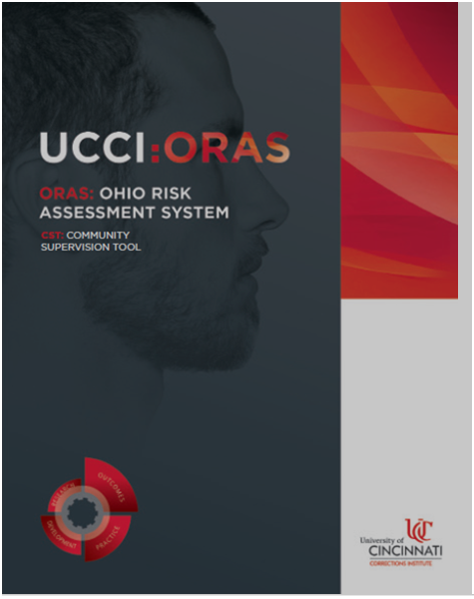
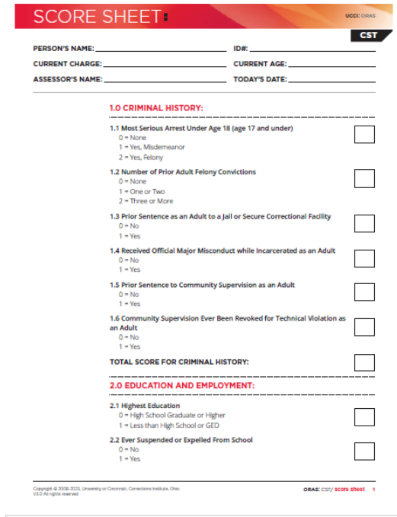
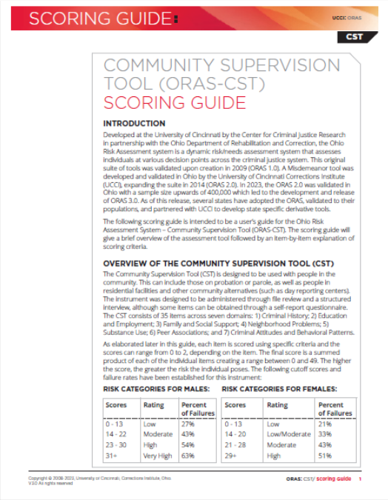

Slide 36
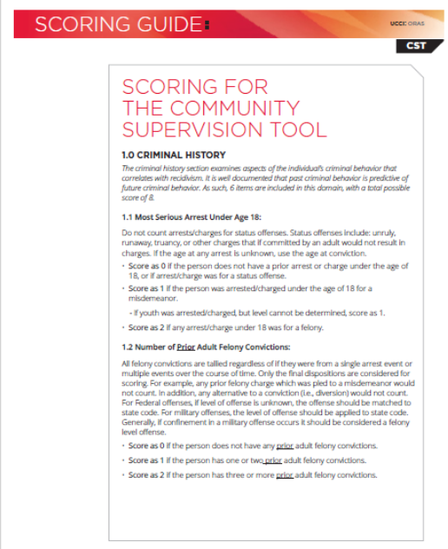
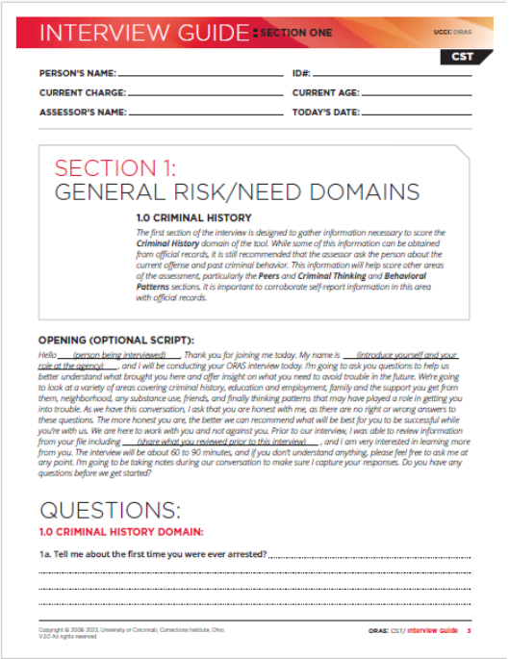
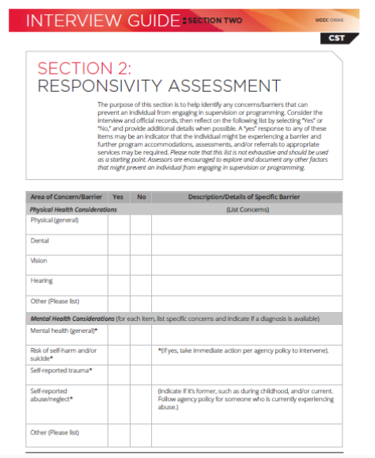

Slide 37

Road Ahead
Update training material
Train master trainers
Develop a plan for TOT
Develop a plan for end user trainings
Disseminate findings
Notes:
The grant ends in September 2023. Once the new ORAS 2.0 instruments are finalized, ODRC will work with UCCI to update all relevant training materials, train master trainers, and develop a plan for training trainers and end-users, and establish plans for disseminating the findings of the study to researchers and practitioners. Dependent upon resources, activities may also include consultation with our information technology contractor to identify the steps that need to be taken to align the ODRC Gateway Portal with the new ORAS 2.0 assessments.

Slide 38

Conclusion
Notes:
The identification of an offender’s risk level is the primary initial step towards successful rehabilitation. To this end, it is imperative that correctional agencies implement validated and objective RA instruments. With the completion of almost 900,000 ORAS assessments to-date, and the support from key partners across the state (e.g., OAG, community agency partners), the time is ripe to develop an updated risk assessment system—the ORAS 2.0. The identification and incorporation of detailed nonviolent and violent criminal history and recidivism data will not only provide an enhanced approach to the assessment and overall case management of offenders in Ohio but will generate information to better inform other CJ-related agencies within the state (e.g., law enforcement) and all CJ entities across the nation (i.e., corrections and community corrections agencies and law enforcement).

Slide 39


Slide 40
Contact Information
Dionne Addison – dionne.Addison@odrc.state.oh.us
Myrinda Smith – schweiml@ucmail.uc.edu
Chris D’Amato – damatocj@ucmail.uc.edu

