Slide 1
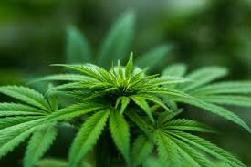
But It’s Just Weed: What Courts Need to Know About Cannabis Use
Dr. Kara Marciani
Judge Kate Huffman

Slide 2
Learning Objectives
Understand the physiological and psychological effects of cannabis use on the brain that can lead to or impact justice-involvement
Explain the unique affect of cannabis use that can precipitate justice-involvement or present challenges to court supervision for adolescents
Recognize the impact on treatment court participation for individuals who use cannabis or who present with a diagnosis of cannabis use disorder
Notes:
May be antisocial
Not regarded as criminogenic – no tie to other criminal offenses, except pertaining to impaired driving or illegal possession
Compare to: Heroin – committing crime to fund use
Cocaine and methamphetamines – may result in other offenses primarily related to increased violence

Slide 3
Why is cannabis problematic?
Impaired driving/parenting/work functioning
Increase in work-related accidents
Increased crashes
Increased emergency department visits
Brain development
Psychiatric symptoms
Addiction/SUD

Slide 4
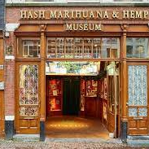
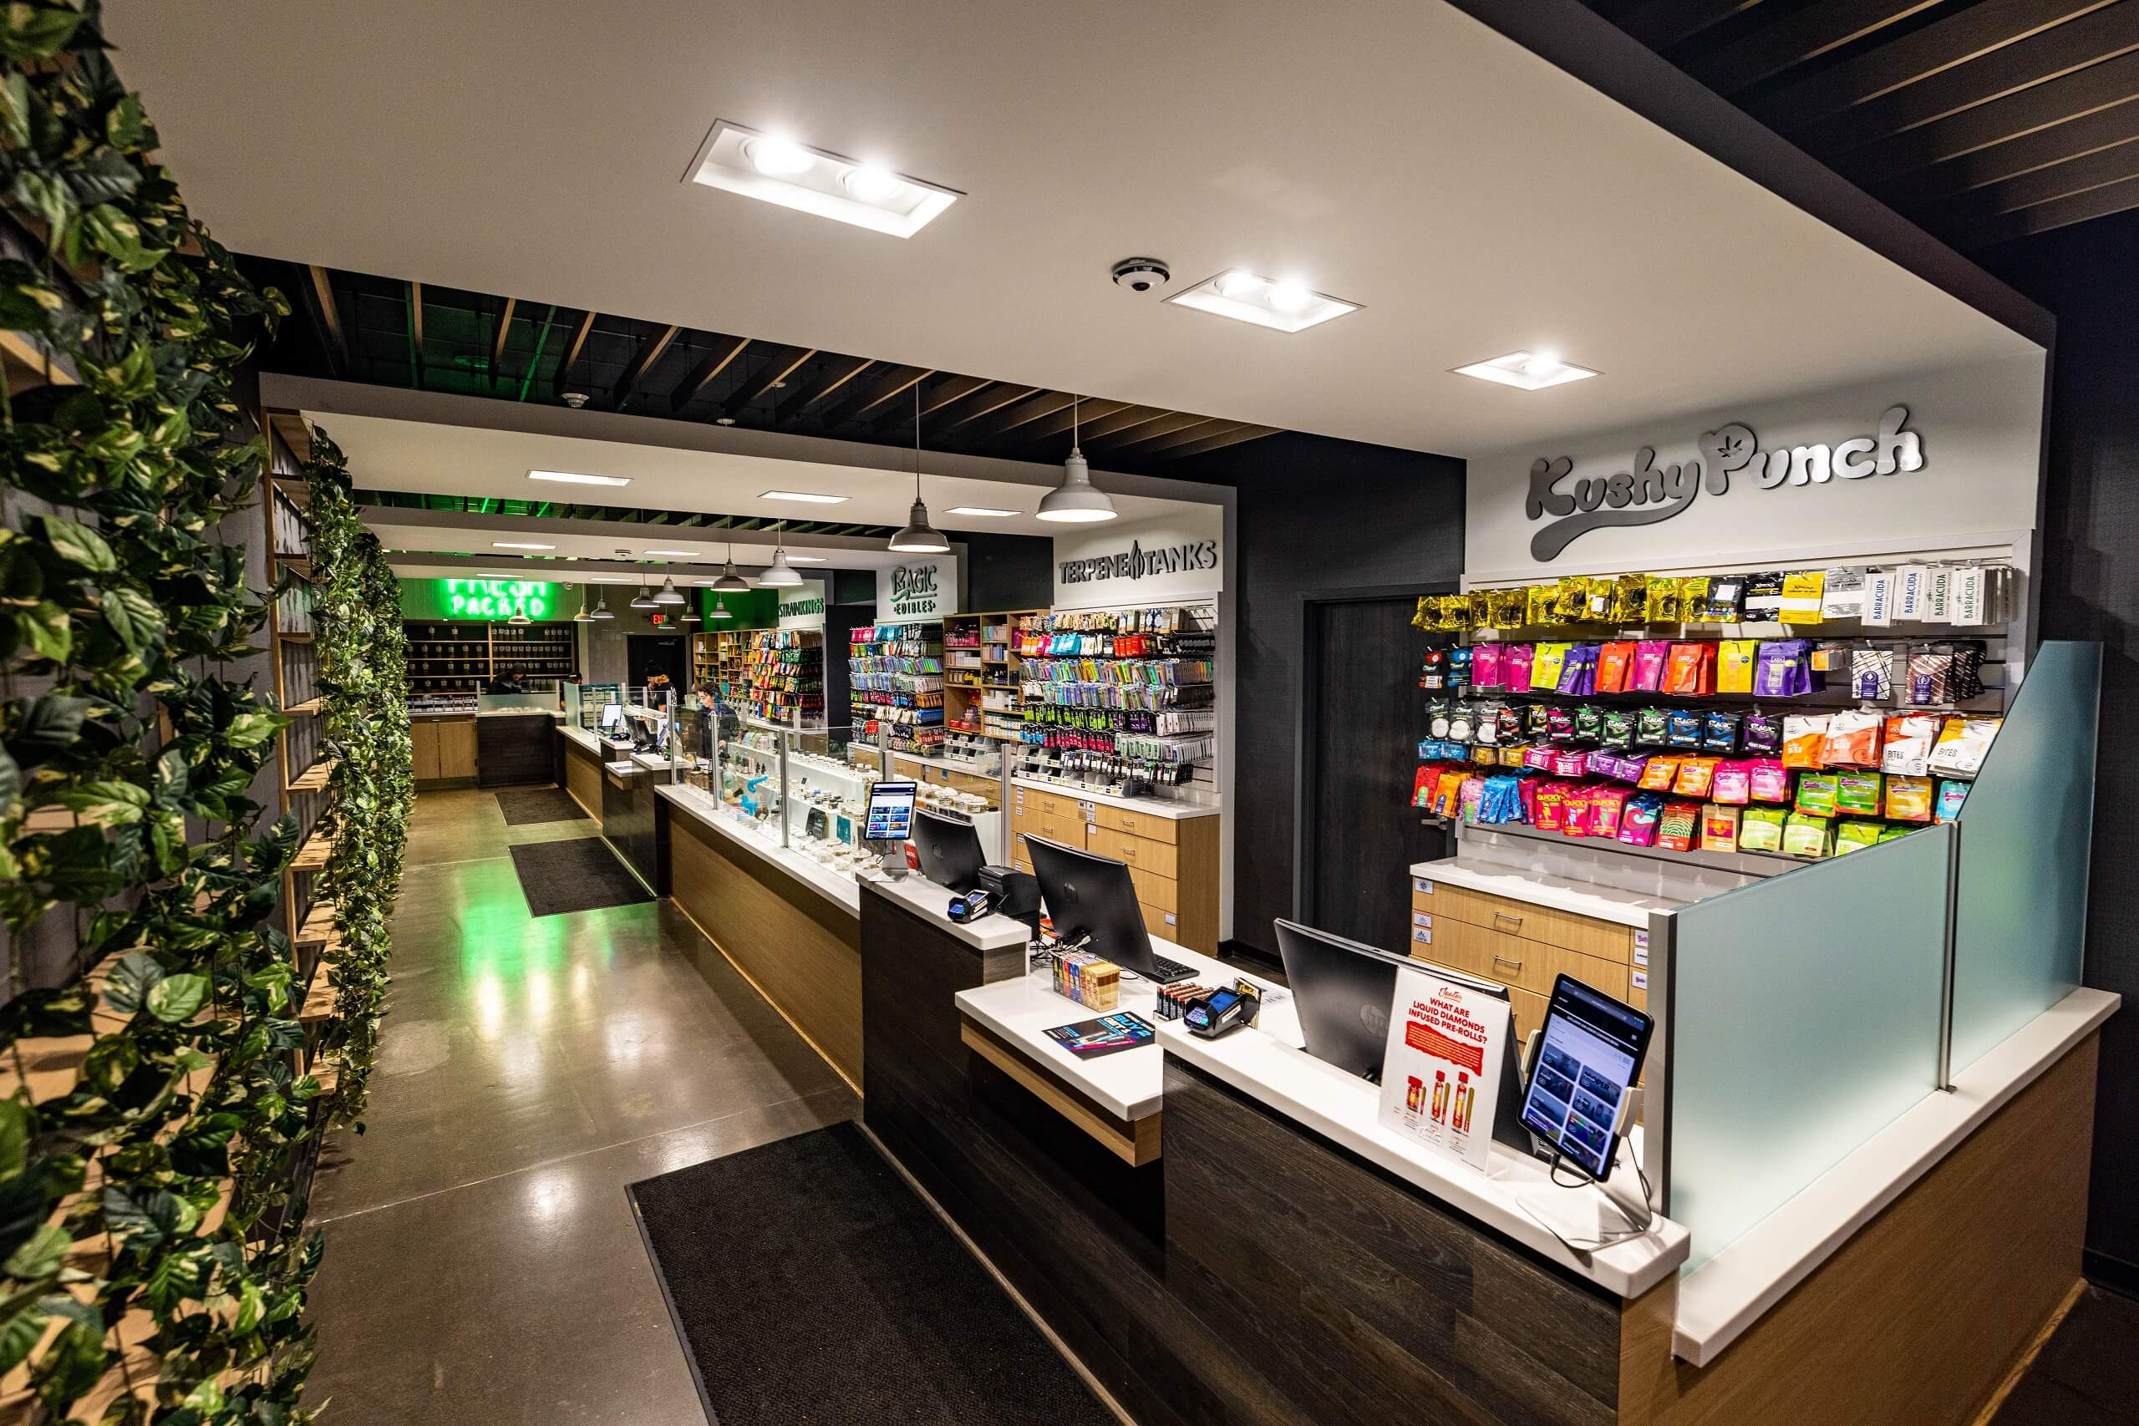
The Normalization of Marijuana Use
Notes:
Imbeded in culture

Slide 5
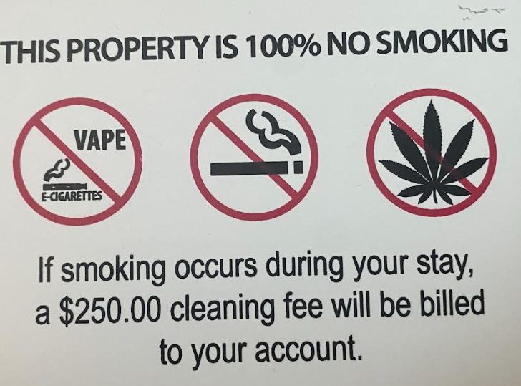
Notes:
If the war is over, what do we do now?

Slide 7
Public Attitudes About Cannabis Use
80% aware that marijuana is more potent today compared to the past
55% felt legalization of cannabis would negatively affect road safety
59% believe legalization would negatively affect employee safety
63% believed legalization would result in increased emergency department visits
Notes:
From Perceptions of Public Health Consequences of Marijuana Legalization, Stella M. Resko, Kathryn A. Szechy, Theresa J. Early, Jennifer D. Ellis, Danielle Hicks and Elizabeth Agius,
29 Addiction Research & Theory (Oct. 2020)
Yet almost half believed it would not negatively affect public health

Slide 8
Perceptions of Cannabis Safety
36% of survey respondents believe daily cannabis smoking is safer than daily tobacco smoking
A similar percentage believe that secondhand cannabis smoke is safer than similar tobacco smoke

Slide 9
Breaking Down the Data
Daily cannabis use is somewhat or completely safe
Users 71%
Daily cannabis use is completely or somewhat unsafe
Non-users 78%
Impact of daily use on mental health
Has no effect, somewhat or significantly improves
Users 76%
Significantly or somewhat harms
Non-users 69%
Notes:
Also more than half of users believe cannabis can prevent health problems, improve mental health, school success, job success and relationships
, Perceptions of Risks of Cannabis Use in a National Sample of U.S. Adults
Yoshiko Kohlwes, Salomeh Keyhani, Beth E. Cohen, 38 J. Gen Intern Med 1094 (2022)

Slide 10
Following Legalization in Colorado
Marijuana use increased 45% when comparing three years prior to legalization and three years post-legalization
Marijuana-related traffic deaths increased 151%, all traffic deaths increased 35%

Slide 11
2022 National Survey on Drug Use and Health
22% of people aged 12 or older (61.9m) used marijuana in the past year
Up from 19% according to the 2021 survey
Notes:
Annual survey conducted by SAMHSA

Slide 12
In 2022 daily, or near daily cannabis use exceeded daily or near daily alcohol use
Notes:
From the 2022 National Survey
For cannabis users, while some risk of use is perceipved, the perception is the positive effects outweigh any expected harm

Slide 13
U.S. adult-use markets represent approximately 56% of total global cannabis sales
Worldwide legal industry forecasted to reach $58b in sales in 2028, fueled by U.S. adult-use market (estimated to be $46b in U.S. alone by 2028)
Notes:
Source: Iris Dorbian, Global Legal Cannabis Market Expected to Reach $58b in 2028, Forbes, March 7, 2024

Slide 14
What is the age group experiencing the greatest increase in cannabis use?

Slide 16
Increase in Past Month Marijuana Use By Age Group
12-17 -10%
18-25 +13%
26-34 +65%
35-44 +43%
45-54 +48%
55-64 +455%
≥65 +333%
Notes:
National Survey on Drug Use and Health, United States as reported by CDC
Significantly higher for men than women
HOWEVER, while cannabis use is increasing among middle-aged and older U.S. adults, however, those age groups do not engage in the risky cannabis use that younger persons do. These populations consume in the evening and engage in less risky use patterns. Age Differences in Patterns of Cannabis Use Among An Online U.S. Sample of Adults Who Consume Cannabis Frequently

Slide 17
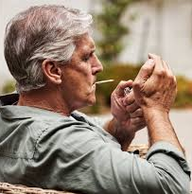
Perceived risk associated with regular cannabis use among adults ≥65 years
2015 52.6%
2019 42.7%
Notes:
Decreases in perceived risk were detected in those never married, those who binge drink, use tobacco, have kidney disease, asthma, heart disease, COPD ad others
Benjamin H. Han, Makaya Funk-White, Roxanne Ko, Tala Al-Rousan, Joseph J. Palamar, Decreasing Perceived Risk of Regular Cannabis Use Among Older Adults in the United States from 2015-2019, 69 J. Am Geriatr. Sco. 2591 (2021)

Slide 18
Cannabis
Cannabis plant contains dozens of different cannabinoids
Cannabinoids represent a group of substances in the cannabis plant – at least 144 known cannabinoids
Cannabidiol (CBD) and tetrahydrocannabinol (THC) – two of the most common cannabinoids, but act differently in the body
Notes:
Different THC forms
Similar chemical structures, but some differences
THC found in cannabis plants typically delta 9
Delta 8 50-75% as psychoactive as delta-9 THC

Slide 19
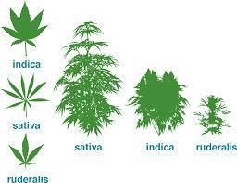
Strains of Cannabis
Main subspecies of the genus – cannabis indica, cannabis sativa and cannabis ruderalis
Look different, grown in different climates
Cannabis indica – higher levels of CBD
Cannabis sativa – higher levels of THC
Cannabis ruderalis – naturally high in CBD and low in THC levels
Notes:
Sativa – hot, dry climates with long sunny days – Africa, Central America, Southeast Asia, portions of Western Asia
Indica – native to Afghanistan, India, Pakistan, Turkey, adapted to the often harsh, dry and turbulent climate of the Hindu Kush mountains
Ruderalis – extreme environments, such as Eastern Europe, Himalayan regions of India, Siberia, and Russia, cold, low-sunlight environments

Slide 20
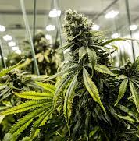
Strains of Cannabis
Each strain has a different concentration of the cannabinoids THC and CBD, as well as other compounds
All THC is biologically and psychologically active
CBD is biologically active
Cultivators and farmers breed different varieties or crossbreeds with characteristics that create hybrids and specific strains (a variety of tastes and effects on the user)
Notes:
Biologically active means it has an effect on the body
Psychoeffective means it can elicit feelings of euphoria, relaxation, altered time perception, and impairing effects
CBD will not cause impairment because it only acts on the body

Slide 21
Delta Differences
Delta 8, delta 9, delta 10
Unique effects on the human body
THC found in cannabis plants typically delta 9 – the psychoactive chemical responsible for intoxicating effects
Delta 8 and 10 found in trace amounts in the cannabis plant and less potent in psychoactive effect than delta 9
Notes:
Delta 8 and 10 are not as potent

Slide 22
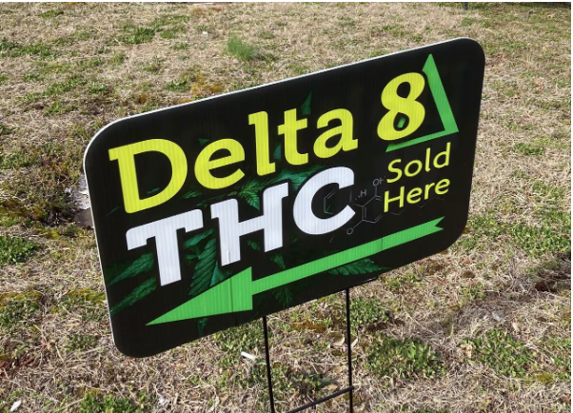
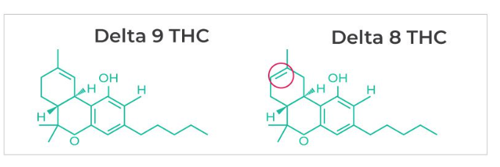
Delta 8 and the 2018 Farm Bill
Sale of delta 8 extracted from hemp legal under Farm Bill
Delta 8 legally extracted from hemp easily converted to Delta 9
Notes:
Unregulated
Synthetic delta 8

Slide 23
THC and the Brain
THC structure similar to the brain chemical anadamide
Because of the similarity, THC attaches to and activates cannabinoid receptors
The similar structure allows the drug to be recognized by and activate cannabinoid receptors and to alter normal brain communication

Slide 24
THC and the Brain
Cannabinoid receptors abundant in the parts of the brain that regulate movement, coordination, learning and memory, higher cognitive functions, such as judgment, and pleasure regions
Activates the brain’s reward system – which releases dopamine at levels higher than typically found,
Teaches the brain to repeat the rewarding behavior

Slide 25
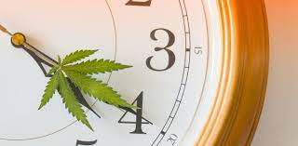
Immediate Effects of Cannabis Use
Euphoria
Sense of relaxation
Heightened sensory perception
Altered perception of time
Increased appetite

Slide 26
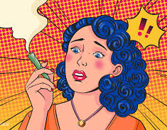
Common Physical and Psychological Reactions
Dry mouth
Dry/red eyes
Dizziness
Anxiety
Paranoia
Rapid heart rate
Decreased blood pressure

Slide 27
Notes:
Discuss the effect on treatment here – it interferes with learning, particularly from treatment and other programming

Slide 28
Notes:
Psychoeffective Reactions:
Senses
Mood
Learning
Memory
Motivation
Motor control/balance
Reaction time
Distorted perception
Executive functioning
Impaired cognitive performance
Attention maintenance
Risk taking

Slide 29
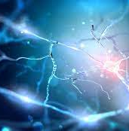
Long-Term Effects on the Brain
Possibly permanent adverse changes in the brain affecting learning, memory, cognitive impairment, reward system
Significant decline in verbal ability
Hastens age-related loss of hippocampus neurons – decreased ability to learn new information, including learning from treatment
Increased risk of head, neck and respiratory cancers
Notes:
Tobacco and cannabis smoke share many known carcinogenic chemical compounds

Slide 30
Fetal Health
Women use cannabis more frequently during pregnancy than any other federally regulated drug
Prevalence of CUD among pregnant females as high as 26.1%
Prenatal exposure related to adverse birth consequences including small size for gestational age, neonatal intensive care unit admissions
Preterm birth
Childhood outcomes such as autism spectrum disorder, attention-deficit/hyperactivity disorder, symptoms of psychopathology
Notes:
Because if affects the development of the endocannabinoid system

Slide 31
It’s Not Your Grandpa’s Weed
Notes:
Marijuana available between the 1960s and the early 1980s yielded a THC content of about 2%
Two to three fold increase in THC levels in both illicit markets and U.S. state-legalized markets over the past four decades, rising from THC levels of 4% in the mid 1980’s to up to 72% in some THC concentrate samples today
Other cannabis products such as oil, shatter, dab and edibles offer a THC potency of up to 95%

Slide 32
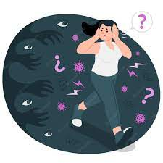
Large Doses or High Potency
Acute psychosis (usually temporary)
Hallucinations
Delusions
Distrust
Panic
Loss of the sense of personal safety
Hallucinations
Vomiting
Tremors
Anxiety
Confusion
Loss of consciousness

Slide 33
Co-occurring Mental Health Disorders
Cannabis-induced mental health diagnoses include anxiety disorders, depression, psychotic and nonpsychotic bipolar disorder, schizophrenia, amotivational syndrome, disruptive cognitive function, neuropsychological decline and psychotic disorders
12% of persons treated for or diagnosed with major depressive disorder also experience CUD
24% of those with bipolar disorder use cannabis and 20% experience CUD
Among patients with schizophrenia, 26.6% exhibit current CUD or meet the criteria for life-time CUD
Notes:
Kara – discuss mental health meds
Not learning to cope
Self-medicating
Escaping

Slide 34
Notes:
Discuss here effect of cannabis on criminal involvement

Slide 35
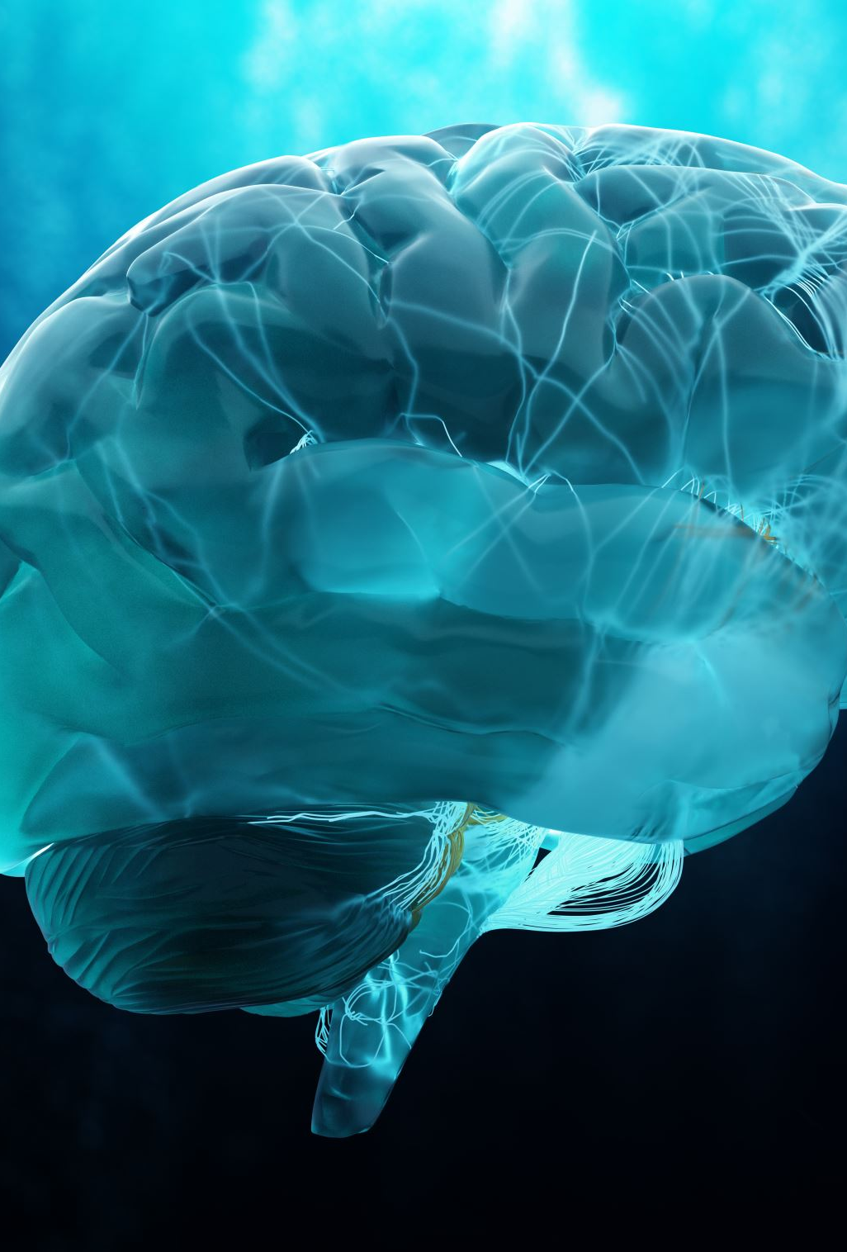
Adolescence
A time of major biological, neurobiological, social and personal transitions – the “fine-tuning” and reorganization of the brain
Changes in capacity to reason, regulate emotions, negotiation of major social transitions, opportunities for independent decision making, preparation for entering the adult world of work
And… a high risk time period
Notes:
The brain continues critical development during adolescence, including the creation of more robust neuronal pathways

Slide 36
The Adolescent Brain
Because the endocannabinoid system performs a key regulatory and homeostatic role that undergoes developmental changes during adolescence, brain development critically susceptible to the effects of exposure to cannabis
Adolescent use found to impair cognition across a number of domains, including executive functioning, processing speed, attention and memory
Impaired functioning greater than in adult use
Linked with suicidality among teens and young adults

Slide 38
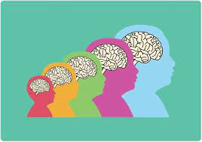
What’s the difference?
Onset of use in adulthood post-brain maturity does not result in changes in brain development

Slide 39
Risk Perception Among Adolescents
Increased knowledge and perception of risk correlate with lower levels of current/intended use
However, studies demonstrate increased use among adolescents and decreased perception of risk
Notes:
Megan E. Harrison, Nuray Kanbur, Kyle Canton, Tejas S. Desai, Stephanie Lim-Reinders, Chase Groulx and Mark L. Norris, Adolescents’ Cannabis Knowledge and Risk Perception: A Systematic Review, 74 J. Adolescent Health 402 (2024)

Slide 40
Managing the Message
Risk awareness insufficient to prevent cannabis use among young persons
Young persons prefer information on cannabis to be delivered in a neutral fashion from what they believe are credible sources – people with authority, famous people, “influencers”
Notes:
From Attitudes to Cannabis Use and Public Prevention Information Among Young Adults: A Qualitative Interview Study with Implications for Prevention Practice
Pia Kvillemo, Anna K. Strandberg and Johanna Gripenberg, Frontiers in Public Health (June 2022)

Slide 41
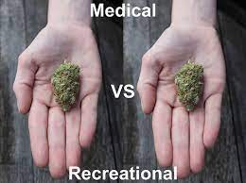
Medical Marijuana
Limited medicinal effect
Blood/urine/saliva tests incapable of distinguishing between recreational and medical marijuana
It’s the same thing!

Slide 43
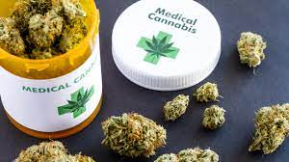
Medical Marijuana Basics
Physician recommendation
Age restriction
Specific conditions
Cultivated and sold by licensed dispensary
Must be stored in dispensary packaging
Limited purchase/possession
Limited THC content
Limited means of ingestion
Notes:
Remove if not Ohio program

Slide 44
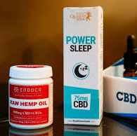
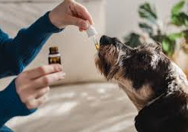
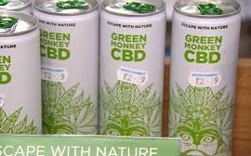
CBD

Slide 45
CBD
A non-intoxicating compound
May affect mood; mild physiological effects
Advertised to provide relief for anxiety, depression and PTSD, promote sleep
Approved by FDA to treat a rare seizure disorder in children
Real effect uncertain

Slide 46
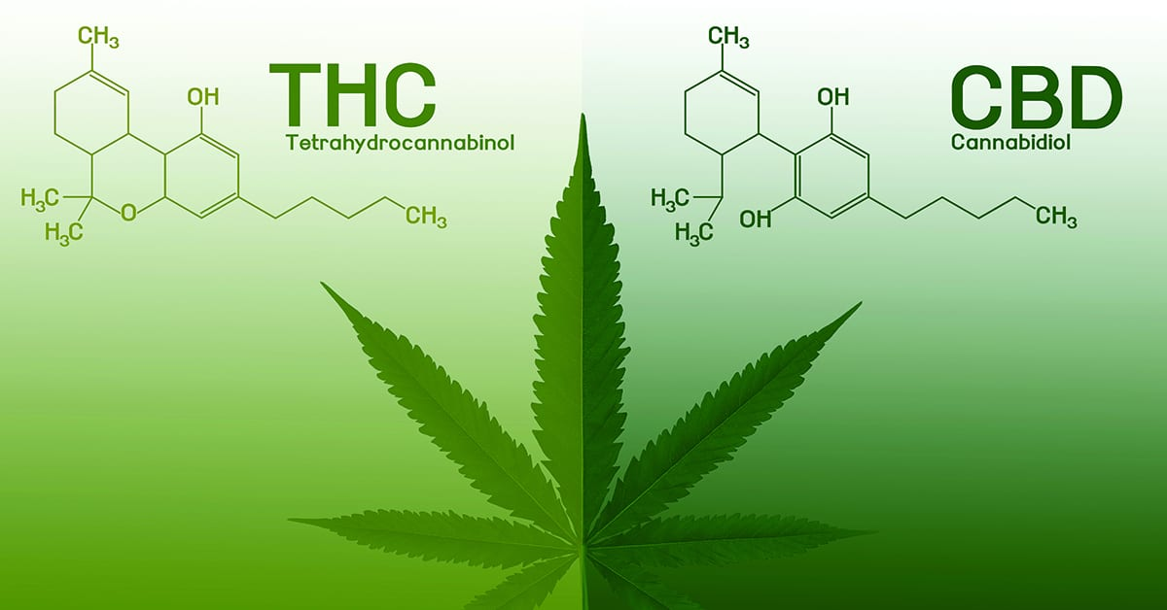
CBD
THC level in CBD limited to .03% by federal law
Use of CBD products will not result in +THC test

Slide 47
Cannabis Use Disorder
20-30% of users experience CUD according to a recent study
Men 1.5 times more likely to be diagnosed with a lifetime CUD
81.8% of individuals diagnosed with CUD eventually achieve recovery
19.1% of individuals diagnosed with lifetime CUD

Slide 48
Cannabis Use Disorder
DSM-5 definition:
A problematic pattern of cannabis use leading to clinically significant impairment or distress, manifested by two or more concerns within a twelve-month period

Slide 49
Notes:
11 factors
2-3 mild CUD
4-5 moderate CUD
6 or more severe CUD

Slide 50
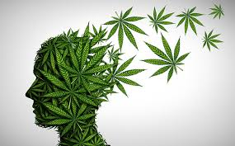
Withdrawal Symptoms
Irritability, anger, aggression
Nervousness or anxiety
Sleep difficulty (insomnia, disturbing dreams)
Appetite disturbance or weight loss
Restlessness
Depression
Physical symptoms causing significant discomfort including abdominal pain, shakiness/tremors, sweating, fever, chills or headache

Slide 51
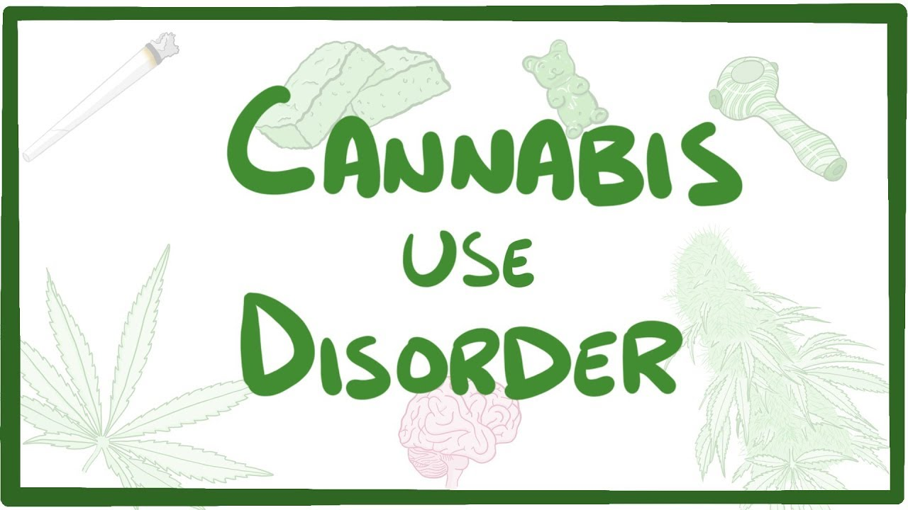
Cannabis Use Disorder and Medical Marijuana
States authorizing the use of medical marijuana experience a significant increase in illicit marijuana use as well as increased DSM-5 diagnosed cannabis use disorder (CUD)
Notes:
JAMA Psychiatry – U.S. Adul Illicit Cannabis Use, CUD and Medical Marijuana Laws (2017) – Columbia University Medical Center and Columbia Mailman School of Public Health researh

Slide 52
CUD Health-Related Concerns
Cognitive decline
Respiratory and cardiovascular disease
Psychiatric symptoms
Increased risk of psychotic and nonpsychotic bipolar disorder and unipolar depression

Slide 53
Treatment Modalities
Cognitive-behavioral therapy
Contingency management
Motivational enhancement therapy
No current FDA-approved pharmacological treatments

Slide 54
Treatment Implications
Adverse interactions/complications when used with commonly prescribed psychotropic medications
Use highly correlated with medication non-compliance
Interferes with learning and the use of active coping skills when cannabis used as a coping mechanism

Slide 55
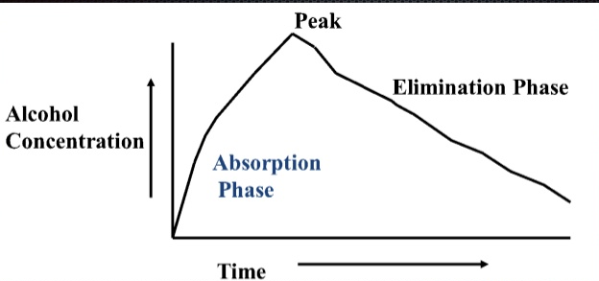
Alcohol – A Simple Drug
Notes:
A simple drug

Slide 56
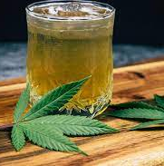
What makes cannabis and alcohol use different?
Alcohol eliminated at a fairly constant rate of 0.01%-0.03% per hour
Peak effects of alcohol use occur at peak blood concentration
THC concentration cannot be correlated to specific impairment
THC dissolves in fatty tissue, which acts like a sponge to reduce measurable amounts in blood, saliva or breath
THC moves rapidly from the blood stream to fatty tissue, including the brain, yet has a long half-life to metabolize
Peak effects of THC use occur after peak blood concentration
Notes:
As a result, impairment does not uniformly rise and fall based on how much THC is present in bodily fluids, as alcohol does

Slide 57
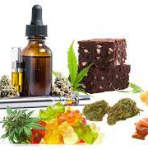
Means of Ingestion
Marijuana – the dried leaves and flowers (buds) of the cannabis plant; generally smoked
Hashish – the dried plant resin that is usually mixed with tobacco and smoked or added to foods and baked goods
Hash oil – liquid that is used sparingly (due to high potency) and added to the tip of a joint or cigarette and smoked
Concentrates – extracts (dabs, wax or shatter), often vaporized in small quantities due to high THC content
Notes:
Various preparations
Edibles are made from oils – has THC and CBD

Slide 58
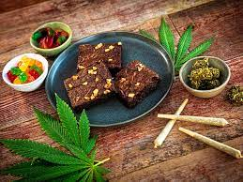
Method of Consumption Matters
Notes:
When smoked, rapidly arrives at the brain; effects almost immediate; if smoked affects lung health
When consumed in food or beverages, effects somewhat delayed – 30 minutes to one hour, because it must first pass through the digestive system, and significantly less THC is delivered to the blood stream
The edible high generally lasts much longer than smoking or vaping, from six to eight hours
With edible consumption, peak blood levels occur around 3 hours post consumption

Slide 60
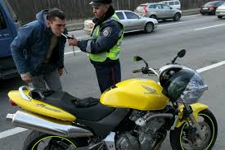
No BAC for THC

Slide 61
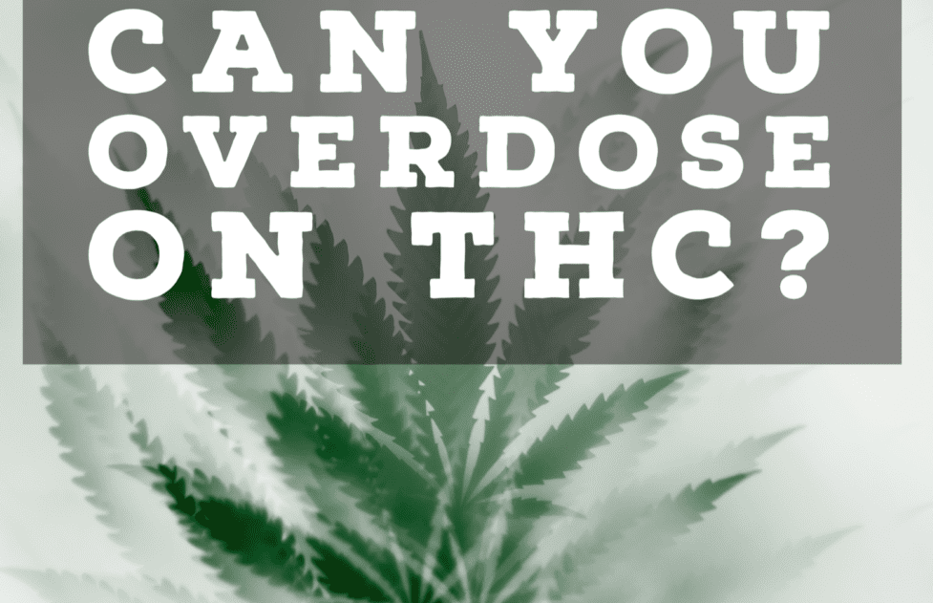
Notes:
Not on THC alone

Slide 62
Gateway or Attitude?
Notes:
Some researchers posit that it is a gateway drug to more serious SUD, and clinicians view it as a gateway drug.
Others posit that it is a drug that sets up an attitude for using
In the words of one expert, marijuana is not the gateway, but the attitude

Slide 63
Court Responses to Cannabis Use
Abstinence-based approach – corrective/responsive action implemented
Tolerance-based approach – use not encouraged but punitive actions not taken
Adaptive approach – tailor response to individual participant’s needs
Notes:
Cite – Nathaniel P. Morris, Problem-Solving Court Policies on Cannabis Use, 47 American Academy of Psychiatry and the Law 1 (2019)

Slide 64
National Association of Treatment Court Professionals (now AllRise)
Supports reasonable prohibitions in drug courts against the use of any form of cannabis by participants and the imposition of suitable consequences, consistent with evidence-based practices
Notes:
Kara – discuss abstinence v. harm reduction
2012 position paper

Slide 65
Supervision Compliance and Treatment
Remember, substance use is a risk factor for recidivism
Adverse interactions/complications when used with commonly prescribed psychotropic medications
Use highly correlated with medication non-compliance
Use disrupts life domains that might otherwise serve as protective factors
Interferes with learning and retaining information, including from treatment, and the use of active coping skills when cannabis used as a coping mechanism
Effect on motivation influences many aspects of supervision, including employment-seeking and retention, appearing for appointments and court hearings

Slide 66
What Would You Do?
John, on probation for a drug possession offense, presents his Medical Marijuana Card to his probation officer and asks to have the conditions of his supervision changed to permit him to use marijuana.

Slide 67
Effect of State Legalization
The legalization of marijuana, either medical or recreational, and the lack of federal enforcement of some laws does not impact federal enforcement of other laws, including the tax code.
Standing Akimbo, LLC v. United States, 594 U.S. ___ (2021)

Slide 68
Questions?
Dr. Kara Marciani
marcianipsych@gmail.com
Judge Kate Huffman
ohiojolhuffman@gmail.com

