Slide 1

OJACC Conference
October 10th, 2024

Slide 2
About NAMI Ohio
NAMI Ohio is a grassroots, advocacy organization that was founded in 1982 by a small dedicated group of mothers.
Our Mission is “to improve the quality of life and ensure dignity and respect for persons with serious mental illness.”
NAMI Ohio advocates for mental health services and access to care, while also encouraging support of legislative policies and government funding related to mental health issues.

Slide 3

Why We Care
1 in 5 adults experience mental illness each year
1 in 25 adults experience serious mental illness each year
1 in 6 youth ages 6-17 experience a mental health disorder each year
Suicide is the leading cause of death among people aged 10-14 and the second-leading cause of death for Ohioans who are 15-24 years old.

Slide 4
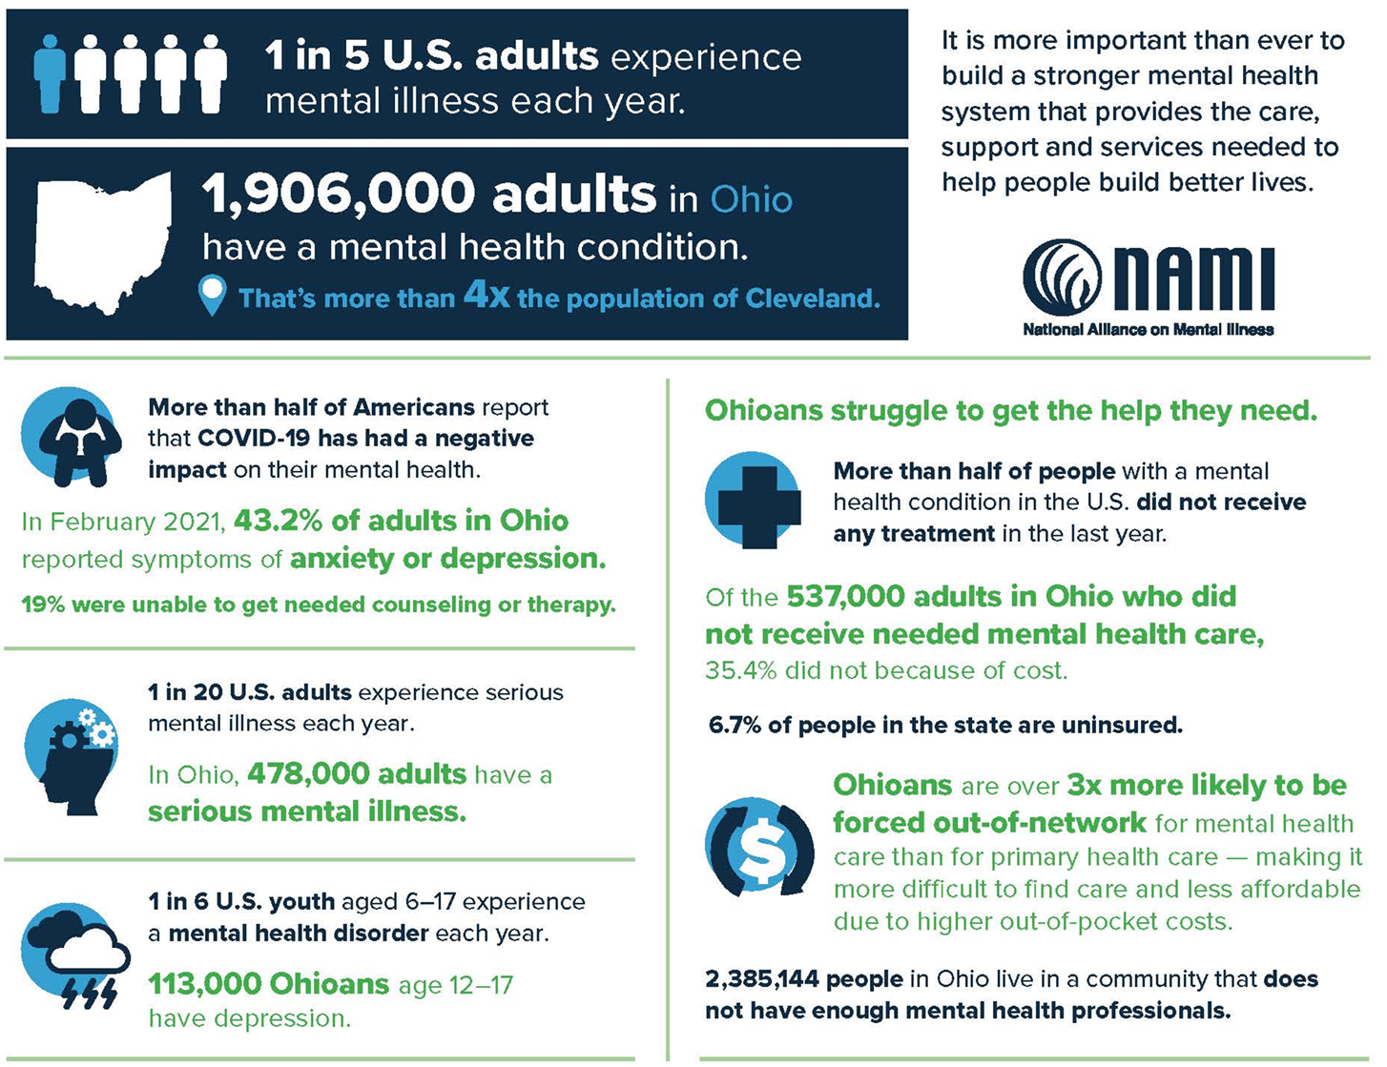

Mental
Health
in
Ohio

Slide 5
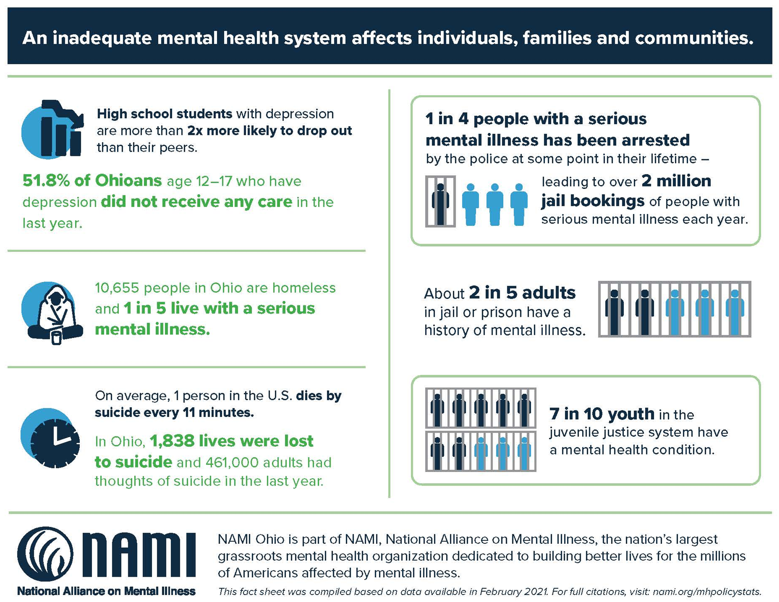
Mental
Health
in
Ohio

Slide 6
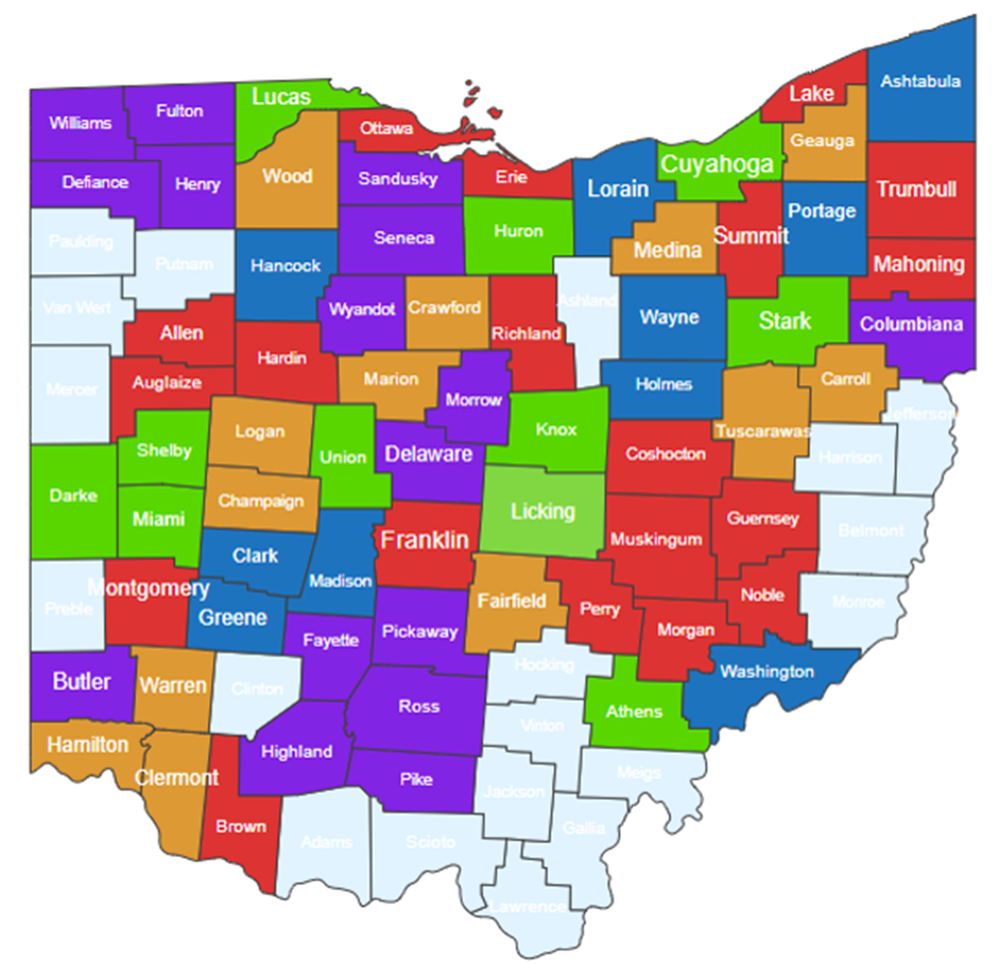
NAMI Ohio Affiliates
Because mental illness is a local issue, we have established a network of local NAMI affiliates to; EDUCATE individuals where they live, ADVOCATE with the local community mental health system to provide needed and quality care to their loved ones, and SUPPORT those living with mental illness and their families as they navigate the often-complicated mental health system.
80% of all caregiving is provided by family members. These families are, many times, ill-equipped to deal with the significant challenges of mental illness in their families.
Having an organization available to them, in their community, is their lifeline.

Slide 7
NAMI Ohio Affiliates
Throughout Ohio, we have 38 local affiliates. These affiliates are not-for-profit corporations with their own Board of Directors, staff, and volunteers.
All affiliates are required to meet the Standards of Excellence for the organization, as designated by NAMI National.
Find your local affiliate’s contact information by visiting www.namiohio.org

Slide 8

EDUCATION
NAMI education programs ensure hundreds of thousands of families, individuals and educators get the support and information they need.
ADVOCACY
NAMI works with members of the legislature to help shape public policy for people with mental illness and their families and leaders with the tools, resources and skills necessary to protect mental health.
SUPPORT
Our toll-free Helpline allows us to respond personally to hundreds of thousands of requests each year, providing free information and support.
NAMI Support groups meet regularly around the state and provide free and confidential in person support to individuals, caregivers and families.
What Does
NAMI Do?

Slide 9
NAMI Signature Programs
Educational Classes

Slide 10

NAMI Family-to-Family is a class for families, significant others and friends of people with mental health conditions.
The course is designed to facilitate a better understanding of mental health conditions, increase coping skills and empower participants to become advocates for their family members.
NAMI Family-to-Family is taught by NAMI-trained family members who have been there, and includes presentations, discussions and interactive exercises.
In the program, participants learn about:
  How to solve problems and communicate effectively
  Taking care of yourself and managing your stress
  Supporting your loved one with compassion
  Finding and using local supports and services
  Up-to-date information on mental health conditions and how they affect the brain
  How to handle a crisis
  Current treatments and therapies
  The impact of mental health conditions on the entire family

Slide 11


NAMI Basics is a class for parents, guardians and other family caregivers who provide care for youth (age 22 or younger) who are experiencing mental health symptoms. This program is now being offered online.
NAMI Provider is a class for mental health professionals. NAMI Provider is designed to expand the participants' compassion for the individuals and their families and to promote a collaborative model of care

Slide 12


NAMI Peer-to-Peer is a class for adults with mental health conditions. The course is designed to encourage growth, healing and recovery among participants.
NAMI Homefront is a class for families, caregivers and friends of military service members and veterans with mental health conditions.

Slide 13
NAMI Signature Programs
Support Groups

Slide 14


NAMI Connection Recovery Support Group is a free, peer-led support group for any adult who has experienced symptoms of a mental health condition.
Participants gain insight from hearing the challenges and successes of others, and the groups are led by trained leaders who've been there.
Designed for adults (18+) with mental health conditions
90 minutes long and meets weekly, every other week or monthly (varies by location)
No specific medical therapy or treatment is endorsed
Confidential
NAMI Family Support Group is a peer-led support group for any adult with a loved one who has experienced symptoms of a mental health condition. Gain insight from the challenges and successes of others facing similar experiences.
NAMI Family Support Group helps:
Aim for better coping skills
Find strength in sharing experiences
Not judge anyone’s pain
Forgive ourselves and reject guilt
Embrace humor as healthy
Accept that we cannot solve every problem
Understand that mental health conditions are no one's fault and can be traumatic experiences

Slide 15
NAMI Signature Programs
Presentations

Slide 16



NAMI Ending the Silence is a presentation designed for middle and high school students, school staff, and parents or guardians of middle or high school aged youth. Audiences learn about the signs and symptoms of mental health conditions, how to recognize the early warning signs and the importance of acknowledging those warning signs.
NAMI Family & Friends is a 4-hour seminar that informs and supports people who have loved ones with a mental health condition. Participants learn about diagnoses, treatment, recovery, communication strategies, crisis preparation and NAMI resources. Seminar leaders have personal experience with mental health conditions in their families.
NAMI In Our Own Voice is a presentation for the general public to promote awareness of mental health conditions and recovery.

Slide 17


NAMI Sharing Hope is a presentation for African American communities designed to promote mental health awareness, explore signs and symptoms of mental health conditions and highlight hose and where to find help.
The NAMI Sharing Your Story with Law Enforcement presentation program trains peers and families to share their stories during law enforcement trainings, such as Crisis Intervention Team (CIT) training.
NAMI Compartiendo Esperanza
NAMI Compartiendo Esperanza is a bilingual presentation for Latino communities designed to promote mental health awareness, explore signs and symptoms of mental health conditions and highlight how and where to find help.

Slide 18
NAMI Signature Programs
Other Programs

Slide 19




NAMI Smarts for Advocacy is a hands-on advocacy training program that helps people living with mental illness, friends and family transform their passion and lived experience into skillful grassroots advocacy.
NAMI FaithNet is an interfaith resource network of NAMI members, friends, clergy and congregations of all faith traditions who wish to encourage faith communities who are welcoming and supportive of person and families living with mental illness.
The need to focus on mental and physical health simultaneously has never been more important. Hearts+Minds educates and empowers individuals to better manage their health, mentally and physically.
NAMI on Campus clubs are student-led, student-run mental health organizations on college campuses.

Slide 20
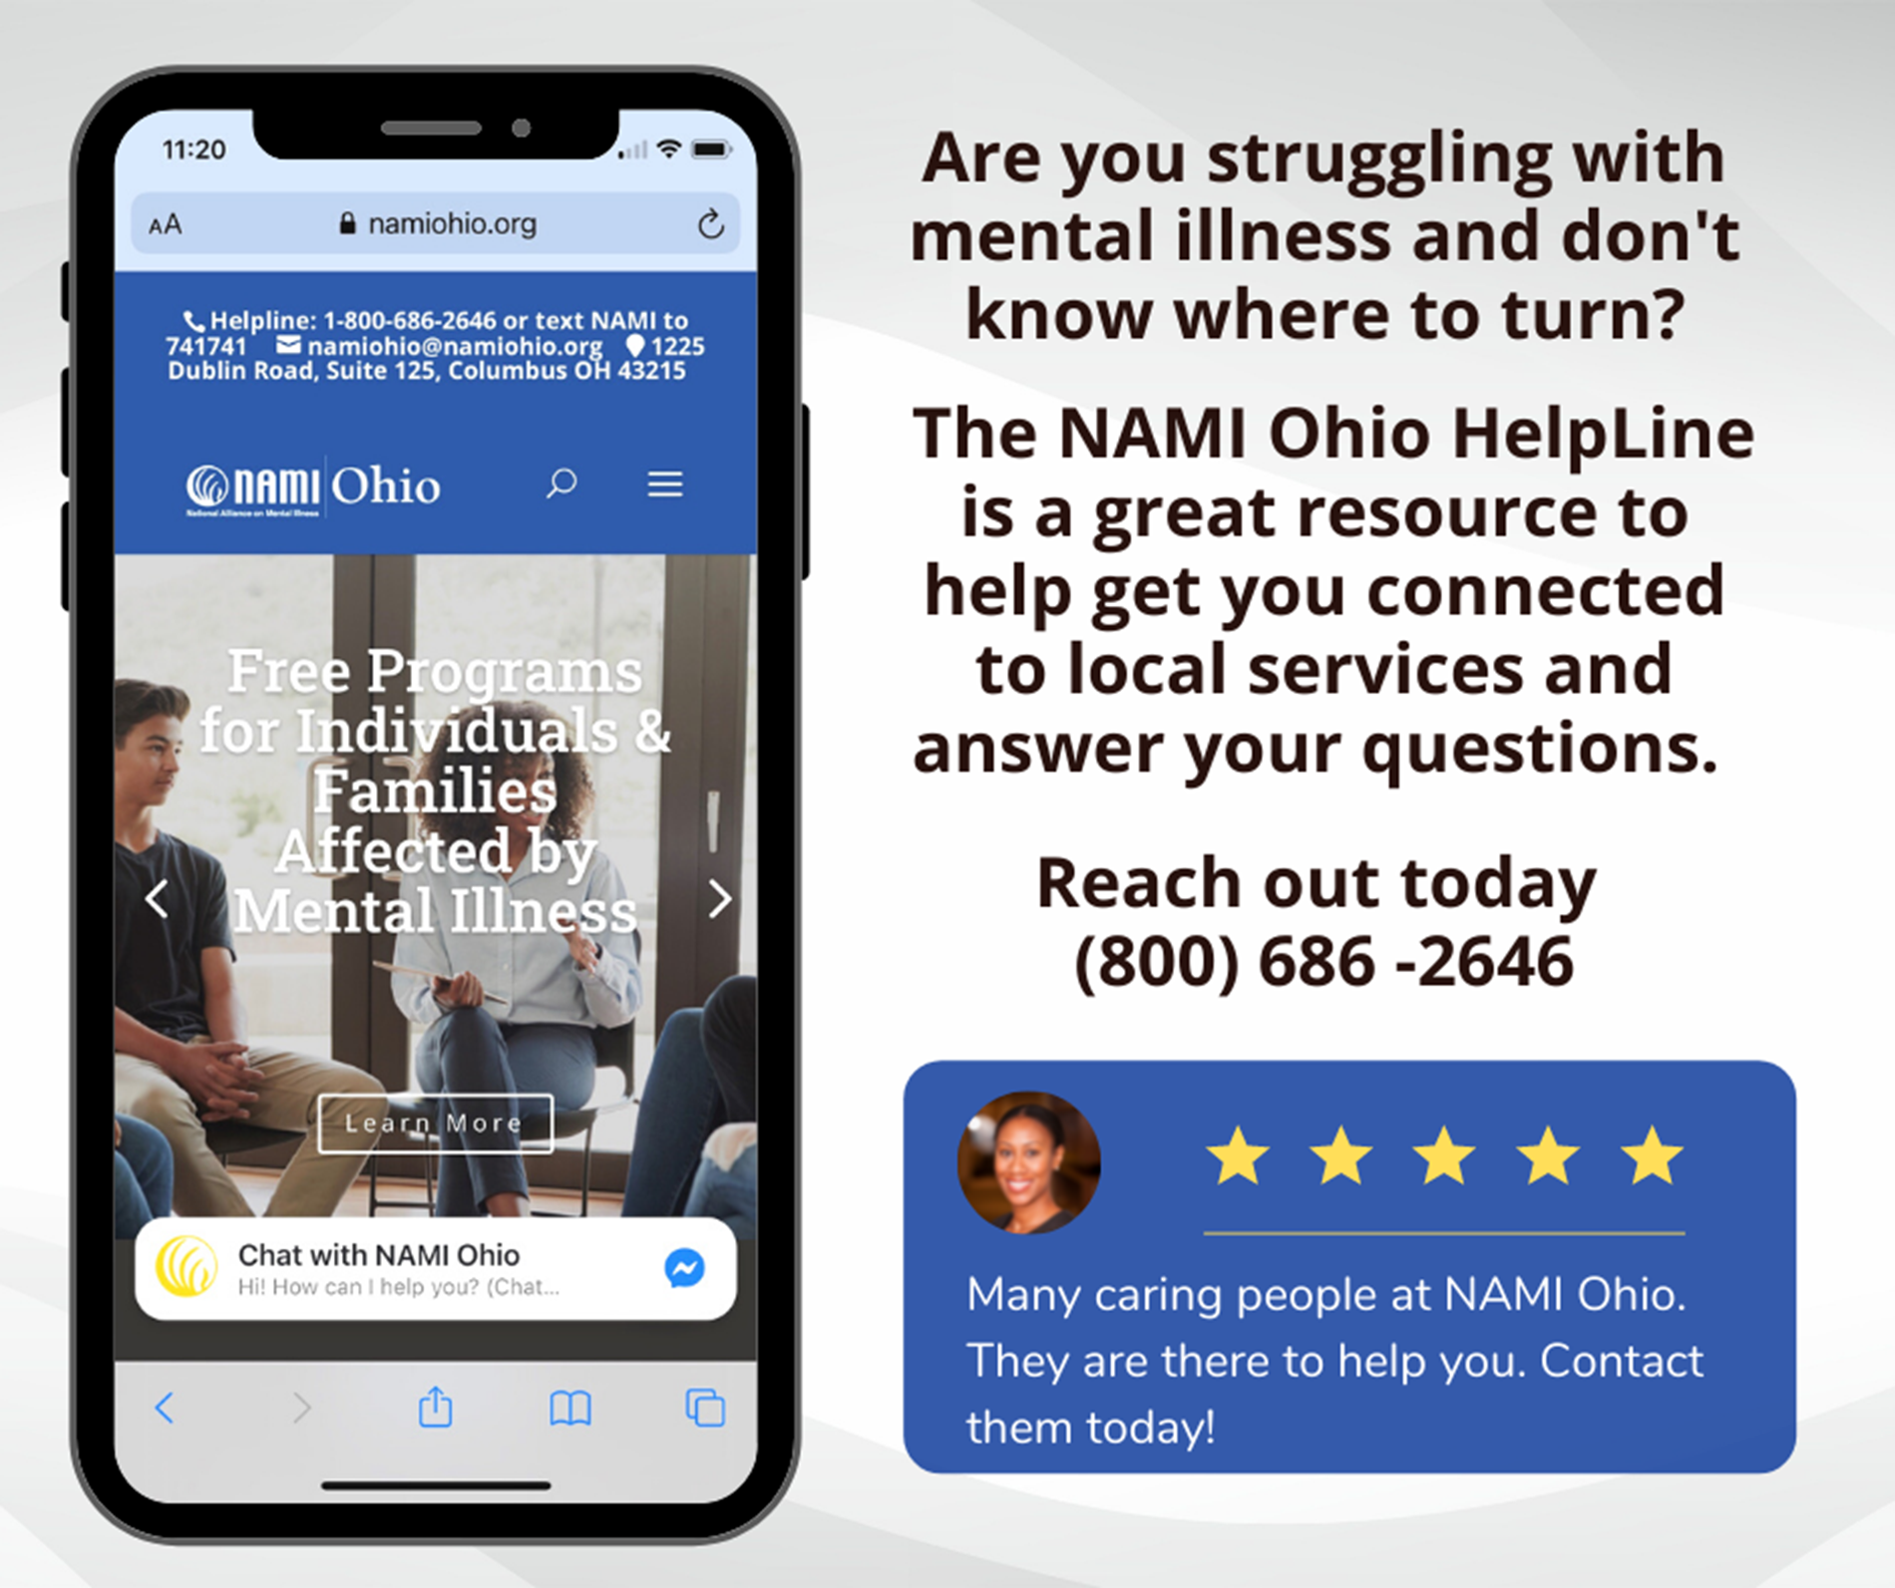
Client Navigation
Anyone can reach out through our:
Help & Referral Line
Social Media
Email
Live Chat

Slide 21
Client Navigation
Direct Assistance for Families and Clients
Monday-Friday
9:00am – 5:00pm
Call, Email, or Chat

Slide 22
NAMI Ohio Children’s Division
Family Peer Support
An individual with lived experience as the primary caregiver or parent of a child or children for whom they have navigated multiple child serving systems.
NAMI Next Gen
NAMI Next Gen is a group of youth and young adult voices throughout Ohio that will be advising, creating, and innovating how NAMI works with youth and young adults.

Slide 23

Children’s Division Staff

Slide 24
NAMI Ohio’s Advocacy Priorities

Slide 25
A Person-Centered Approach – Cross System Collaboration
A new focus on services for those with serious and persistent mental illness beyond the typical community mental health treatment model will save lives by increasing access to care.
More Ohioans are needing and getting the mental health services and help they need. It is now time that we prioritize the development and funding of a comprehensive person-centered, client navigation system for people with Severe and Persistent Mental Illnesses (SPMI). We can all work together to improve experiences, outcomes, and lives for people with SPMI by doing three things:
  Identify people with SPMI and prioritize working to improve their lives We need to develop and implement a shared definition of SPMI, so that plans, boards, and providers all can identify people with SPMI and implement needed care and improvement initiatives.
  Ensure access to the full continuum of person-centered services for people with SPMI We need to work together to determine the comprehensive services that should be available to people with SPMI, including responsive Person-Centered Care Coordination, critical social and relational care such as housing and supported employment, and needed crisis and acute care services.
  Committing to accountability for availability of care and responsive person-centered care coordination We need to identify who is responsible to people with SPMI and their families for ensuring access to needed services; and who is accountable for responsive Person-Centered Care Coordination for each Ohioan with a SPMI and their families.
"The system isn’t broken, it was just never fully built, and it does not exist everywhere in Ohio… yet. “
Ohio Governor, Mike DeWine

Slide 26
NAMI Ohio Collaboration

Slide 27
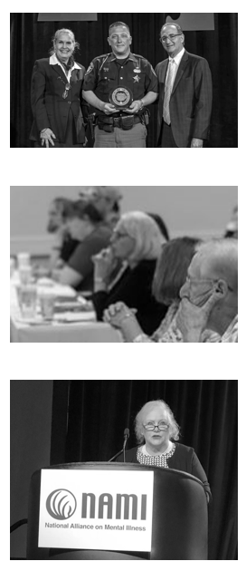
NAMI Ohio works with partners to provide the family and peer voice in several areas of importance:
Crisis Intervention Team Training – in partnership with the Criminal Justice Coordinating Center of Excellence at NEOMED
Ohio Stepping Up Initiative – Core Team
Coalition of Health Communities – Chair
Ohio Department of Mental Health and Addiction Services – committees and workgroups
RecoveryOhio
The Ohio Council of Behavioral Health Providers
Ohio Association of County Behavioral Health Authorities
Ohio Department of Medicaid
Ohio Department of Rehabilitation and Corrections
Ohio Adult Care Facilities Association
And many other agencies and organizations providing services and supports to individuals with serious mental illness and their families

Slide 28
Criminal Justice and Mental Health
Our Mission:
This includes those involved in the Criminal Justice System.
Key Efforts:
  Stepping Up
  CIT
  Ohio Department of Rehabilitation and Corrections
  Attorney General’s Taskforce on Criminal Justice and Mental Health
Best Practices:
  Building partnerships
  Advocating for community resources
  Engagement of peers and those with lived experience

Slide 29
Stepping Up Initiative
The Stepping Up Initiative is a national initiative targeted at reducing the number of people with mental illnesses in jails. Without change, large numbers of people with mental illnesses (many with co-occurring substance use disorders) will continue to cycle through the criminal justice system, often resulting in missed opportunities to link them to treatment, tragic outcomes, inefficient use of funding, and failure to improve public safety.
The mission of the Stepping Up Initiative is to help criminal offenders with mental illnesses get connected to clinical treatment and other services so they can get well, make positive life changes, and stay out of jail. Directed by Ohio Supreme Court Justice Evelyn Lundberg Stratton (ret.) and along with other state and county leaders, Stepping Up Ohio is supported by the CSG Justice Center and is generously funded by Peg’s Foundation.
NAMI Ohio is on the Steering Committee and participates in Monthly engagement meetings with Counties throughout Ohio. We are also part of the AG Taskforce on Criminal Justice and Mental Health (I co-chair the Public Policy Committee). We also act as the fiscal agent with this Initiative.
More Information: https://stepuptogether.org

Slide 30
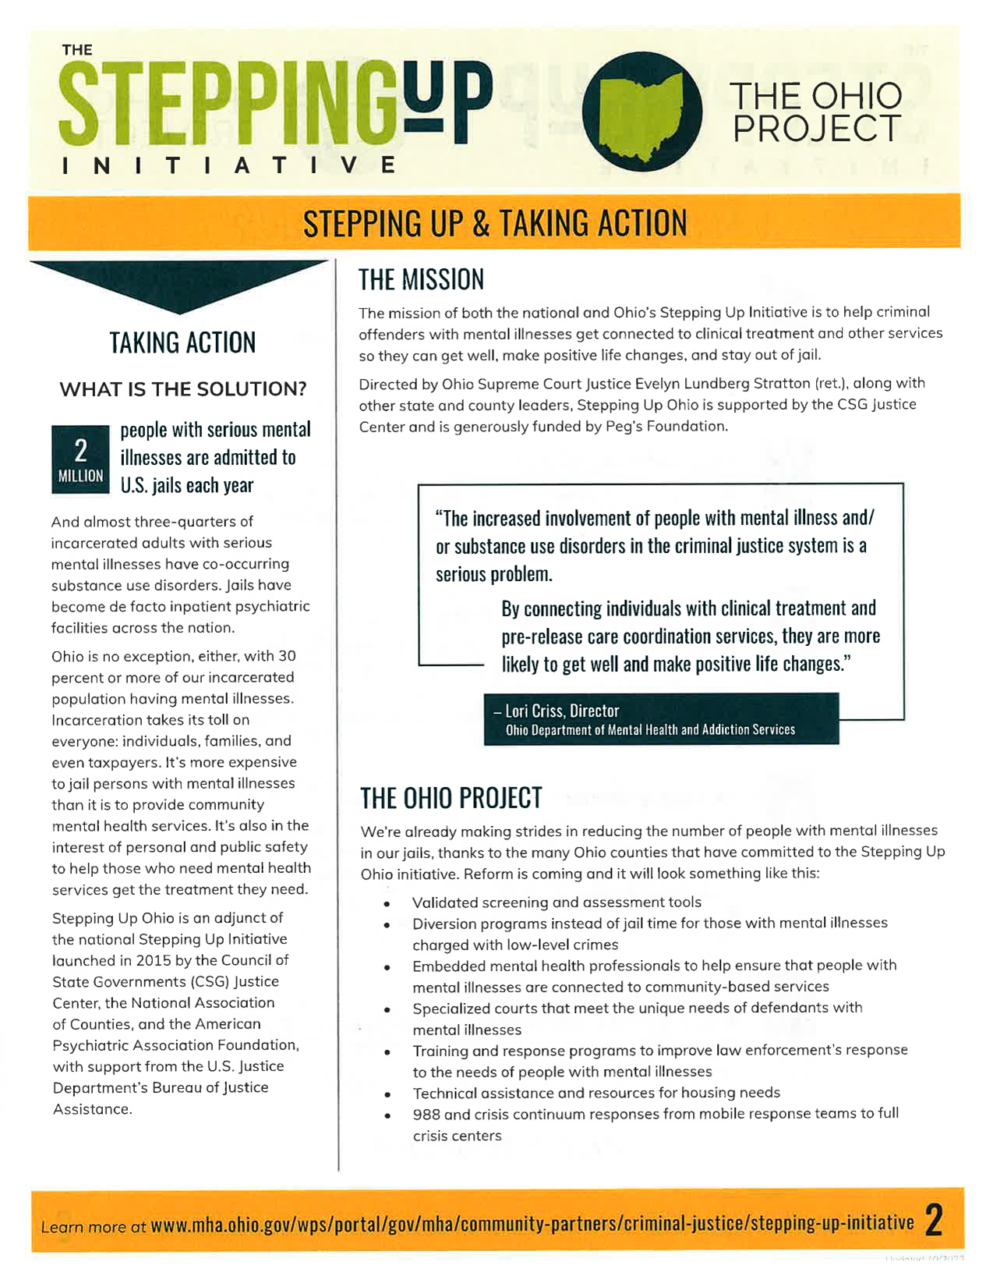
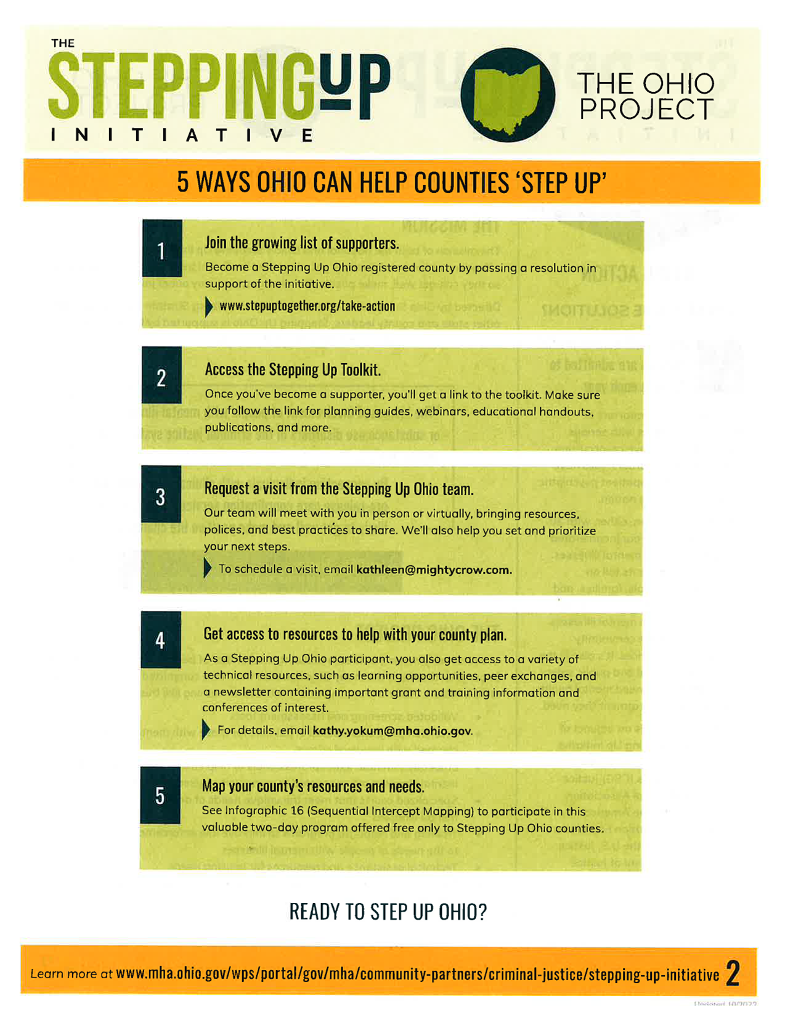

Slide 31
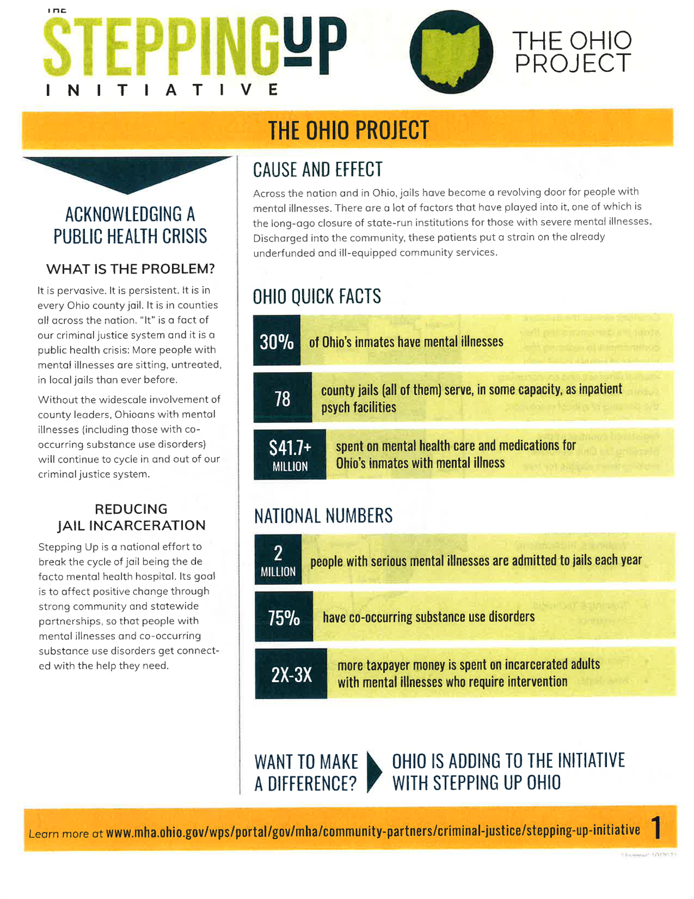
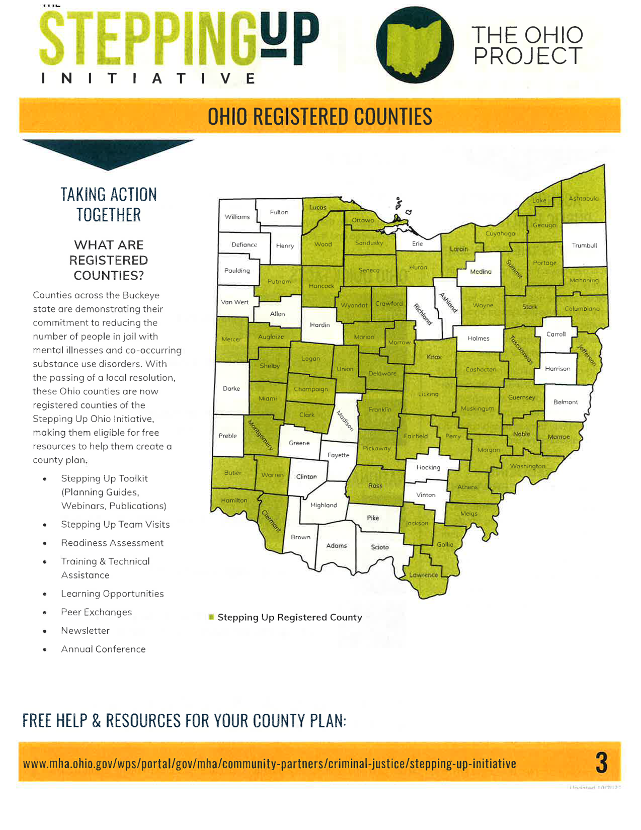

Slide 32
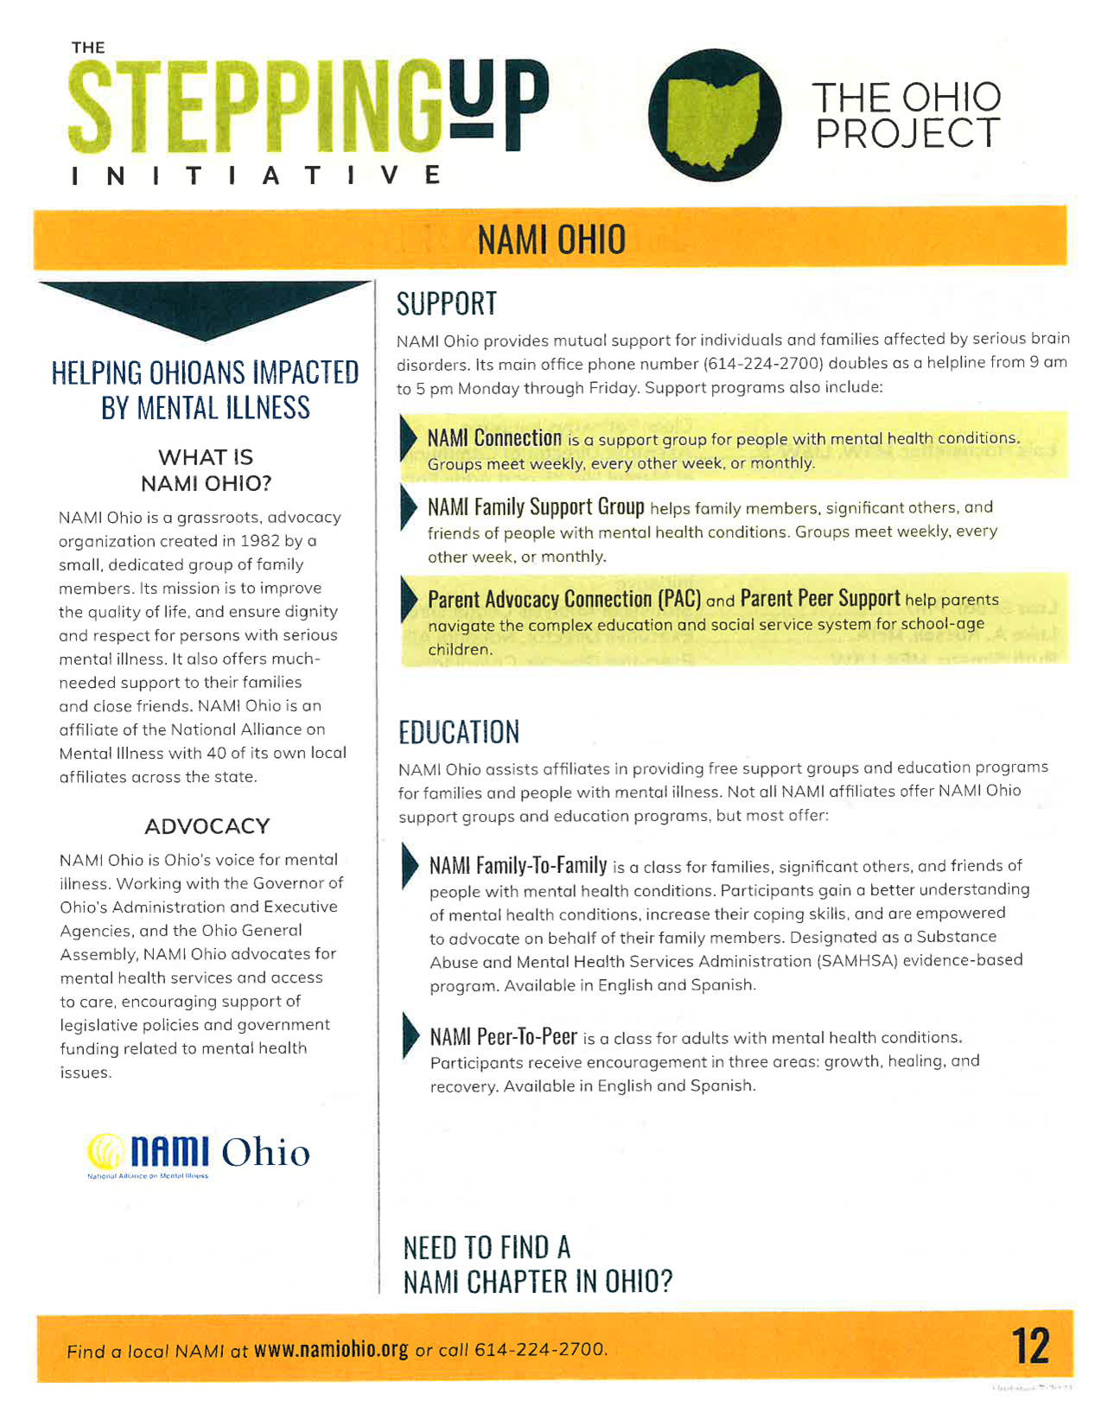
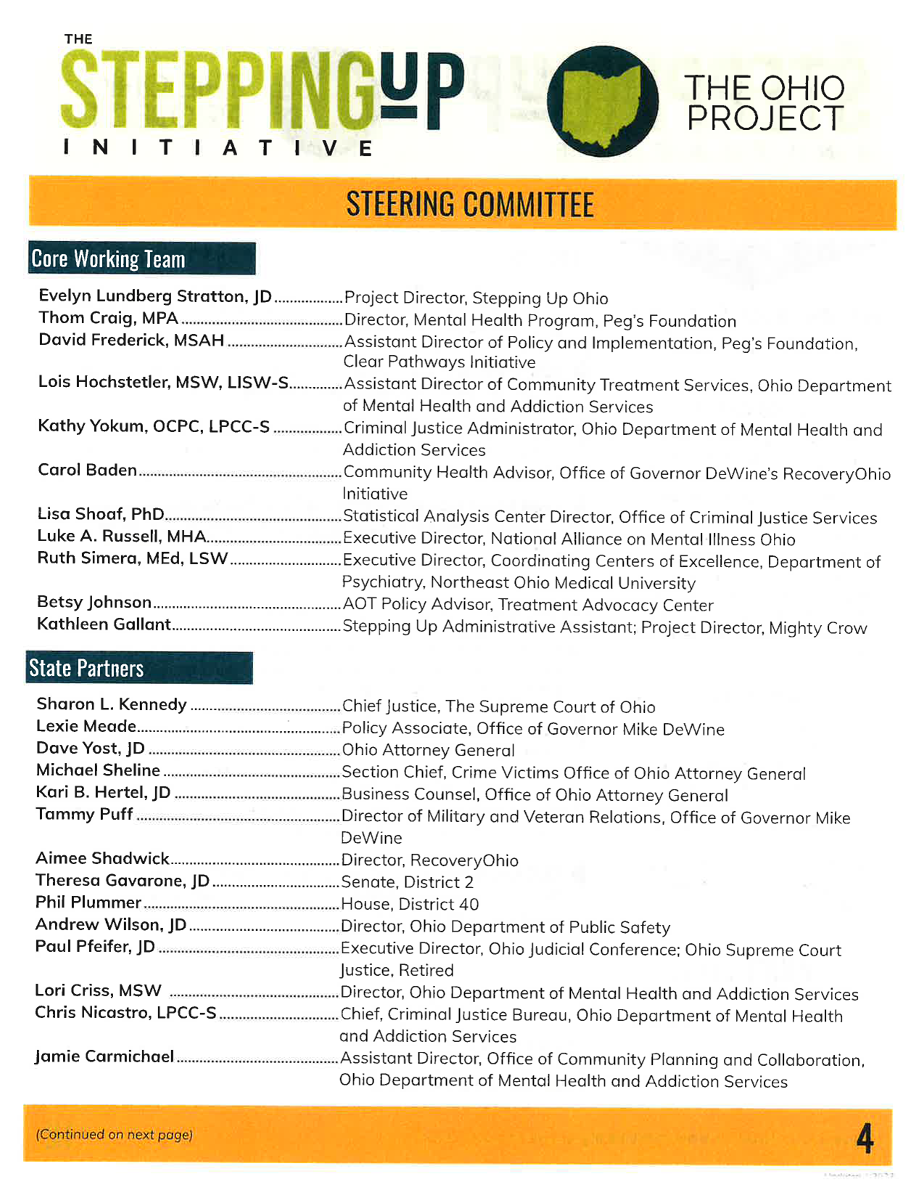

Slide 33
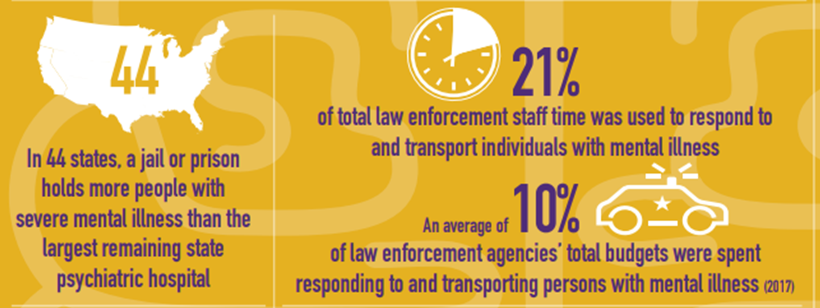
Crisis Intervention Team
With de-institutionalization and the use of community-based treatment, chances are very likely that police will encounter an individual with mental illness. This has had varying degrees of success throughout history. In 1989 in Memphis Tennessee there was a police shooting involving an individual experiencing mental illness. This caused the individuals in Memphis to re-evaluate their training, and they realized they lacked education on mental illness for their officers. Which leads us to the creation of the Crisis Intervention Team training model, which is a specialized police-based program intended to enhance officers’ interactions with individuals with mental illnesses and improve the safety of all parties involved in mental health crises.
The model states that to be successful it involves several different systems to work together including providers from the mental health system, advocacy (NAMI), as well as law enforcement.

Slide 34
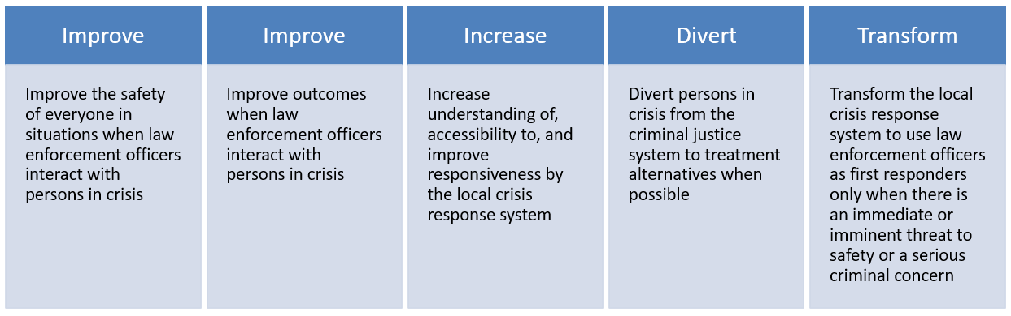
Goals for C.I.T.

Slide 35
Ohio CIT Expansion Grant 2019 - 2023
Since 2019 and the inception of Ohio CIT Support and Expansion, NAMI Ohio has delivered approximately 1 million grant funds to support:
260 Patrol Officer Training Courses
167 Advanced, Refresher, and Role-Specific Courses
122 Law Enforcement Scholarships
244 Lived Experience Stipends
25 Other Opportunities like Data Collection
11 CIT Peer Reviews
3 Ohio CIT Conferences

Slide 36
Impact CIT has in Law Enforcement
Reduced overall time spent on mental health calls.
  Officers have the tools to recognize scenarios involving a mental health crisis and respond appropriately.
    Observable characteristic of a person in crisis
    De-escalation goals known
    Reduces officer time spent involved with rehabilitation, court or internal investigations.
Lower Incidence of injury and Use of Force
  CIT trained officers perceived themselves as less likely to escalate to the use of force in a hypothetical mental health crisis.
Cost Savings
  Less Injury
  Incarceration
  Court/Prosecution

Slide 37
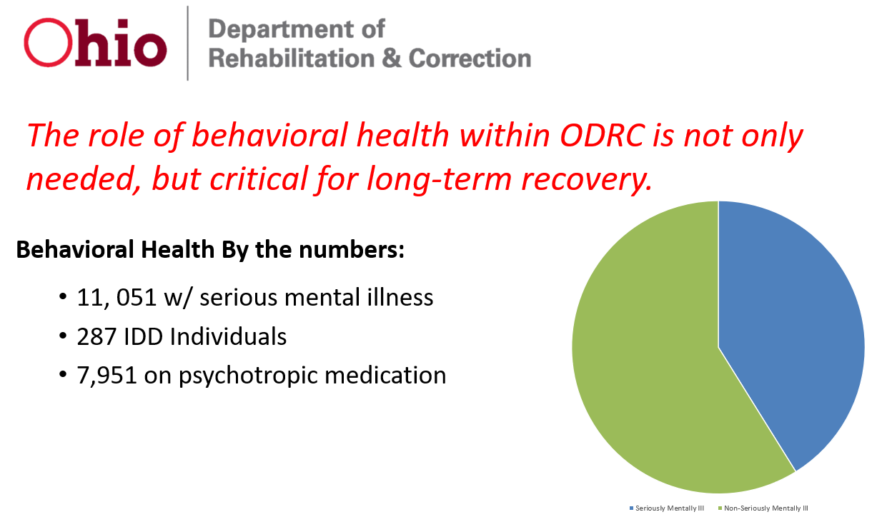

Slide 38
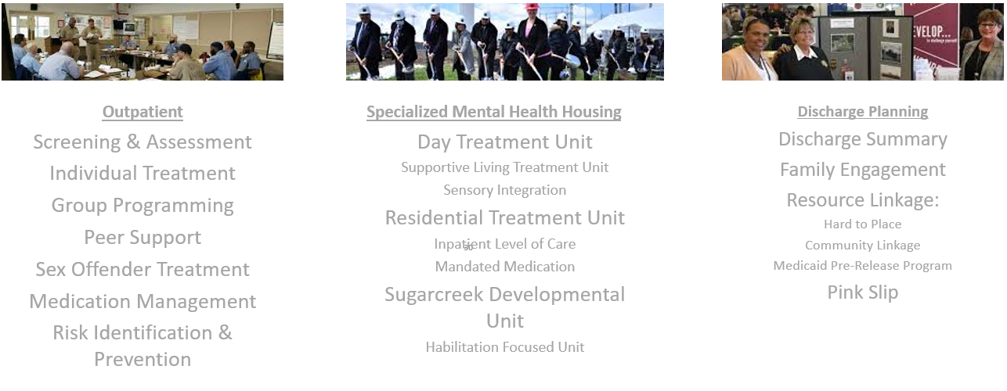
Behavioral Health Services in ODRC

Slide 39
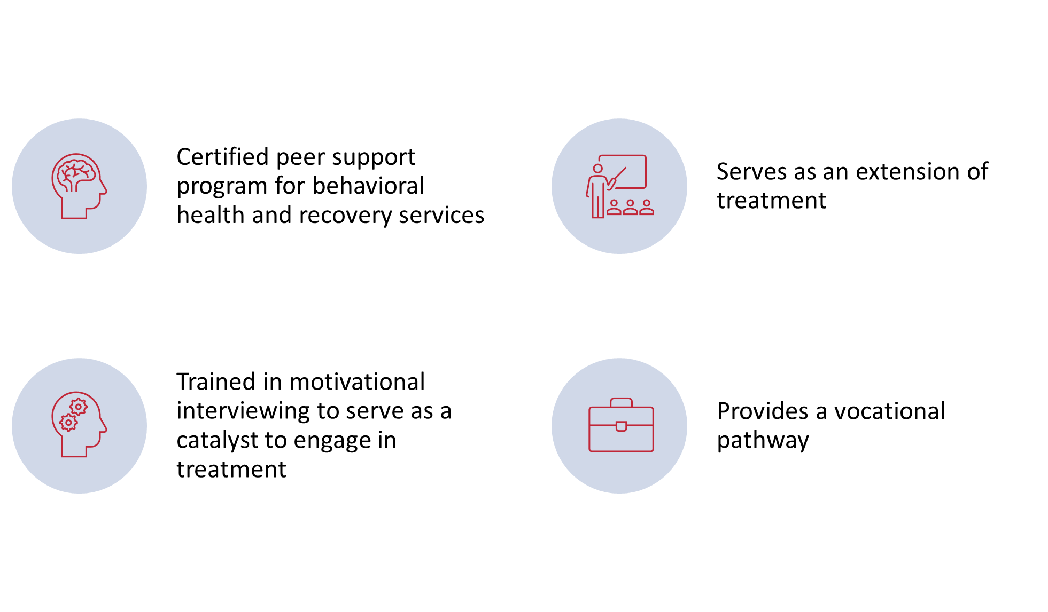
Peer Support in ODRC
116 Peer Supports Trained to Date

Slide 40
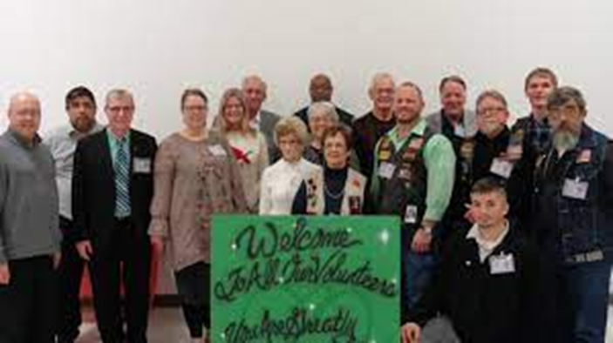

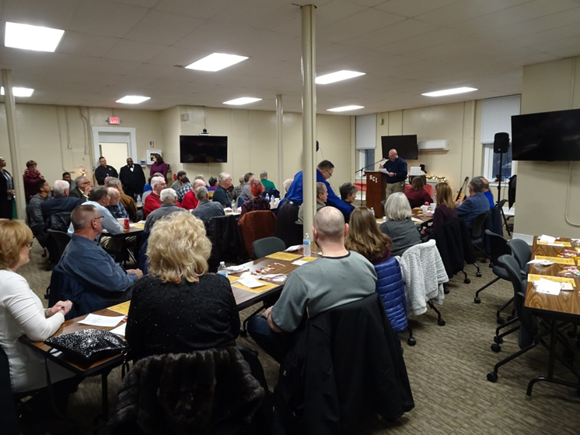
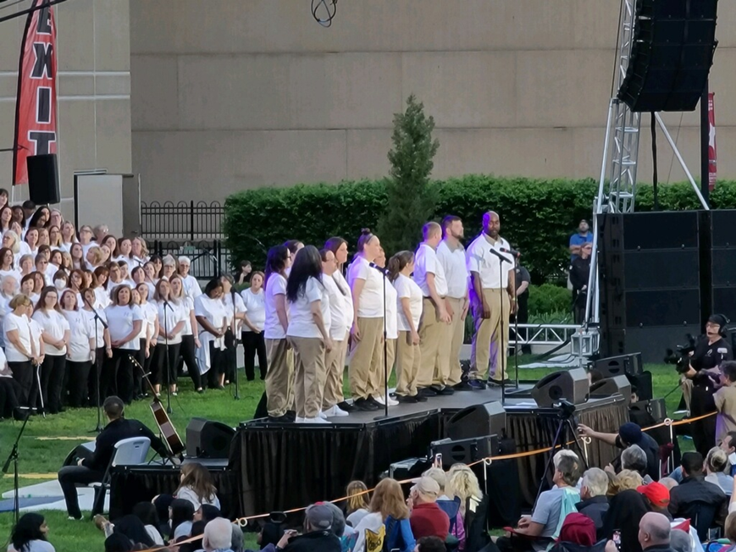
Partnership with ODRC
Continuity of Care
Participation in Health and Re-Entry Fairs
Advocacy
Reducing the Stigma
CIT
Peer-to-Peer (AOCI)

Slide 41
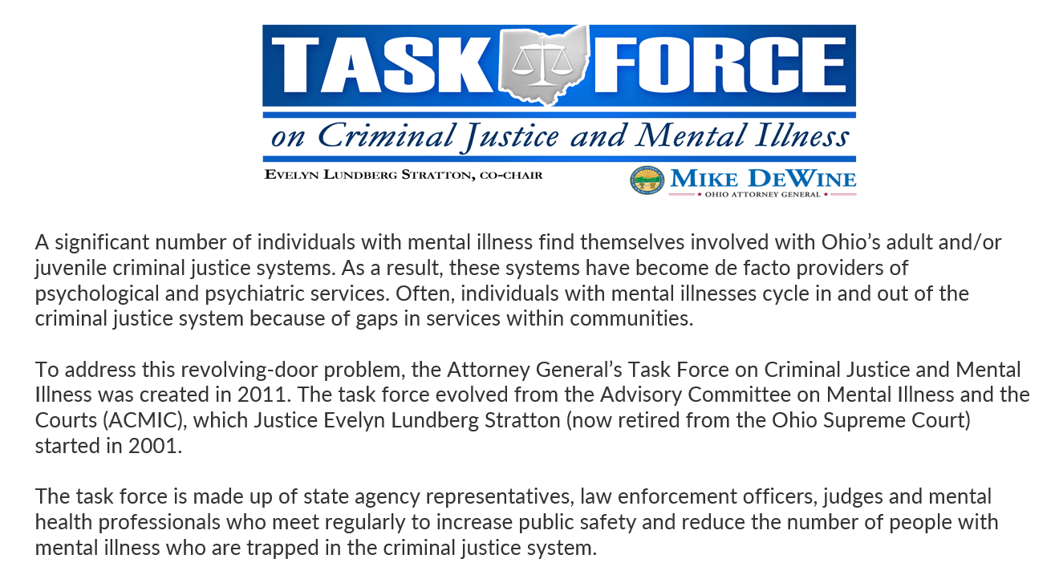

Slide 42
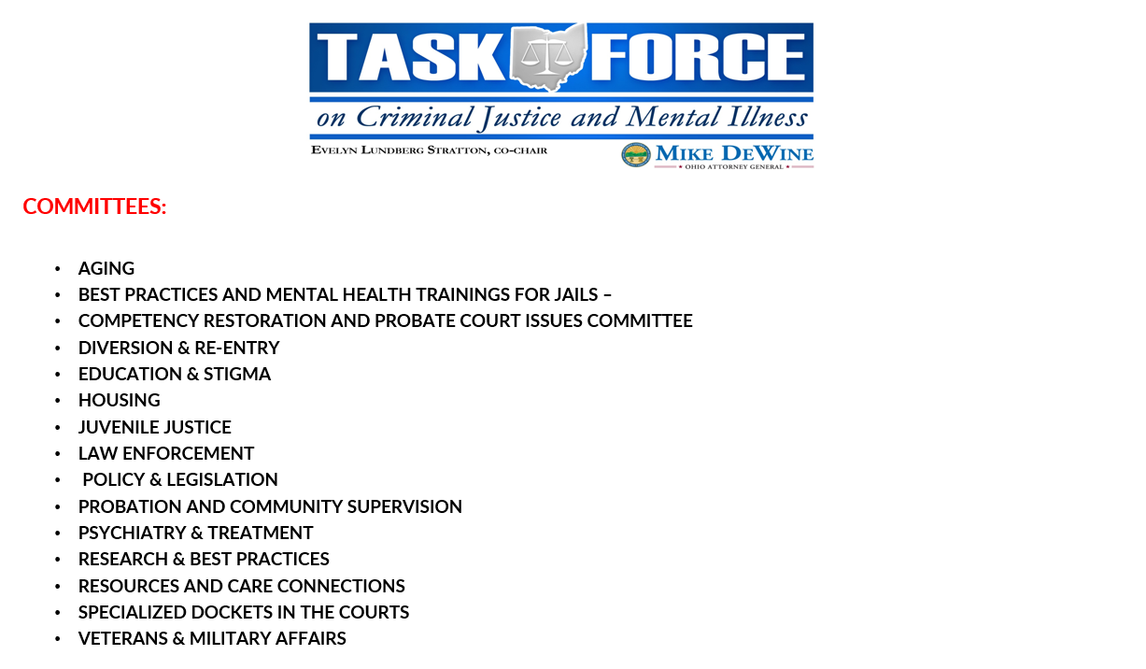

Slide 43
Other NAMI Ohio Staff

