Slide 1
Crime Victims’ Rights in Ohio Post Marsy’s Law
The Current Legal Landscape for Ohio’s Crime Victims

Slide 2
Who is a victim?
Marsy’s Law and HB 343 Changes

Slide 3
Ohio Constitution, Article I, Section 10a(D)
Marsy’s Law and R.C. 2930.01 expand the legal definition of victim to protect the person against whom the criminal offense or delinquent act was committed and/or the person directly and proximately harmed by the criminal offense or delinquent act.

Slide 4
Who is “directly and proximately harmed”?
Parents of child victims?
Families of homicide victims?
Others?

Slide 5
RC 2930.044
Any person claiming victim status by virtue of being directly and proximately harmed by the criminal offense or delinquent act must identify themselves to criminal justice officials to exercise rights.

Slide 6
What are a victim’s rights?

Slide 7
Rights Applicable Throughout the Process
Rights with application throughout the criminal justice process and beyond

Slide 8
Wait, what does “and beyond” mean?

Slide 9
Ohio Constitution, Article I, Section 10a(B)
The victim, the attorney for the government upon request of the victim, or the victim's other lawful representative, in any proceeding involving the criminal offense or delinquent act against the victim or in which the victim's rights are implicated, may assert the rights enumerated in this section and any other right afforded to the victim by law. If the relief sought is denied, the victim or the victim's lawful representative may petition the court of appeals for the applicable district, which shall promptly consider and decide the petition.

Slide 10
Case Law Spotlight
Rights to Safety and Reasonable Protection
The Ohio Supreme Court decided that victims’ rights apply in application for relief from firearms disability proceedings, even though these proceedings are not criminal in nature.
State ex rel. Suwalski v. Peeler, 2021-Ohio-4061, ¶ 20.

Slide 11
Case Law Spotlight
In S.D. v. S.L., 2023-Ohio-4575, ¶ 26 (6th Dist.), the court stated that victims’ rights would apply in the context of a civil protection order case.

Slide 12
Ohio Constitution, Article I, Section 10a(A)(1)
Right to be treated with fairness and respect for:
Safety
Dignity
Privacy

Slide 13
Right to Privacy: RC 2930.07
Victims have the right to redaction of their names, addresses, and identifying information from public records, upon request.
In certain instances, victims may receive this right automatically until contacted by the prosecutor.
Victims may make a request for redaction using the Victims’ Rights Request Form (VRR form) or any other method in writing.
Victims have the right to unredacted versions of their own records.
Victim preferred contact information may be shared with victim service organizations who are designated by LE or prosecutors without waiving the right to redaction.

Slide 14
Right to Protection: Ohio Constitution, Article I, Section 10a(A)(4)
Marsy’s Law provides victims with the right to reasonable protection from the accused and those acting on behalf of the accused.

Slide 15
Case Law Spotlight
Rights to Safety and Reasonable Protection
The Eighth District Court of Appeals held that a trial court must notify a victim of a probation or community control revocation disposition proceeding or any proceeding in which the court is asked to terminate the probation or community control.
State v. Malfregeot, 2024-Ohio-257, ¶ 11 (8th Dist.).

Slide 16
Right to Effective Communication: RC 2930.041
Victims with disabilities have the right to a registered or certified American Sign Language interpreter on the registry for interpreters for the deaf at the following times:
All court proceedings
All prosecutor meetings
All investigative contacts with LE
All contacts with probation, DRC, and DYS

Slide 17
Right to Effective Communication: RC 2930.041
Victims who are non-English speaking or limited English proficient have the right to a certified, provisional, registered, or language skilled foreign language interpreter at the following times:
All court proceedings
All prosecutor meetings
All investigative contacts with LE
Exception: LE may use technology assisted interpretation services in the field if interpreters are not reasonably available
All contacts with probation, DRC, and DYS
Interpretation services guaranteed under this section are subject to availability but not cost

Slide 18
Right to Effective Communication: RC 2930.041
Interpretation services are provided at no cost to the victim and shall be paid for as follows:
By the court at all hearings and probation contacts
By the prosecutor at all meetings with the prosecutor
By the LE agency at all contacts with LE
By the custodial agency at all contacts with DRC and DYS

Slide 19
The Victims’ Rights Request Form
How the form is created, its format, and who gets it when

Slide 20
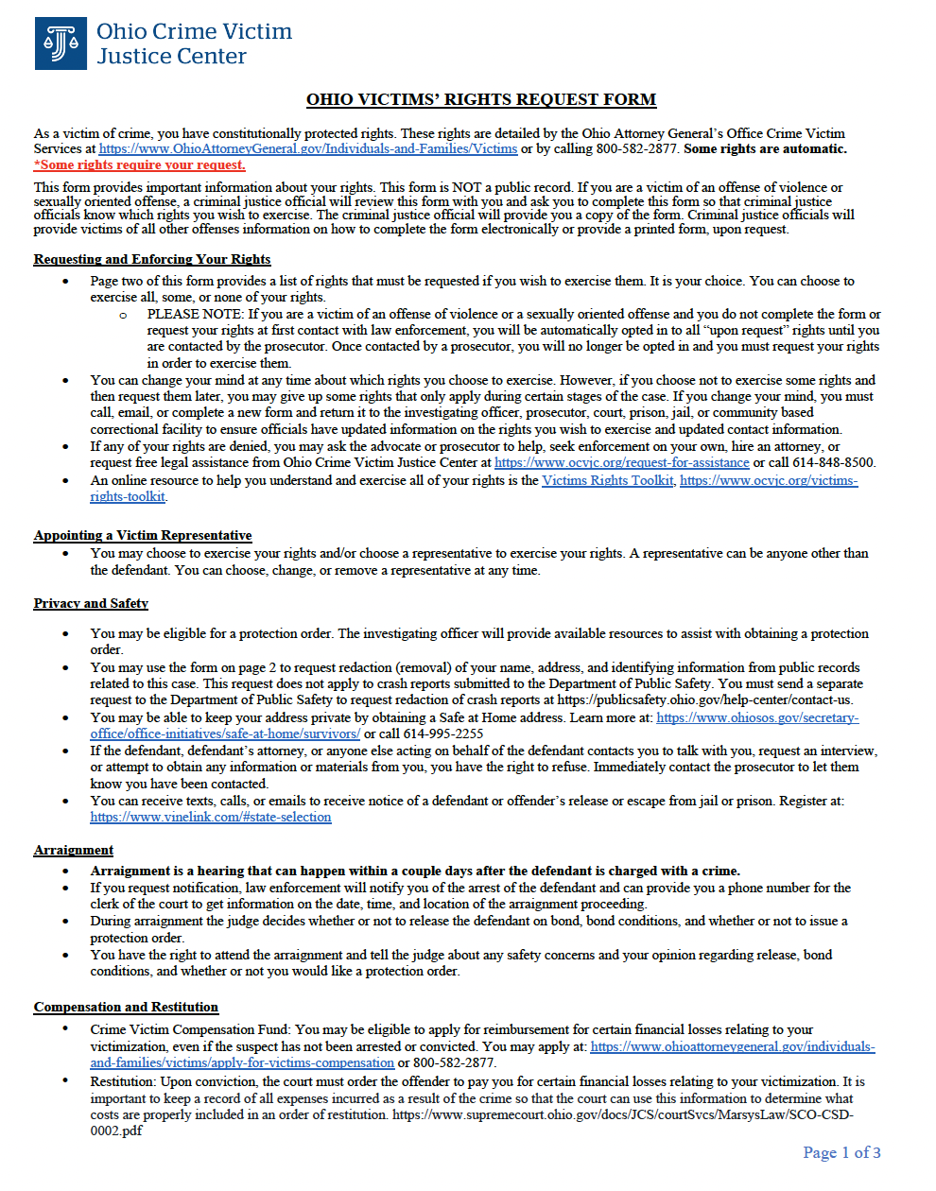
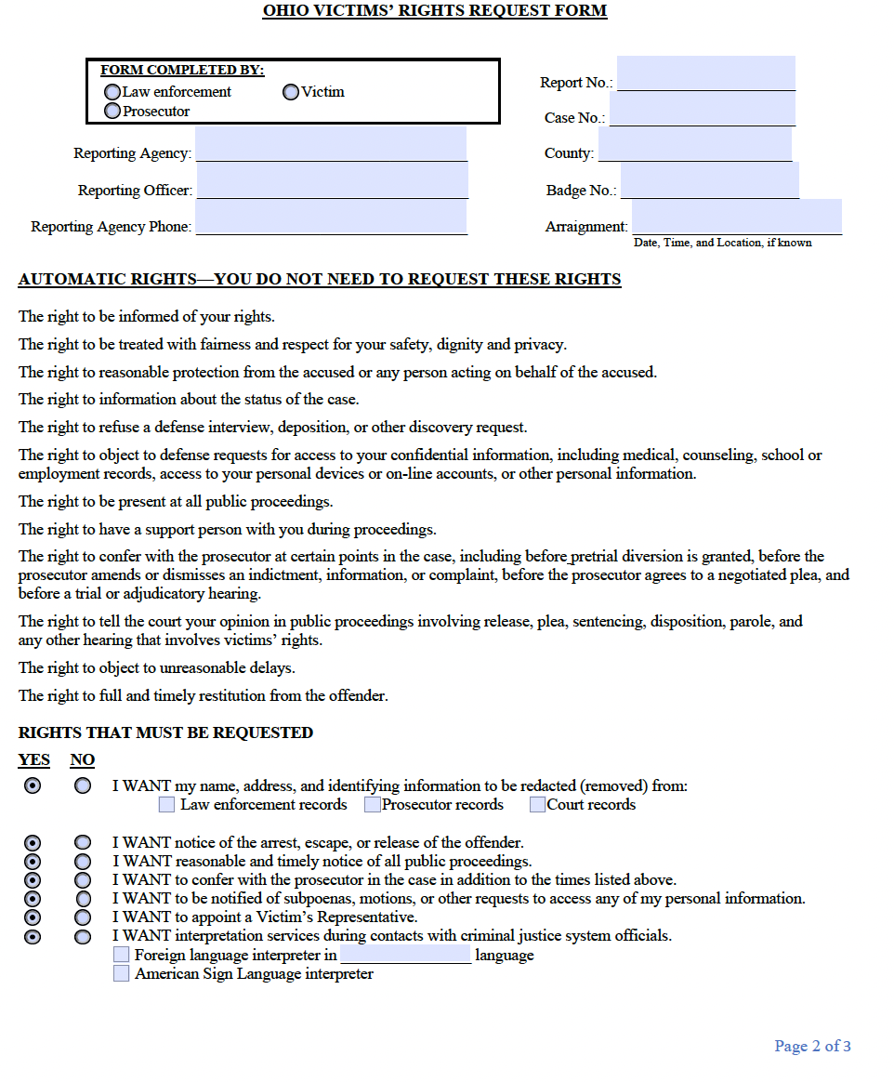
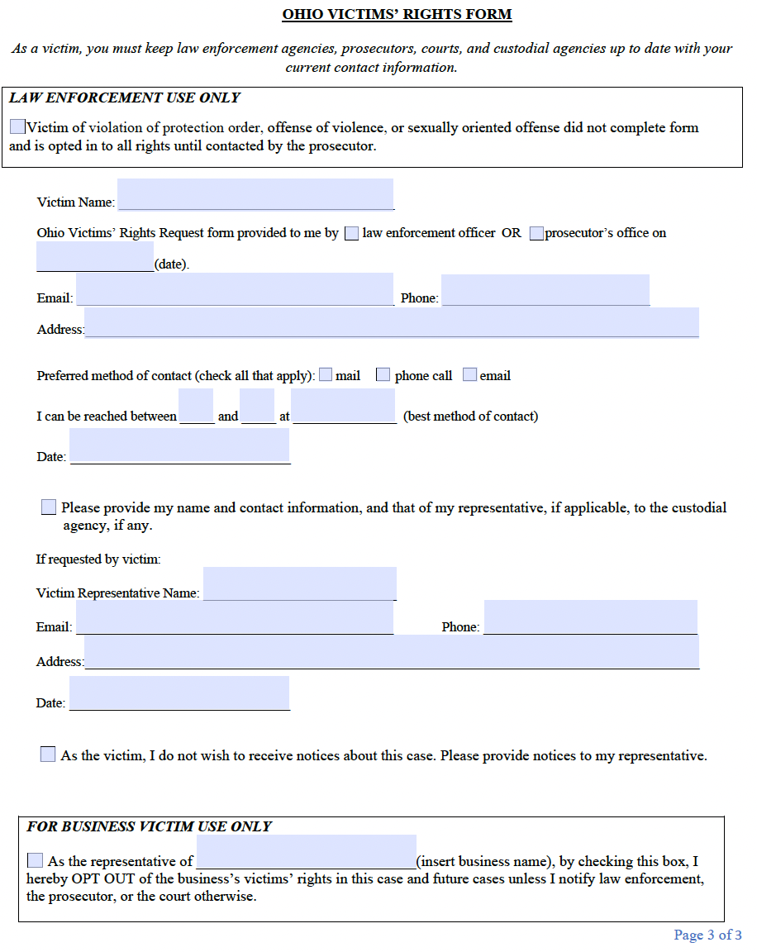

Slide 21
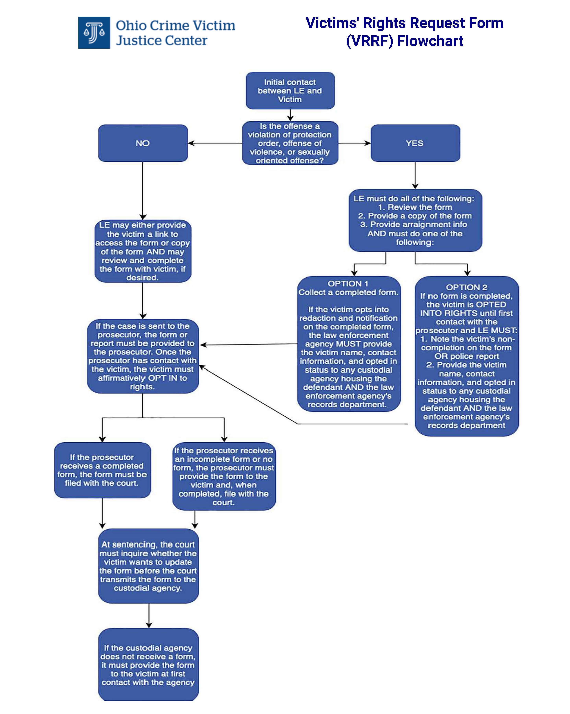

Slide 22
Right to Notice: Ohio Constitution, Article I, Section 10a(A)(2)
Marsy’s Law provides victims the right to reasonable and timely notice of all public proceedings, upon request.

Slide 23
Right to Notice: RC 2930.06
Specifically, victims are entitled to notice seven days prior to the hearing, unless shorter notice is reasonable under the circumstances
Victim and representative must keep prosecutors updated with current contact information
Prosecutors must attempt notice at least one time and record this attempt

Slide 24
Methods of Notice: RC 2930.06 & 2930.16
Prosecutors and courts, if applicable, must keep records of attempts to notify including
Recipient of notice
Date of notice
Manner of attempt
Person who made attempt

Slide 25
Case Law Spotlight
Right to Notice
The Eighth District Court of Appeals held that a trial court must reopen sentencing after a victim was not notified of the hearing and was, therefore, unable to be present, heard, and seek restitution.
City of Cleveland v. Rudolph, 2022-Ohio-2363, ¶ 1 (8th Dist.).

Slide 26
Right to be Present: Ohio Constitution, Article I, Section 10a(A)(2)
Marsy’s Law provides that victims have the right to be present at any public proceeding.

Slide 27
Right to be Present and Heard: RC 2930.09
If victim or representative are not present at a proceeding implicating the victims’ rights, the Court MUST ask prosecutor:
If victim requested notice, was the victim notified of time, place, and purpose of proceeding?
The prosecutor must disclose:
Attempts to provide notice
Whether victim and representative were advised of right to be heard at proceeding
Whether the victim and representative were conferred with

Slide 28
Right to be Present and Heard: RC 2930.09
If timely notice was not given, inadequate information about proceeding was given, or the prosecutor failed to confer, the court cannot rule on any substantive issue that implicates victims’ rights, accept a plea, impose a sentence, and shall continue for the time necessary to notify the victim.
If victim and representative are not present, the court may proceed if prosecutor informs court that victim was notified of time, place, and purpose of hearing, which attempts were made to contact them, and informs court of victim’s position relative to proceedings.

Slide 29
Right to be Present and Heard : RC 2930.09
Victims and representatives have right to be present at:
Arraignment
Any hearing on release
Any hearing to terminate probation or community control
Any hearing to modify the terms of probation or community control

Slide 30
Right to be Heard: Ohio Constitution, Article I, Section 10a(A)(3)
Marsy’s Law provides victims with the right to be heard in any public proceeding involving release, plea, sentencing, disposition, parole, OR any time a victim’s right is implicated.

Slide 31
Right to Notice: RC 2930.12
Within seven days, victims must be notified of:
Acquittal or conviction for each offense
Purpose of pre-sentence investigation (PSI) and right to view PSI
Contact info for probation officer conducting PSI
Sentence imposed and subsequent modifications
Including right to file restitution lien, if applicable
Right to make victim impact statement (VIS)
VIS may be disclosed to defendant

Slide 32
Right to be Heard: Pre-Sentence Investigations
Probation must contact the victim to request a written victim impact statement to include in the PSI.
VIS should contain information about the physical, psychological, and financial impact on the victim.
VIS can contain the restitution request with supporting documentation and victim’s sentencing recommendation.

Slide 33
Right to View PSI: RC 2930.131
If a PSI is available to the defense, the prosecutor must also be given a copy.
The prosecutor must forward a copy to the victim and representative.
If any portion of the PSI is redacted, the court must explain this on the record.

Slide 34
Right to Restitution: Ohio Constitution, Article I, Section 10a(A)(7)
Marsy’s Law makes restitution mandatory so long as the victim can prove their losses.
Losses must be proven by competent, credible evidence.
Alert victims to save receipts, invoices, estimates, medical bills, etc.
Losses may also be proven by testimony

Slide 35
Right to Restitution: RC 2152.20, RC 2152.203, RC 2929.18, RC 2929.28, RC 2929.281
Examples of compensable losses include, but are not limited to:
Full or partial payment for the value of stolen or damaged property. The value of stolen or damaged property shall be the replacement cost of the property or the actual cost of repairing the property when repair is possible.
Medical expenses;
Mental health counseling expenses;
Wages or profits lost due to injury or harm to the victim as determined by the court. Lost wages include commission income as well as base wages. Commission income shall be established by evidence of commission income during the twelve-month period prior to the date of the delinquent act for which restitution is being ordered, unless good cause for a shorter time period is shown.
Expenses related to making a vehicle or residence accessible to the victim if the victim is partially permanently disabled or totally permanently disabled as a direct result of the delinquent act.

Slide 36
Right to Restitution: RC 2152.20, RC 2152.203, RC 2929.18, RC 2929.28, RC 2929.281
Court must order full restitution that is proven by a preponderance of evidence.
An offender’s tax return can be seized to pay restitution.
A restitution order does not expire until paid in full. Upon termination of court’s jurisdiction, it becomes an automatic civil judgment for the victim, at no cost to the victim.
The Supreme Court must create a form to assist victims in requesting restitution.

Slide 37
Right to Restitution: Practical Tips
A court can, and should, set a restitution hearing separate from sentencing if needed.
A restitution hearing is only required if the defendant disputes the restitution amount.
Restitution can be proven by receipts or testimony or both, but testimony alone can be sufficient.

Slide 38
Case Law Spotlight
Right to Restitution
The Ohio Supreme Court held that restitution cannot be ordered for victim lost wages, mileage, etc. incurred in attending court proceedings.
State v. Yerkey, 2022-Ohio-4298, ¶ 16.

Slide 39
Post-Conviction: Prison
Phases of the Criminal Justice Process

Slide 40
VRR Form Process Cont’d
If a defendant is convicted and sentenced to incarceration, the court must ask the victim if the victim wishes to update the VRR form.

Slide 41
Right to Notice: Ohio Constitution, Article I, Section 10a(A)(5)
Under Marsy’s Law, upon request, victims are entitled to notice of any release or escape of the offender.

Slide 42
Right to Notice: RC 2930.16
Upon request, prosecutors must notify victims of:
Incarceration and release date of offenders
Information on Ohio Department of Rehabilitation and Correction (DRC) or Ohio Department of Youth Services (DYS) Office of Victims’ Services
Hearings on judicial release
If judicial release is being considered, the court must inform the prosecutor at least seven days before the hearing.
The prosecutor must then notify the victim and representative of the hearing, and the right to be present and heard.

Slide 43
Victims’ Rights Request Form Process: RC 2930.16
On first contact with a victim, the custodial agency must verify the victims’ choices in the VRR form.
If no VRR form was transmitted to the custodial agency, it must send one to the victim.
Any victim by virtue of being directly and proximately harmed by an offense must identify themselves to the custodial agency.

Slide 44
Right to Notice and to be Heard: RC 2930.16
Victims of violent felony offenses of the 1st, 2nd, or 3rd degree** will automatically receive the following notifications from DRC or DYS at least 60 days in advance:
Pardon or commutation
Parole, including an opportunity to attend parole board hearing and make a statement prior to parole
Transfer to transitional control
**Other victims MUST REQUEST these notices
These victims also have the right to attend victim conferences with at least three victim family members to discuss the case privately with DRC.

Slide 45
Right to Notice: RC 2930.16
In addition, victims of violent felony offenses of the 1st, 2nd, or 3rd degree** will receive notice of:
Escape and recapture within three days
Death within 30 days
DRC petition for early release within 30 days
**Other victims MUST REQUEST these notices

Slide 46
Right to Notice: RC 2930.162
Before the governor grants pardon, commutation, or reprieve for an offense of violence, the governor’s office shall notify victim, representative, and victim counsel of the application for pardon, commutation, or reprieve at least 30 days before issuing decision.
Victim and representative may submit a written statement and must be informed of this right.

Slide 47
Right to be Present and Heard: RC 2930.17
When determining whether to grant judicial release, a court shall allow victim and representative to be heard orally, in writing or both.
Defendant may review a copy of the statement and DRC/DYS shall receive a copy.
The court must consider any victim’s and representative’s statement.
If the court orders release, it shall notify the prosecutor promptly and shall send its journal entry to the custodial agency BEFORE release.

Slide 48
Methods of Notice: RC 2930.06 & 2930.16
Custodial agencies must attempt notice at least three times via either mail, phone, or email.
Custodial agencies must keep records of attempts to notify including
Recipient of notice
Date of notice
Manner of attempt
Person who made attempt
Success of notice if applicable
Records must be kept in such a way to permit public inspection while protecting contact information of victim and representative

Slide 49
Right to Safety: VINE
Advocates or prosecutors should talk to victims about VINE (Victim Information and Notification Everyday—vinelink.com) to track incarcerated offenders.

Slide 50
Post-Conviction: Community Control
Phases of the Criminal Justice Process

Slide 51
Notification to Victim Letters

Slide 52
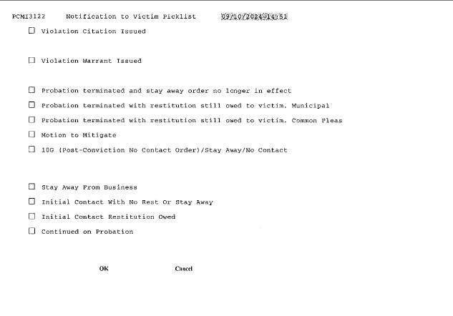

Slide 53
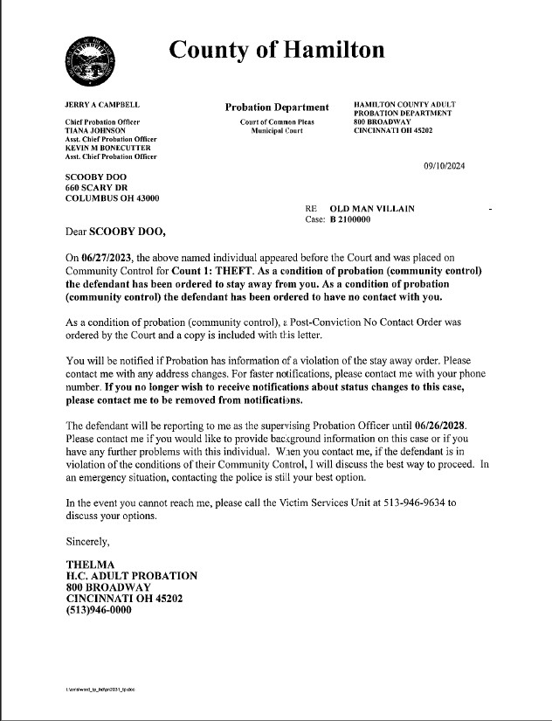

Slide 54
Right to Safety: Post-Conviction No-Contact Orders
If an offender is not incarcerated, the court can provide victim safety by ordering a post-conviction no contact order as a condition of probation.

Slide 55
Rules of Superintendence
RULE 10.02.
(D) Post-conviction no contact order
In every case in which a sentencing court imposes community control sanctions that prohibit contact as part of a sentence for a misdemeanor or felony offense for the purpose of preventing violent or threatening acts or harassment against, sexual violence, or contact or communication with or physical proximity to a victim, regardless of the family or household member relationship to the Defendant, it shall use a form that is substantially similar to “Form 10-G” and send to the local law enforcement agency a completed form that is substantially similar to “Form 10-A” and a copy of the order for entry in of the order into the “National Crime Information Center Protection Order File.”

Slide 56
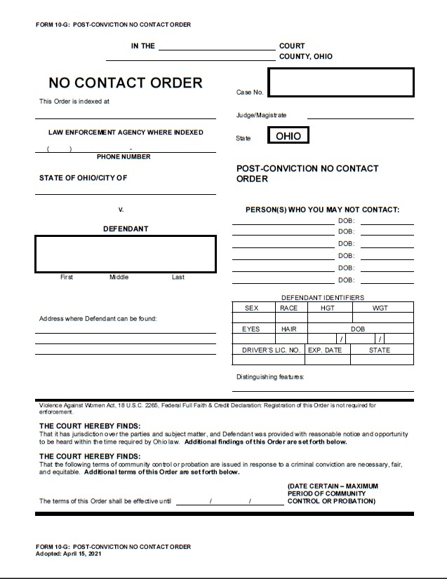

Slide 57
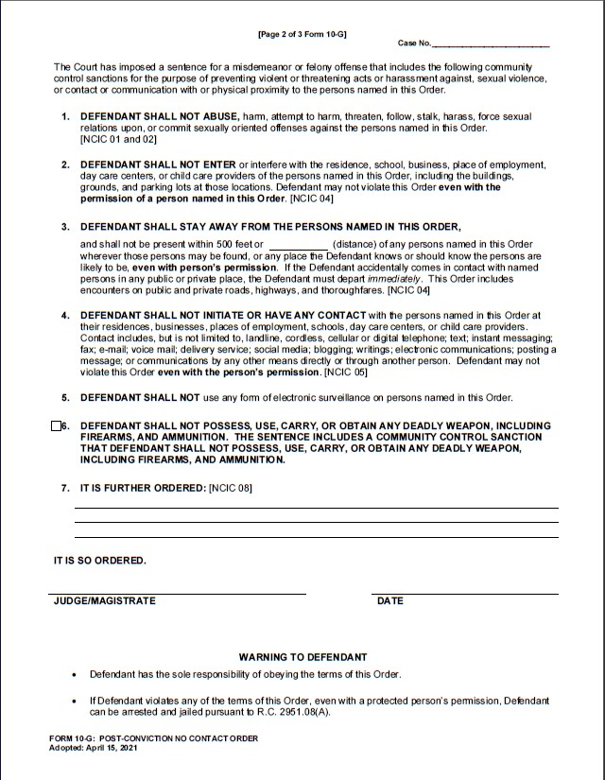

Slide 58
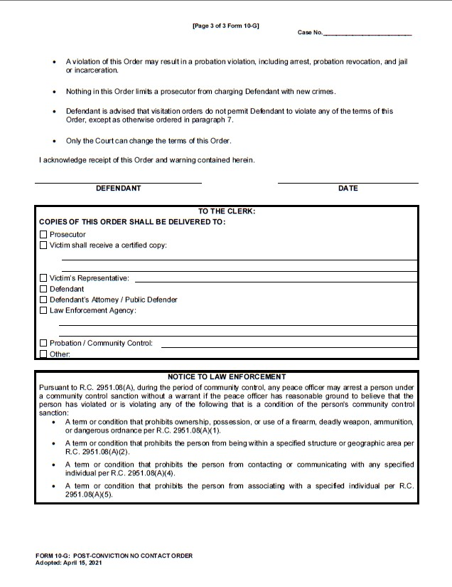

Slide 59
Right to Safety, Right to be Present and Heard: RC 2930.161
On request of victim or representative who provided contact information, a court must provide notice of:
Probation termination hearing
Probation modification hearing
Arrest for any probation violation
Failure to complete diversion

Slide 60
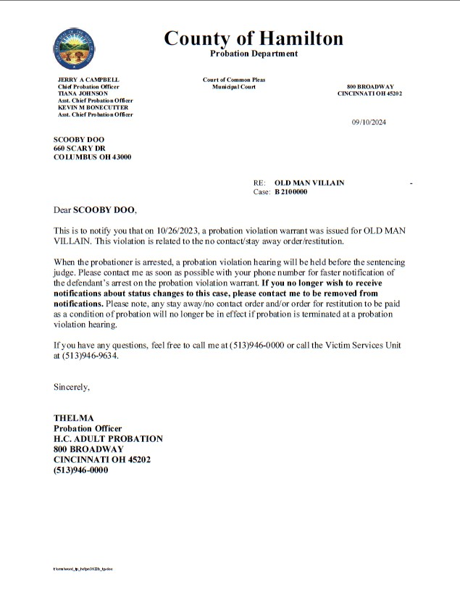

Slide 61
Right to Safety, Right to be Present and Heard: RC 2930.161
On request of victim or representative who provided contact information, probation must provide notice of the following, as soon as it becomes known to probation:
Any proposed modification of probation that impacts restitution, detention status, or victim safety
Victim’s right to be heard at any probation hearing
The violation that led to any revocation hearing
Following a risk assessment, any probation terms, including restricted locations, and other conditions impacting victim safety

Slide 62
Right to be Present and Heard: Sealing and Expungement of Records
A court must notify the prosecutor 60 days before** any hearing to seal or expunge records.
The prosecutor shall provide timely notice to victim and representative if the victim requested notice and kept their contact information updated.
The court must allow the victim, representative, and victim counsel to attend and make a statement orally, in writing, or both.
Defendant may review written statement.
Court shall give APA/DYS a copy.
Court shall consider victim statement.
Upon decision, court shall promptly notify prosecutor and prosecutor shall promptly notify victim and representative.
**Notice is 30 days before hearing for juvenile cases

Slide 63
THANK YOU!
It’s not goodbye, but just see you later!

